Slide 1
On-demand streaming
of massive climate simulation ensembles
Cameron Christensen*
Giorgio Scorzelli*
Peer-Timo Bremer°
Valerio Pascucci*
*
°

Slide 2
overview
Data reordering facilitates more rapid, dynamic analysis and visualization
Reordering can be done on-the-fly, or during data generation
Coarse resolutions support both spatial and temporal filtering
Highest resolution is identical to original data
Existing tools and APIs can take advantage of reordered data
Advanced tools can enable lightweight exploratory data analysis
Streaming data flow for coarse-to-fine analysis and visualization
Server-side blending
User-interactive scripting
Simple inclusion/exclusion of ensemble members

Slide 3
Analysis and Visualization
Retrieve datasets to common location
Regrid data to common domain
Process using out-of-core or parallel supercomputer
Downsample large domains or visualize using distributed parallel cluster application
Store results
Share

Slide 4
Analysis and Visualization
Retrieve datasets to common location ➠significant storage
Regrid data to common domain ➠expensive preprocess
Process using out-of-core or parallel supercomputer ➠inflexible and expensive
Downsample large domains or visualize using distributed parallel cluster application ➠post process or expensive
Store results ➠more storage
Share ➠more downloading

Slide 5
advantages
existing tools and infrastructure
analyses use entire datasets

Slide 6
disadvantages
requires significant…
storage
computation
bandwidth
time
prohibits exploratory analysis
ensemble members
processing scripts
ideas

Slide 7
streaming multiresolution
Interactive view-dependent data loading
Fast coarse resolution results for visualization and analysis
High resolution results through user-directed refinement
Low requirements
low bandwidth
low storage and computation
fast
you already use it every day!

Slide 8
streaming multiresolution
Interactive view-dependent data loading ➠permits flexible exploration outside fixed regions
Fast coarse resolution results for visualization and analysis
High resolution results through user-directed refinement
Low requirements
low bandwidth: ➠download less
low storage and computation ➠process and cache only what you download
fast
you already use it every day!

Slide 9
IDX
Streaming multi resolution

Slide 10
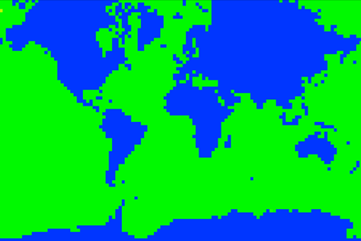
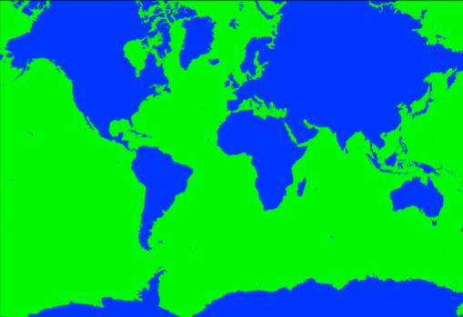
IDX: How it works
Original data is reordered in a spatially coherent, coarse-to-fine manner.
When loading, a progressively refined version of the original full resolution data is received.
Data can also be reordered over the temporal dimension, enabling progressive computation of, e.g. seasonal averages
loading time
loading time
*coarse data is original, not a down-sampled copy

Slide 11
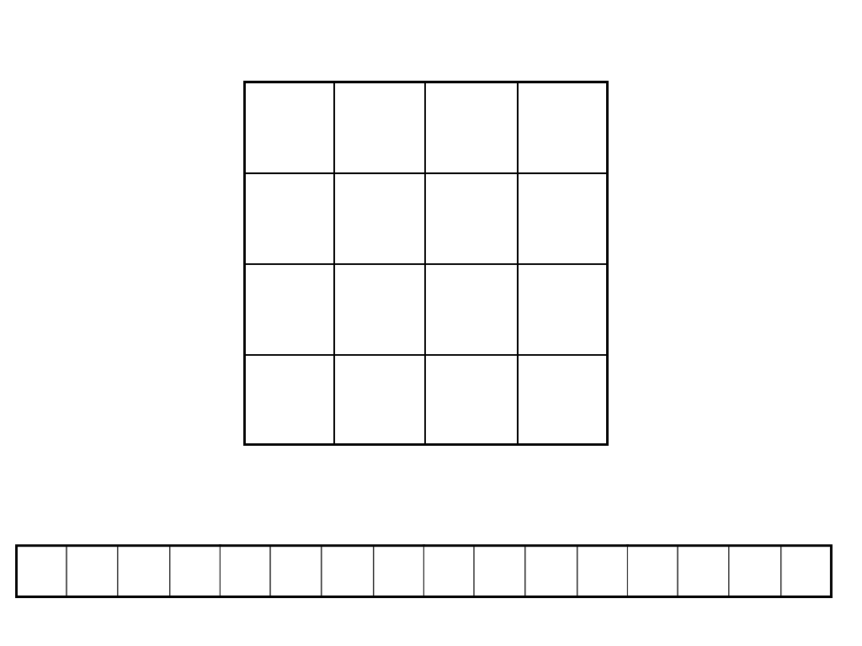
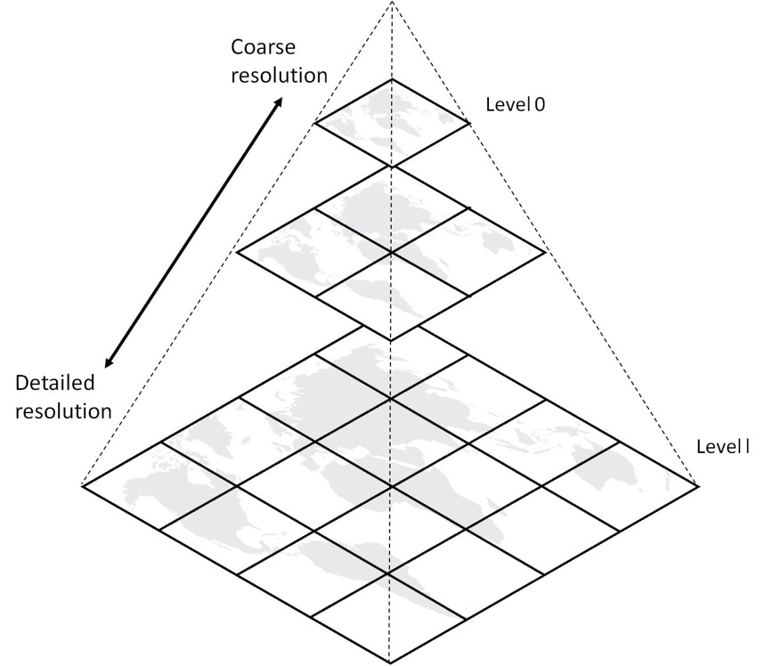
IDX Is Space Efficient
Traditional image pyramid creates down sampled copy at each resolution level:
IDX reorders original data such that coarse resolutions come first on disk:
*courtesy Ricardo García

Slide 12
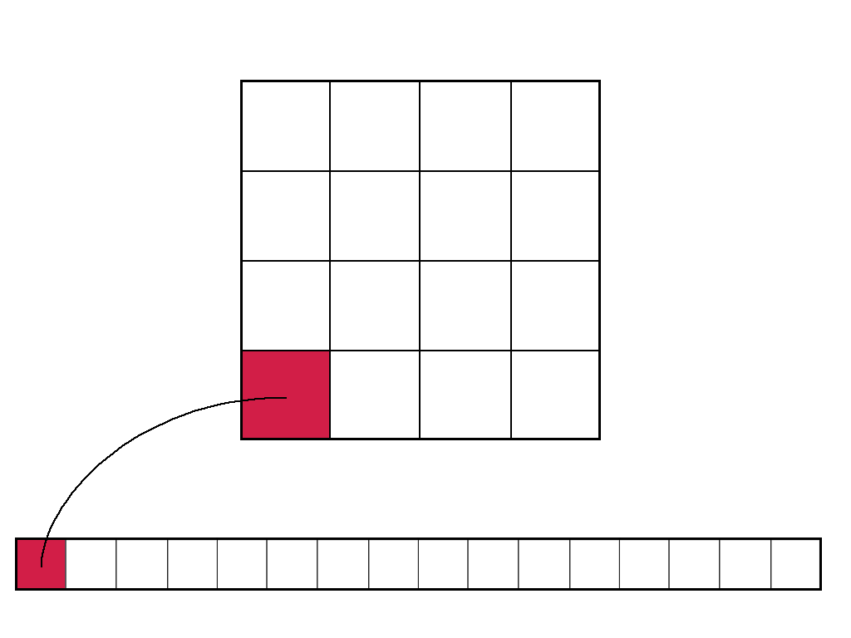
IDX Is Space Efficient
Traditional image pyramid creates down sampled copy at each resolution level:
IDX reorders original data such that coarse resolutions come first on disk:
*courtesy Ricardo García

Slide 13
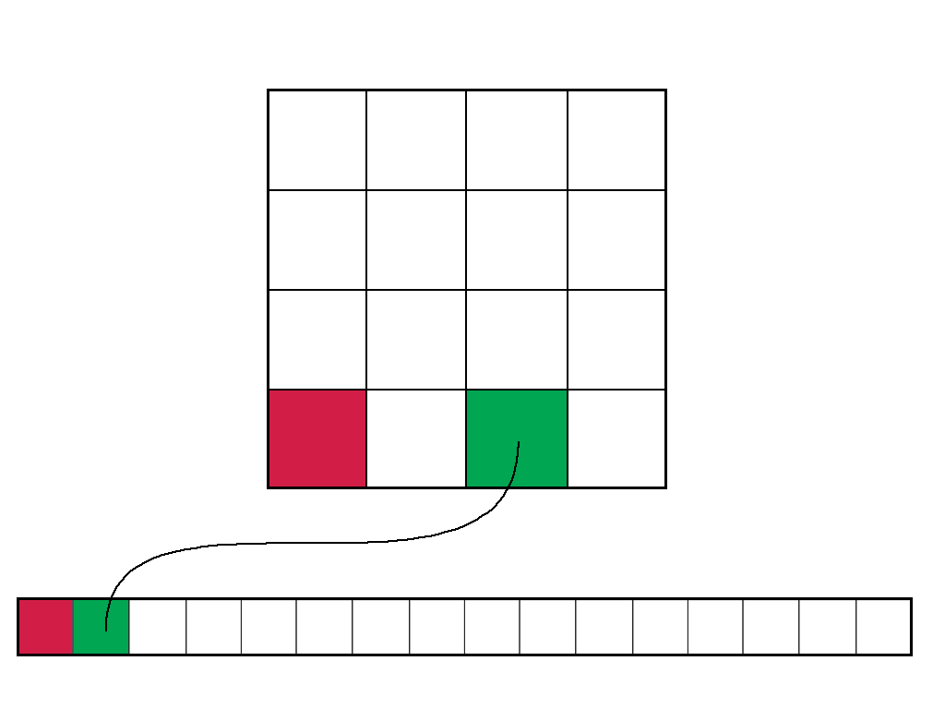
IDX Is Space Efficient
Traditional image pyramid creates down sampled copy at each resolution level:
IDX reorders original data such that coarse resolutions come first on disk:
*courtesy Ricardo García

Slide 14
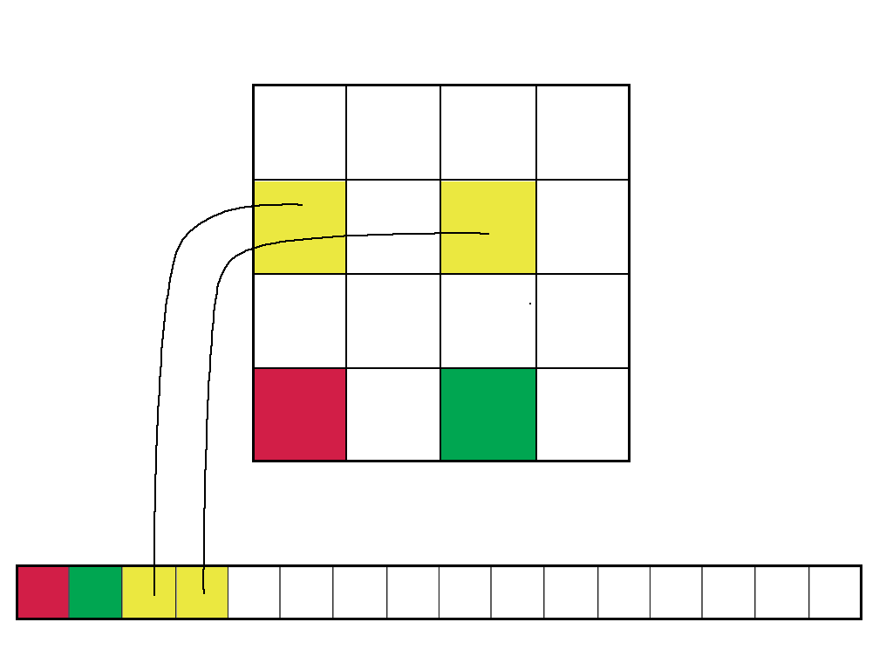
IDX Is Space Efficient
Traditional image pyramid creates down sampled copy at each resolution level:
IDX reorders original data such that coarse resolutions come first on disk:
*courtesy Ricardo García

Slide 15
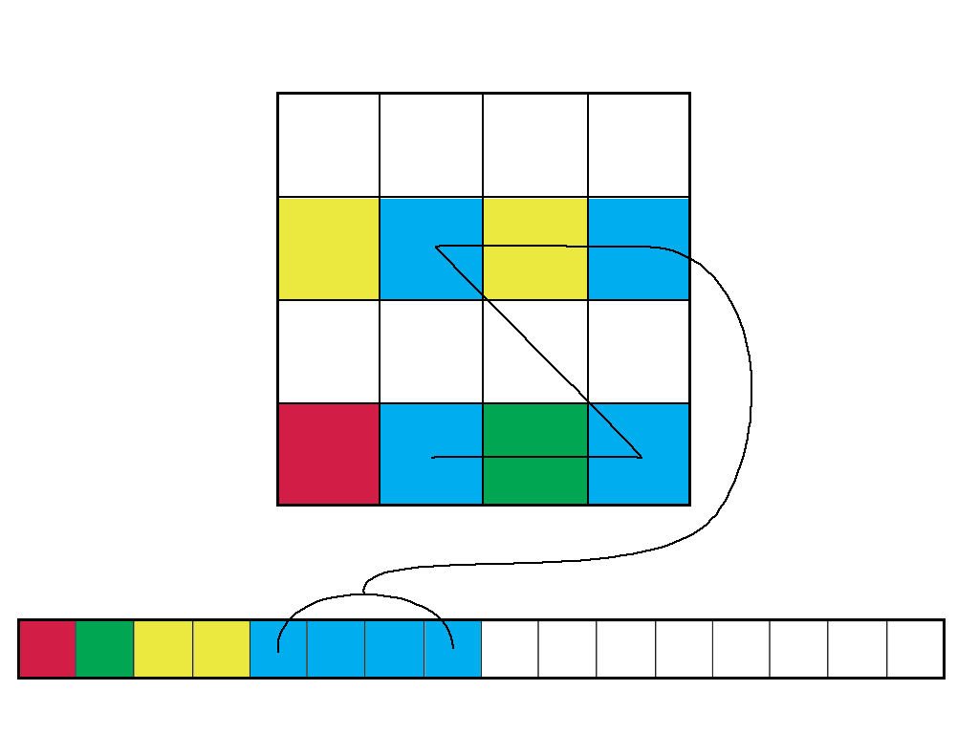
IDX Is Space Efficient
Traditional image pyramid creates down sampled copy at each resolution level:
IDX reorders original data such that coarse resolutions come first on disk:
*courtesy Ricardo García

Slide 16
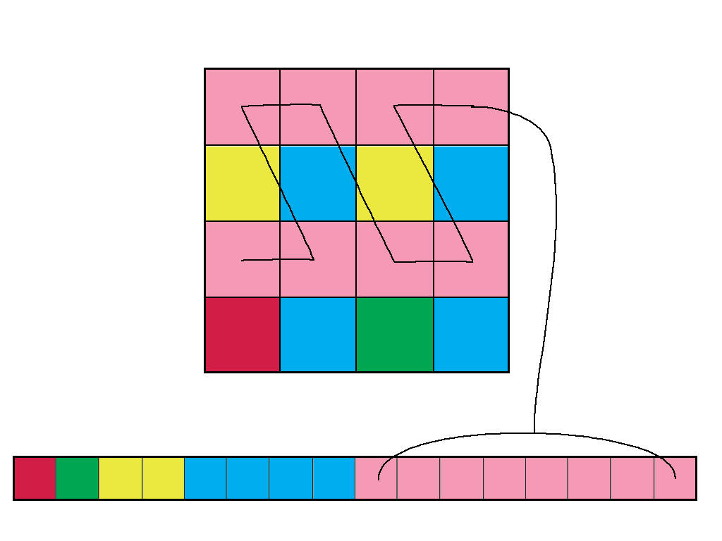
IDX Is Space Efficient
Traditional image pyramid creates down sampled copy at each resolution level:
IDX reorders original data such that coarse resolutions come first on disk:
*courtesy Ricardo García

Slide 17
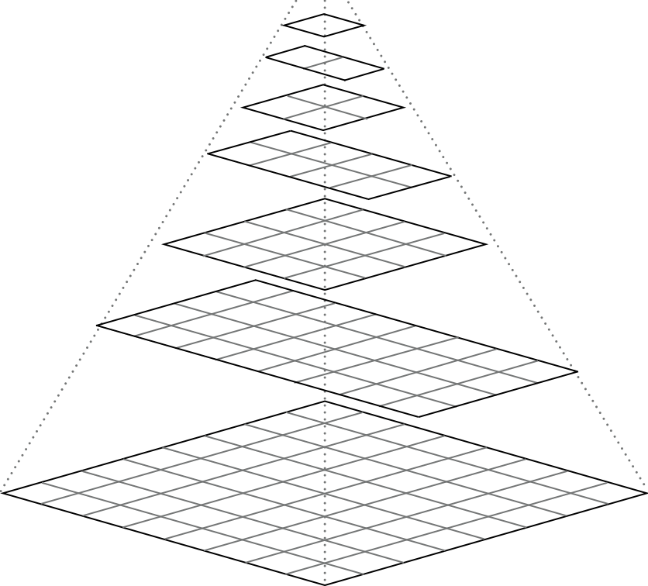
Hierarchical Z-Order

Slide 18
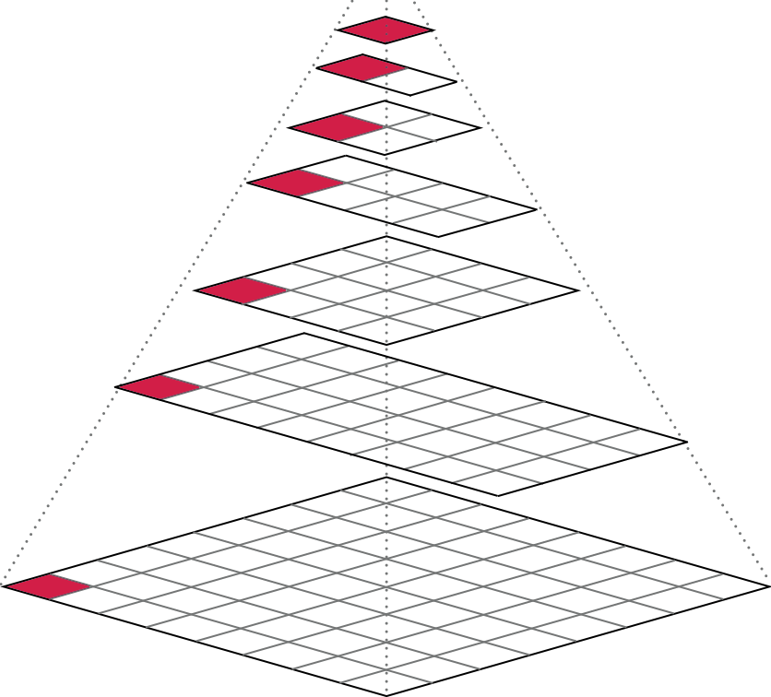
Hierarchical Z-Order

Slide 19
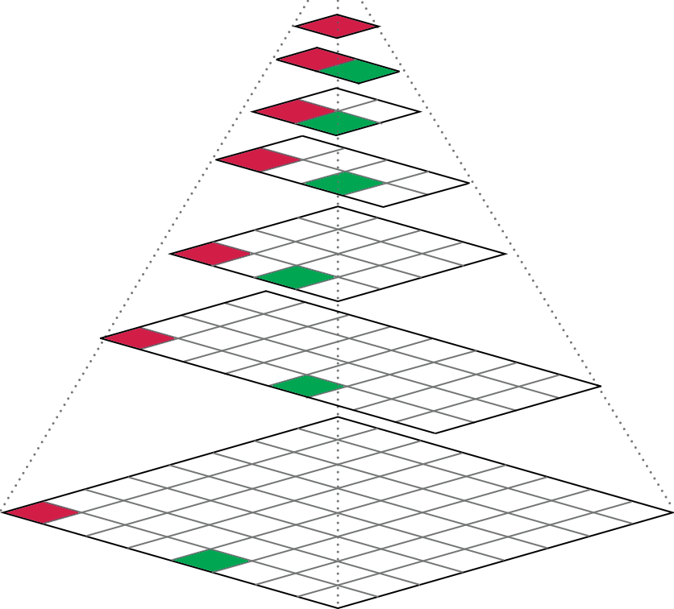
Hierarchical Z-Order

Slide 20
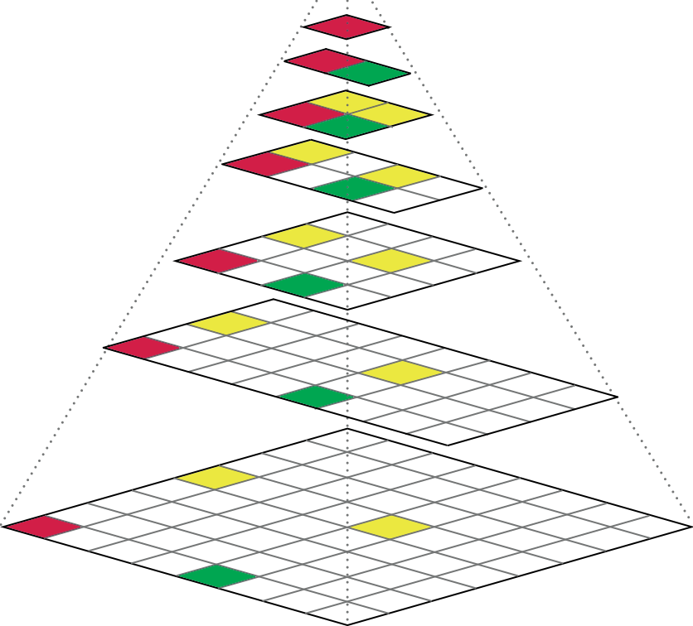
Hierarchical Z-Order

Slide 21
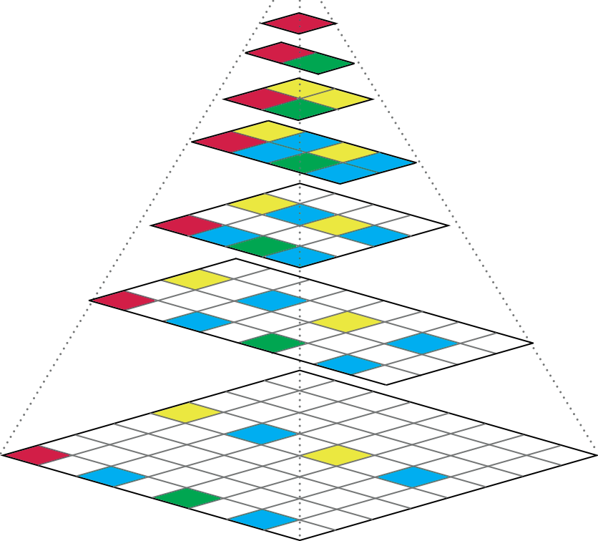
Hierarchical Z-Order

Slide 22
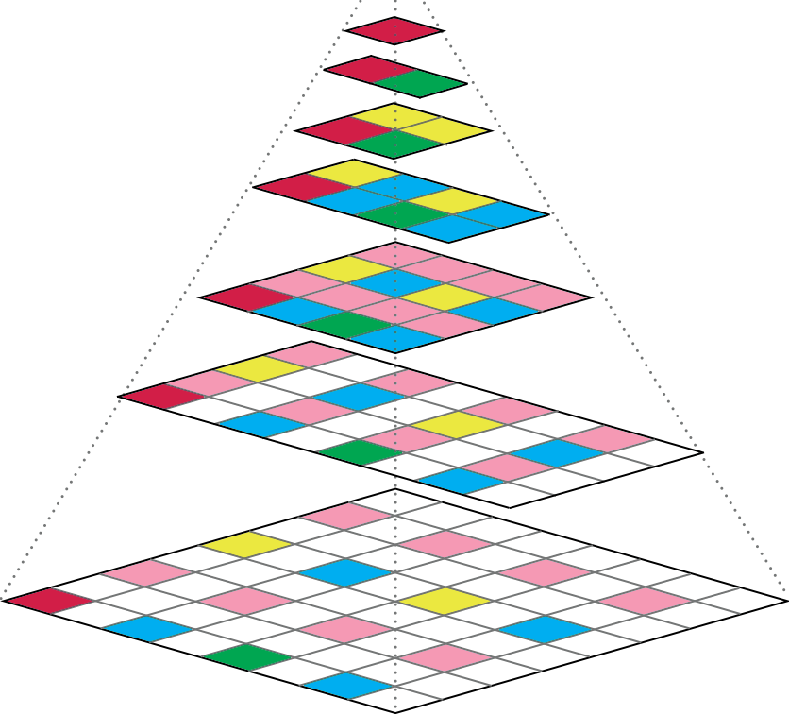
Hierarchical Z-Order

Slide 23
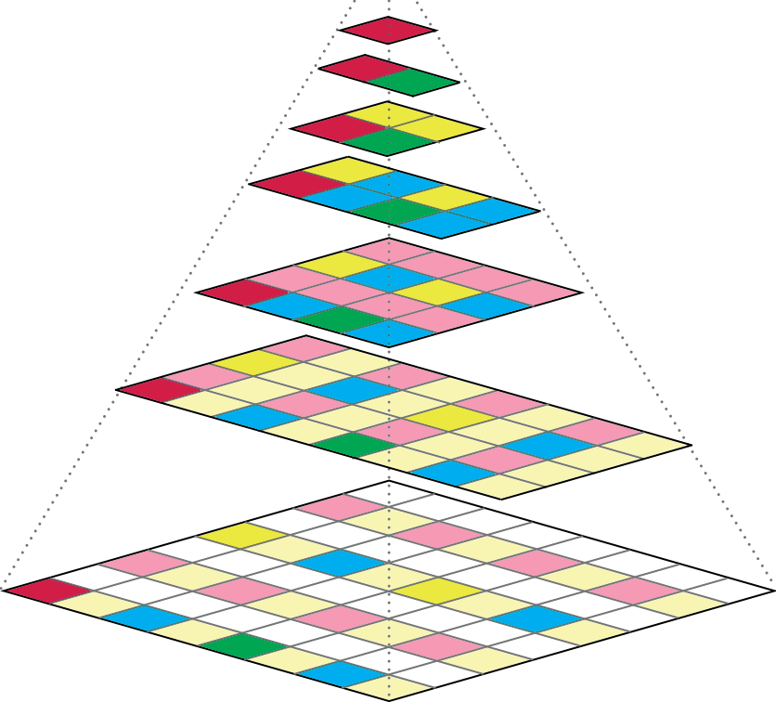
Hierarchical Z-Order

Slide 24
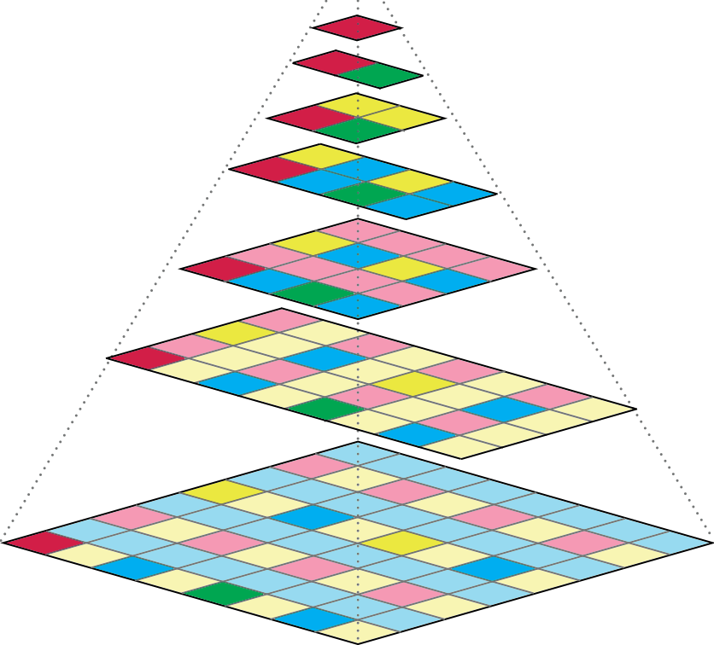
Hierarchical Z-Order

Slide 25
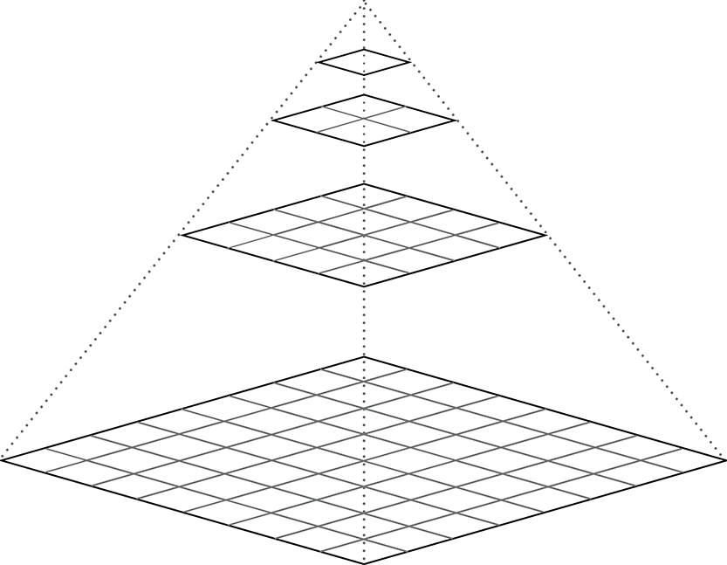
Hierarchical Z-Order

Slide 26
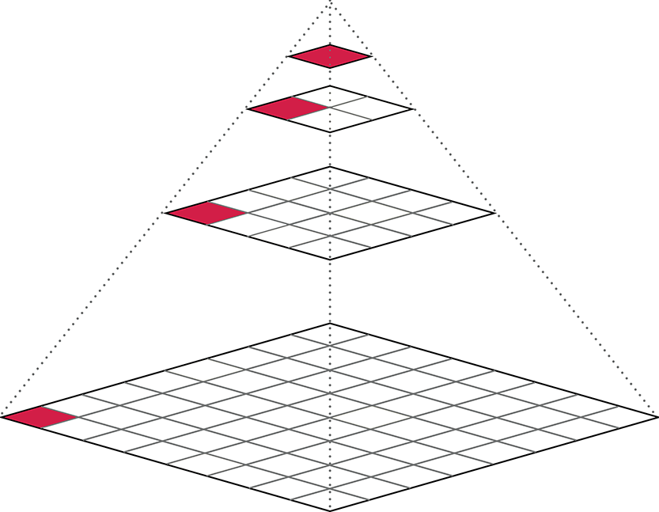
Hierarchical Z-Order

Slide 27
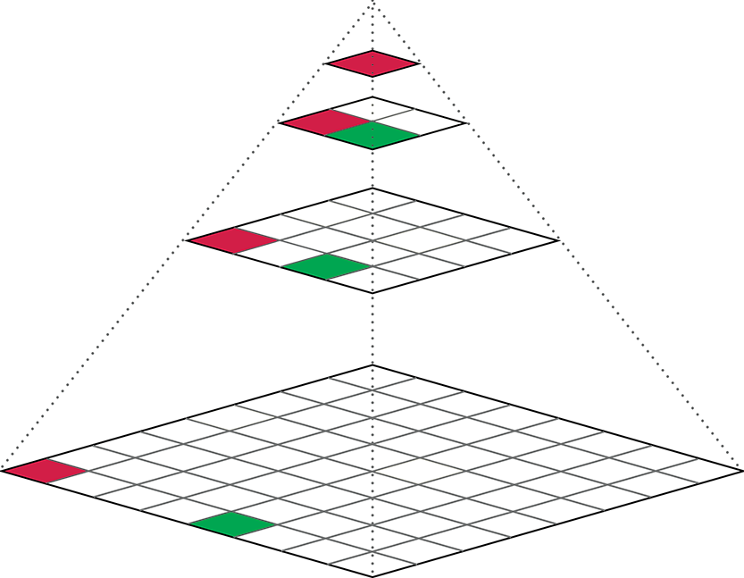
Hierarchical Z-Order

Slide 28
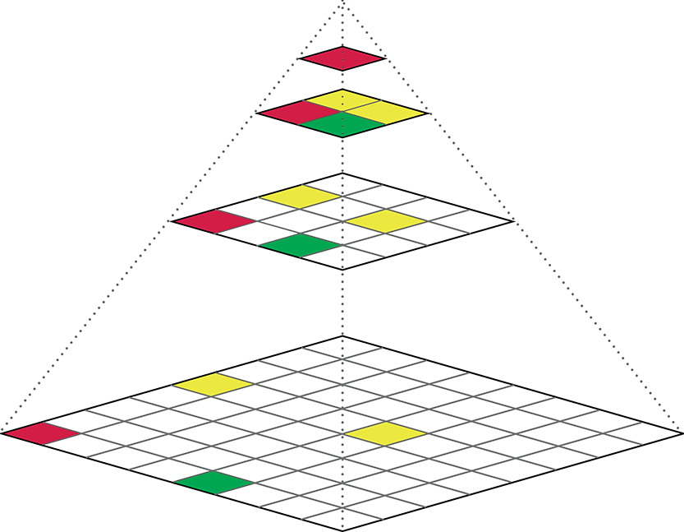
Hierarchical Z-Order

Slide 29
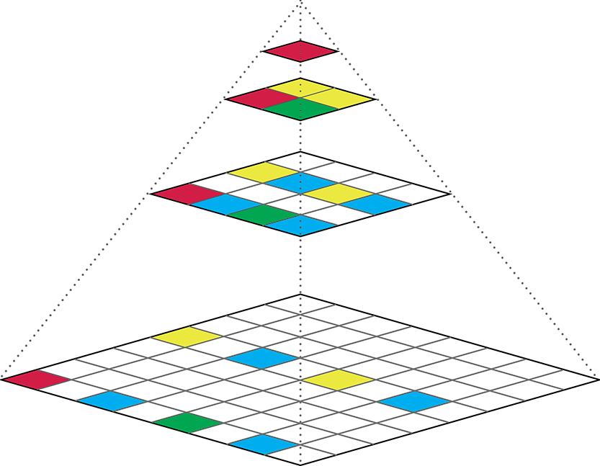
Hierarchical Z-Order

Slide 30
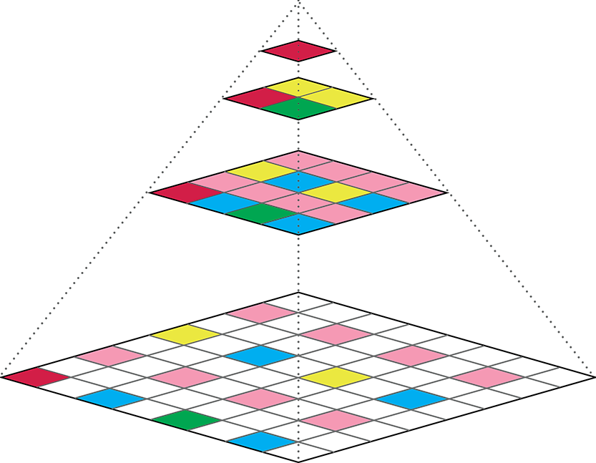
Hierarchical Z-Order

Slide 31
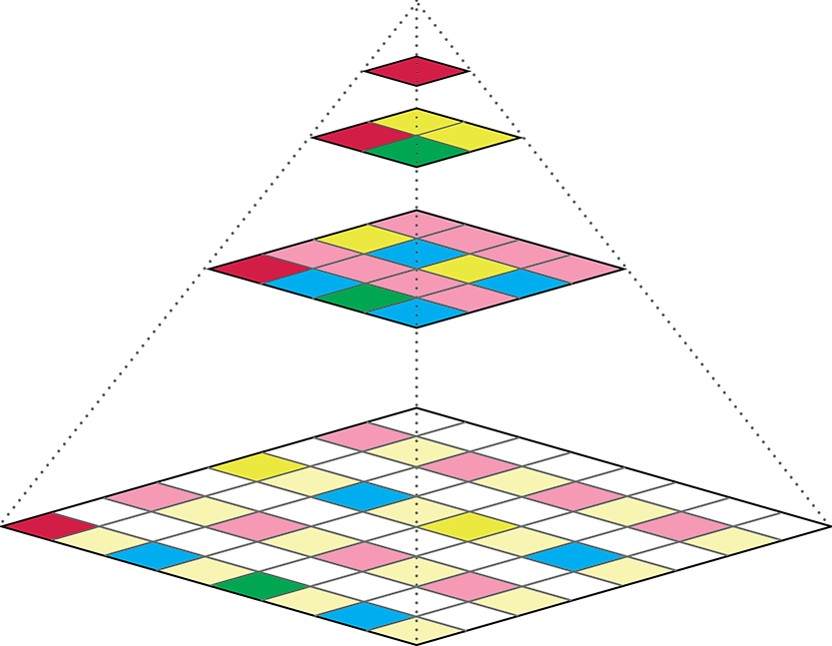
Hierarchical Z-Order

Slide 32
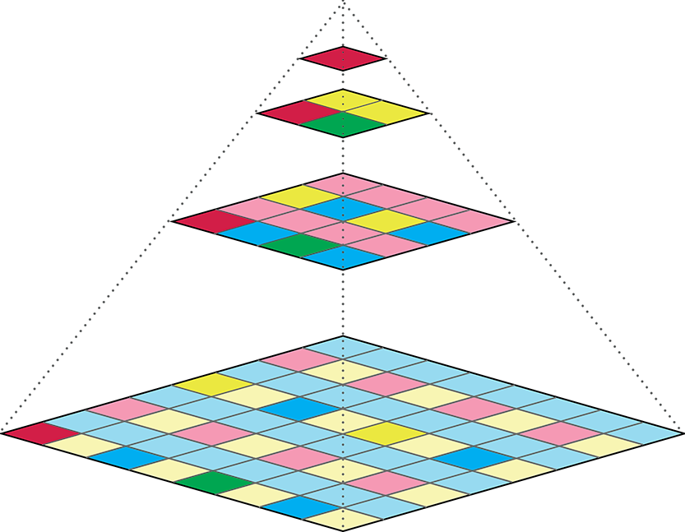
Hierarchical Z-Order

Slide 35
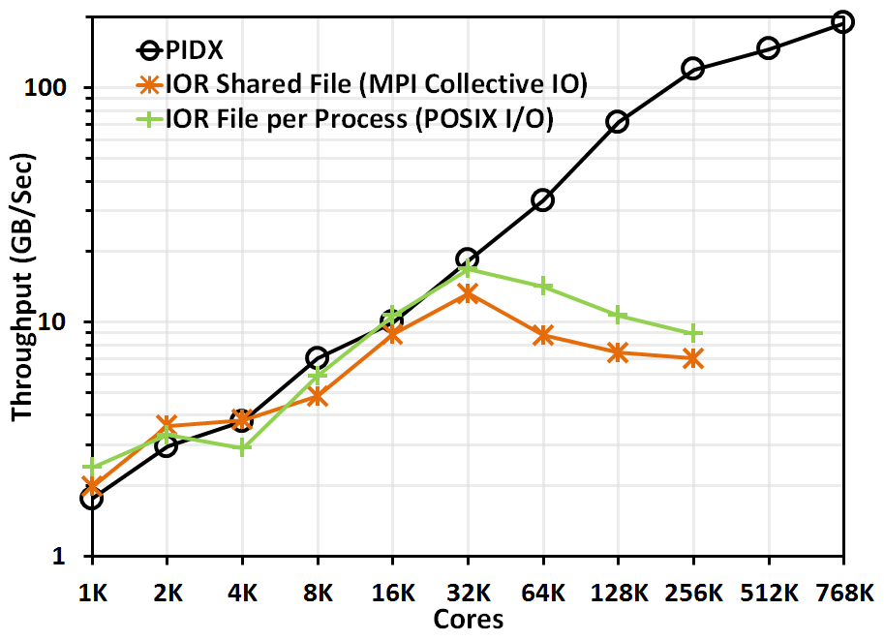
PIDX parallel I/O
Parallel I/O library to write cache oblivious, multi-resolution data in parallel.
Fast I/O (high bandwidth)
Enables interactive analysis and visualization (low latency)
Supports AMR meshes and region-of-interest (ROI)
Enables real-time simulation monitoring
Open Source:
http://github.com/sci-visus/PIDX
Scales to 768K cores on ANL Mira
Tunable for any system
*PnetCDF uses MPI Collective I/O

Slide 36
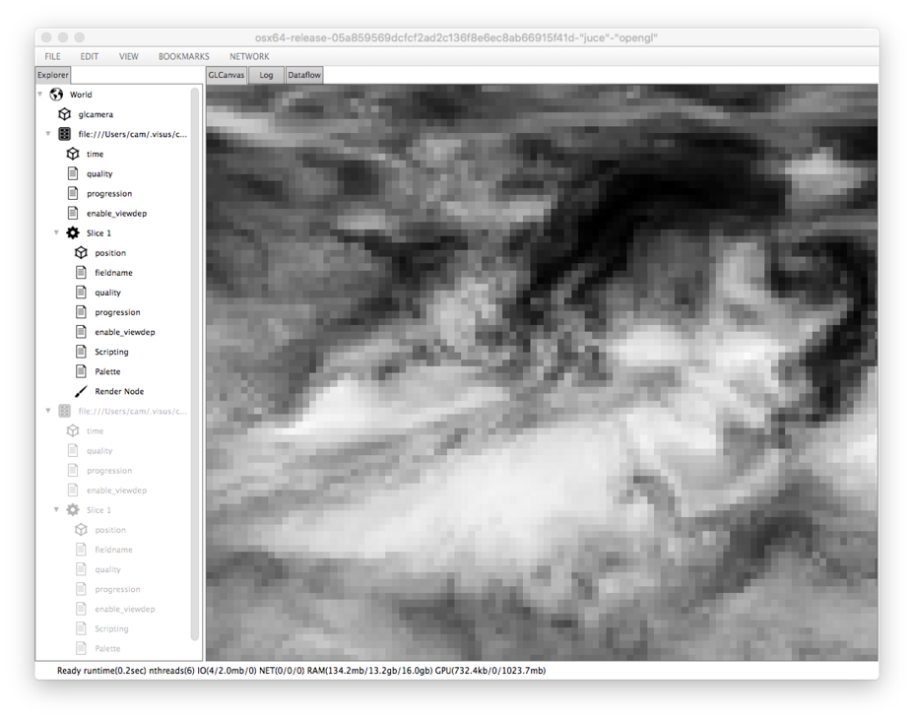
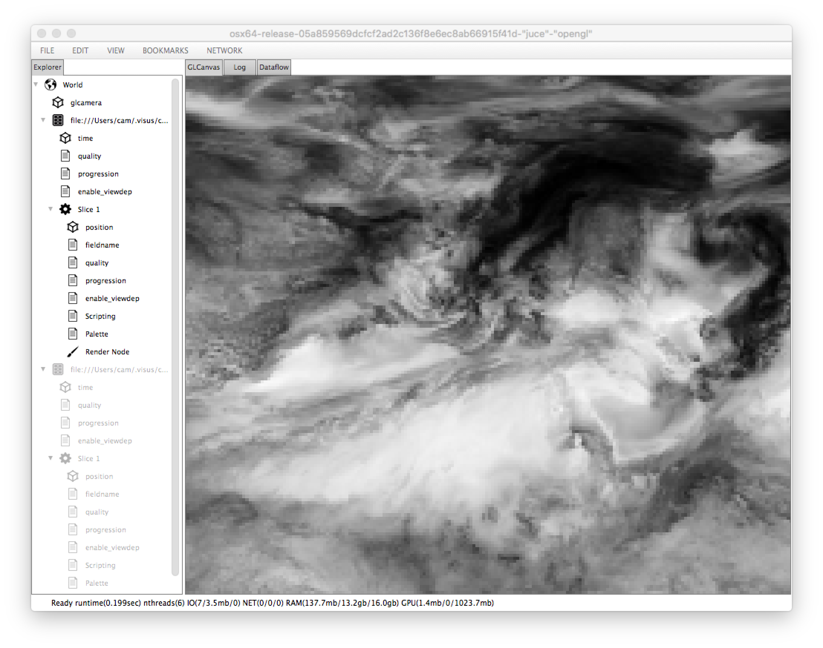
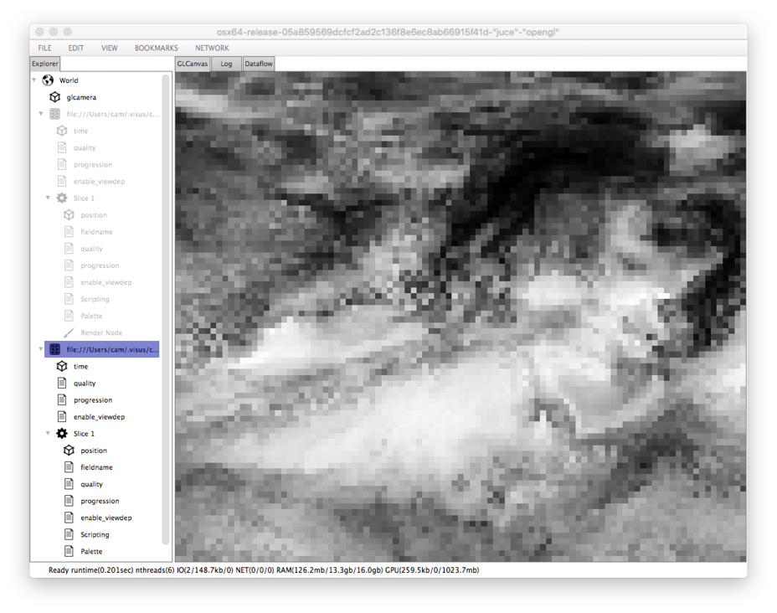
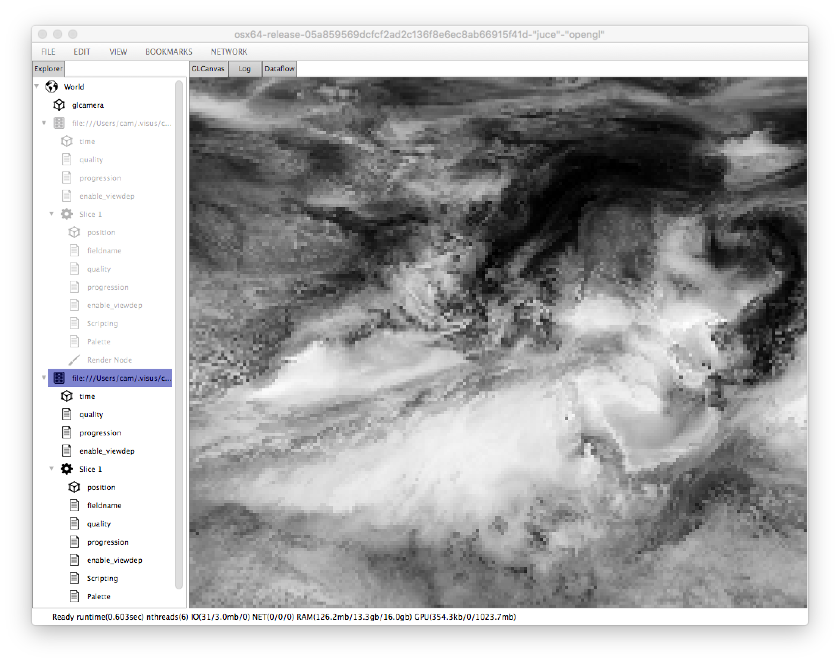
1:256 resolution
1:64 resolution
1:16 resolution
filtered (wavelet)
subsampled
IDX: Supports both subsampling and filtering
*examples rendered with GLNearest filter for clarity

Slide 37
ViSUS
IDX-based streaming multi- resolution data processing

Slide 38
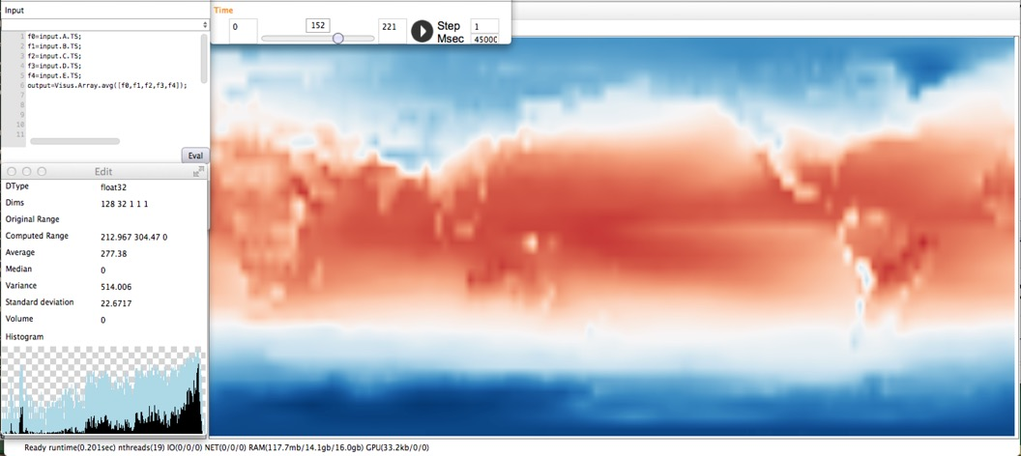
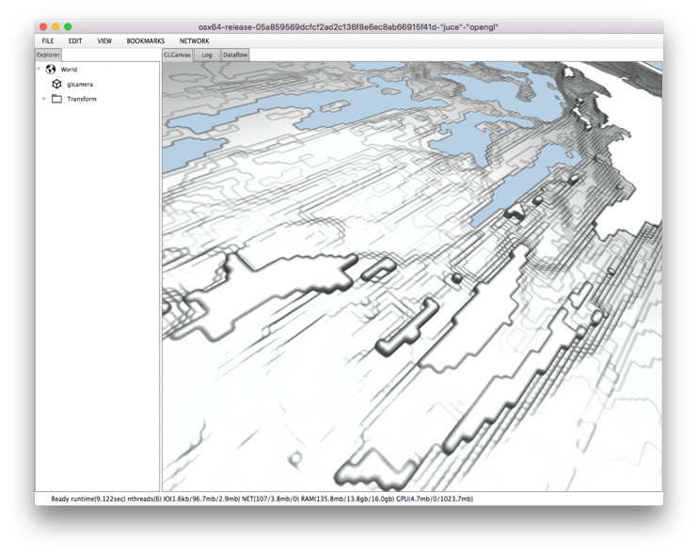
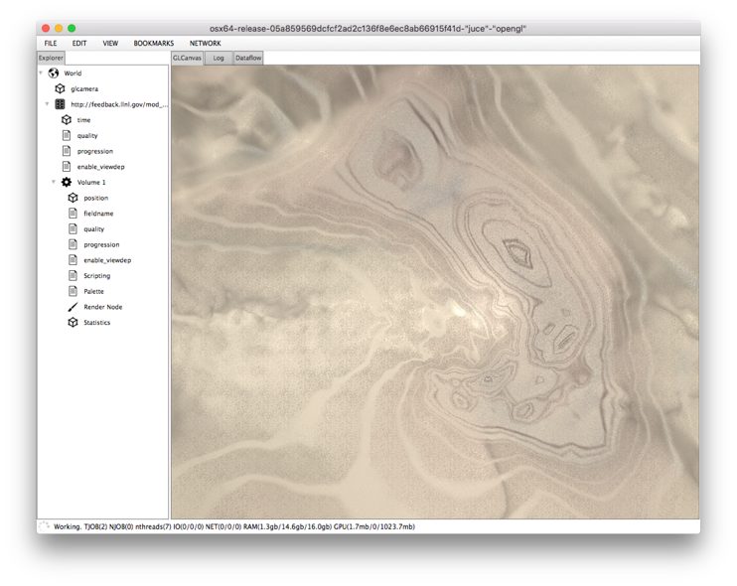
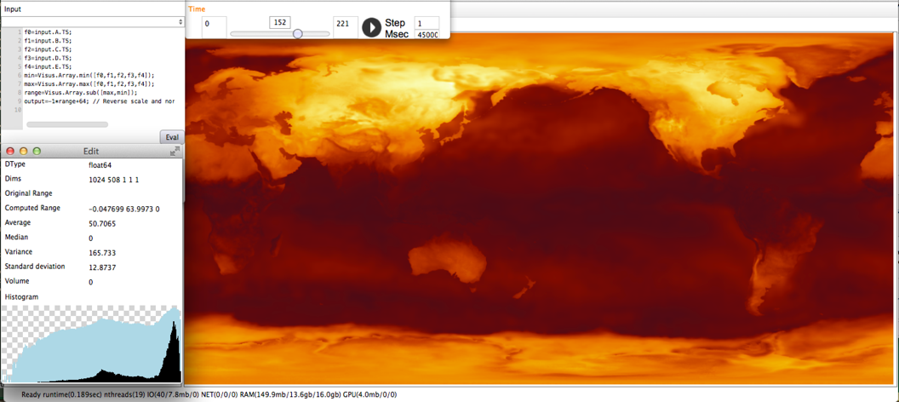
ViSUS framework
Designed for streaming IDX multi resolution data format
Interactive view-dependent data loading as well as manual resolution and region selection
Interruptible streaming data flow
Interactive scripting data flow
Remote server
shared data access
remote data processing
Python wrappers of entire library

Slide 39
Eureka! ViSUS is a game-changer!
-Barack Obama

Slide 40
Data movement remains expensive

Slide 41
Remote data processing
Streaming coarse-to-fine dataset retrieval supports interactive visualization and analysis, remote processing operations
Can interactively combine data from multiple sources

Slide 42
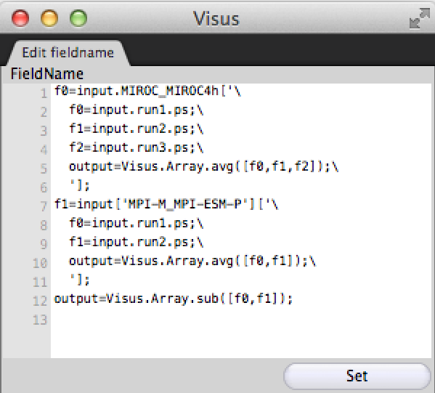
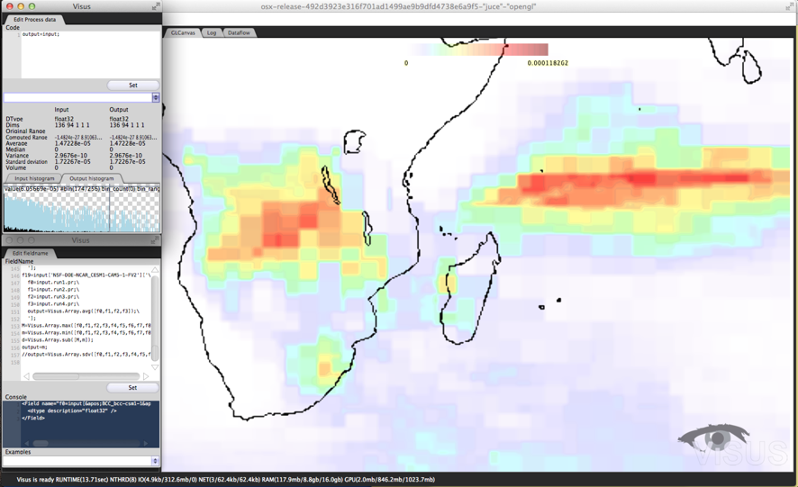
User-directed analysis
Built on streaming multi resolution framework for fast coarse resolution results
Javascript syntax for custom interactive processing
Blend local and remote datasets
Select ensemble members at runtime
Server-side blending of ensemble members for reduced network traffic

Slide 43
on-demand data reordering
Users can request IDX volumes directly from ESGF search results (in progress)
IDX metadata is created, but data is not converted until a specific time step field is requested
Data conversion utilizes cdms2 module, supports local files as well as remote OpenDAP volumes
Cache size is maintained through LRU policy

Slide 44
ViSUS / ESGF / UV-CDAT INTEGRATION TIMELINE
2013: SWIG-generated Python wrappers of entire ViSUS library
2013: Exploratory integration with UV-CDAT provided remote data selection and integration of ViSUS components
2014: User-interactive scripting for exploratory ensemble analysis
2014: Automatic regridding of different size fields to common domain
2015: On-demand conversion of NetCDF data to IDX
2015: Data cache is maintained to enable instant access for later users
Proposed integration at CDMS2 module level will enable first class treatment of IDX datasets
Extend API to enable multi resolution or view-dependent data loading for user modules
More server-side computation and distributed cloud support
Extend WPS API to include multi resolution selection

Slide 45
Key points
Data reordering facilitates more rapid, dynamic analysis process
Reordering can be done on-the-fly, or during data generation (e.g. PIDX)
Reordered data can be optionally filtered using wavelets, etc.
Reordering can be done in temporal domain as well as spatial domain
On-demand data reordering is already live at LLNL: http://pcmdi7.llnl.gov
Existing tools and APIs (e.g. WPS) can take advantage of reordered data formats
Most basic: simply load full resolution version, which is identical to original data
More useful: extend data loading to facilitate loading coarse resolution levels
Most advanced: streaming coarse-to-fine data analysis and visualization
ViSUS Framework: interactive streaming data flow
Implements streaming coarse-to-fine analysis and visualization
Supports server-side blending and user-interactive scripting
Python wrappers for entire framework
Available for all platforms at http://atlantis.sci.utah.edu/builds

Slide 46
DEMO / MOVIE

