Slide 1
ESGF Face to Face 2015
Monterey, CA
http://climate4impact.eu/
Bridging CMIP5, CORDEX and SPECS data infrastructure to impact users
Web Processing Services
CERFACS, KNMI, University of Cantabria, SMHI, Wageningen University, CMCC, STFC, IPSL Maarten Plieger, Wim Som de Cerff, Ernst de Vreede, Christian Pagé, Natalia Tatarinova,
Antonio Cofiño, Manuel Vega Saldarriaga,
Ronald Hutjes, Fokke de Jong, Lars Bärring, Elin Sjokvist

Slide 2
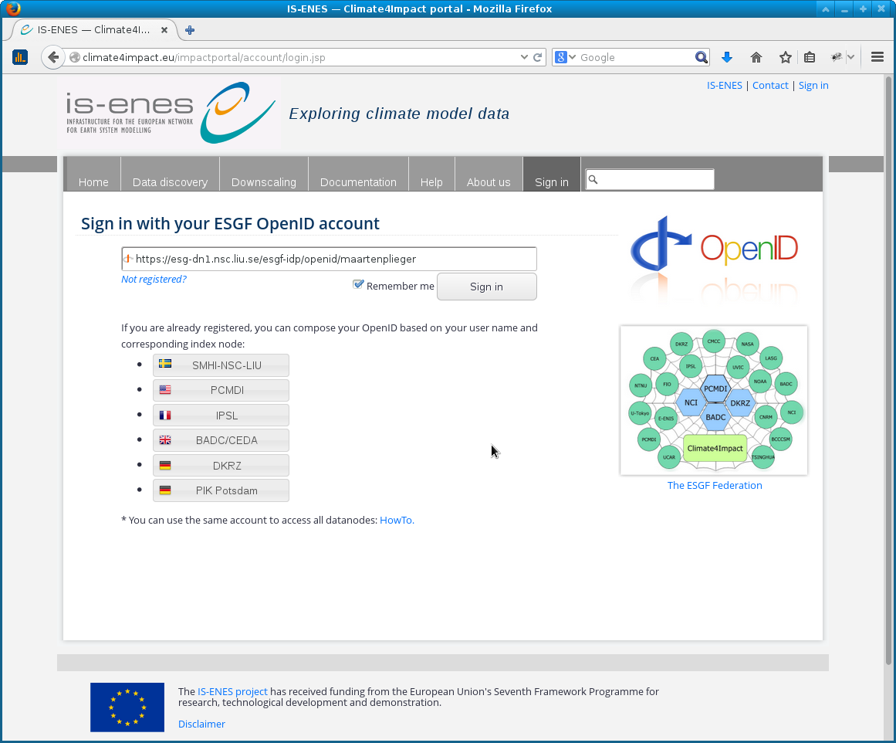
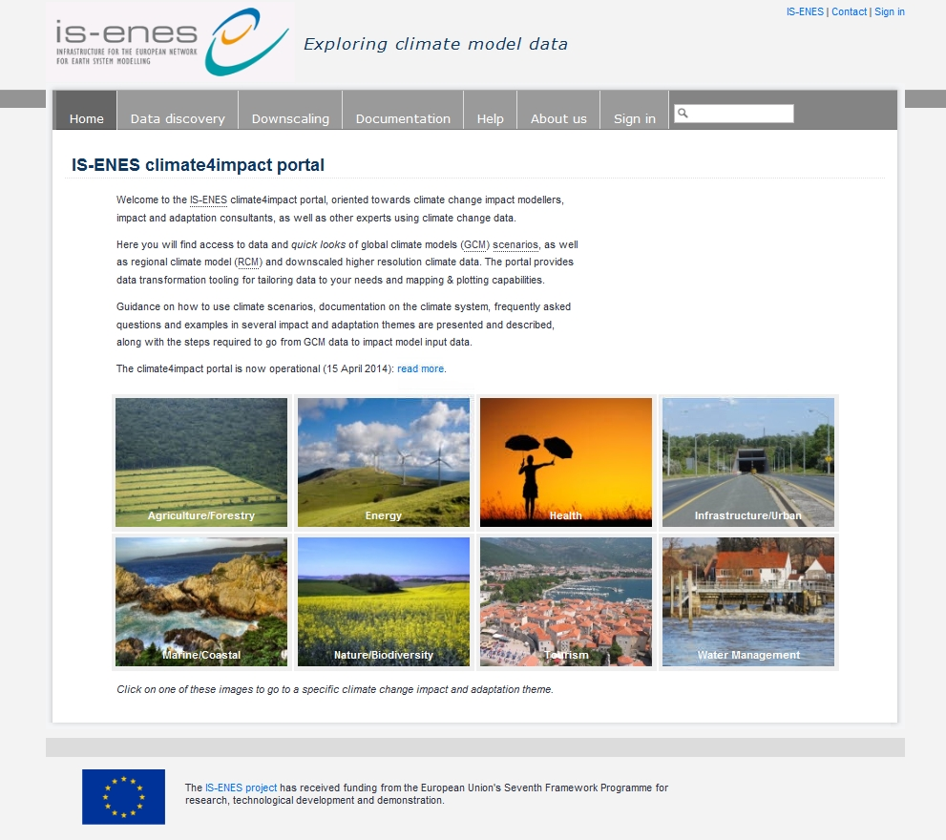
http://climate4impact.eu/
ESGF Face to Face 2015
Monterey, CA
Platform for impact researchers to explore climate data and perform analysis
Currently implementing use cases from impact researchers
Searches ESGF using search API
Visualize ESGF data using OpenDAP
Uses ADAGUC WMS visualization
Perform calculations / process data - WPS
Climate indices calculation, data reduction
Personal store for processing outcomes
Upload and store your own data

Slide 3
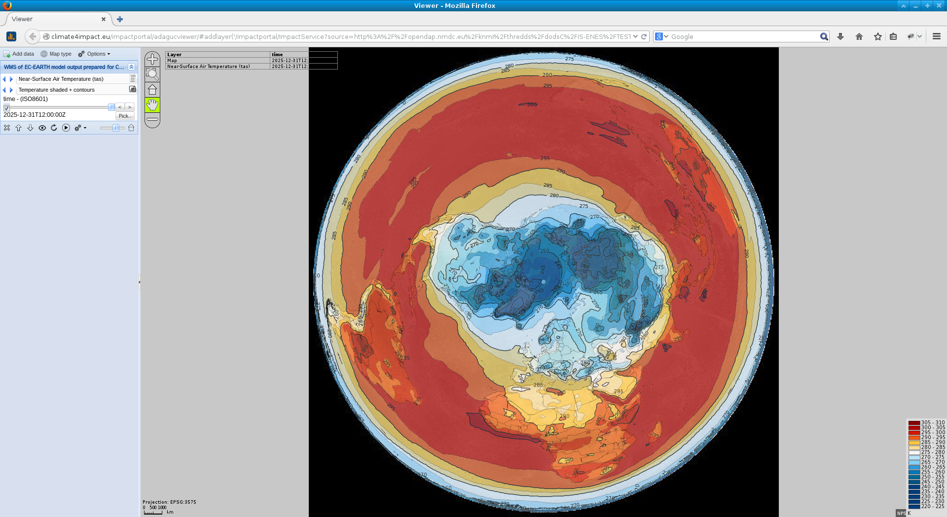
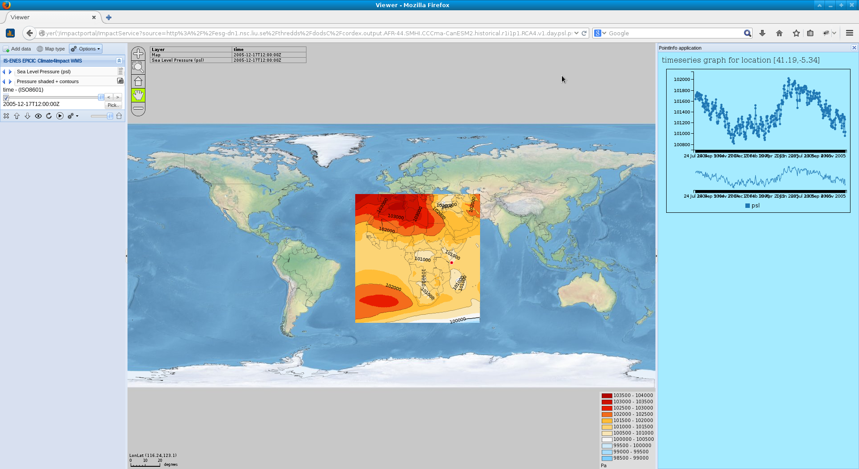
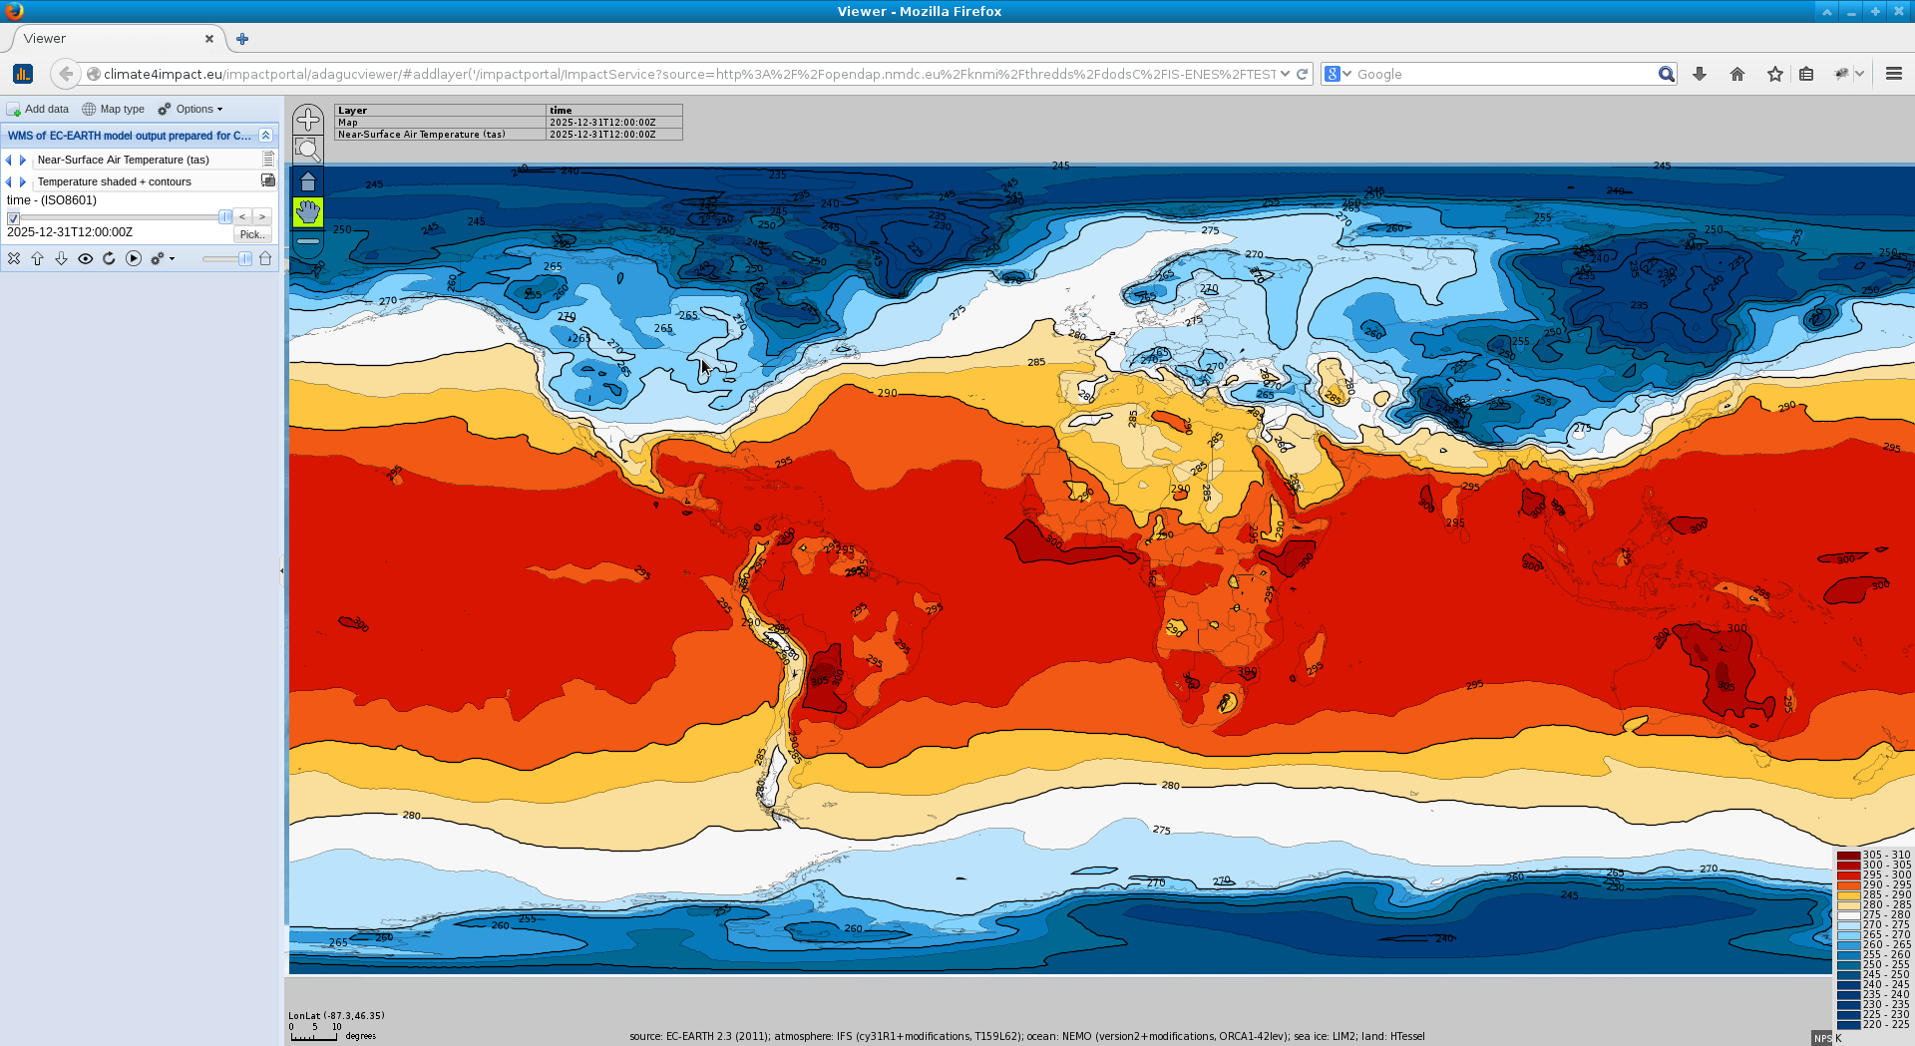
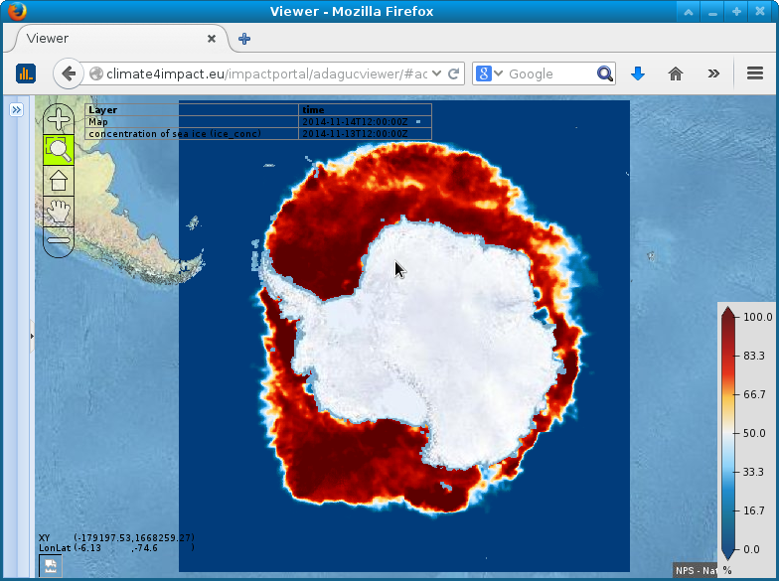
Real use of open standards and open source software:
Data access over OPeNDAP → THREDDS
Online analysis using WPS → PyWPS and ICCLIM
Online visualization using WMS → ADAGUC
Single Sign On using OpenId, and OAuth2, delegation using MyProxy X509

Slide 4
Earth System Grid Federation
DKRZ
CMCC
NASA
CEA
LASG
IPSL
UVIC
Robust and distributed
Global Climate Model Data (CMIP5)
Regional Climate Model Data (CORDEX)
~3 Petabyte of data
Search API
OpenDAP data access
THREDDS Catalogs
Climate4impact builds on and contributes to this global infrastructure
NTNU
FIO
NOAA
BADC
PCMDI
NCI
DKRZ
U-Tokyo
BADC
NCI
E-ENIS
CNRM
PCMDI
BCCCSM
Climate4Impact
UCAR
TSINGHUA

Slide 5
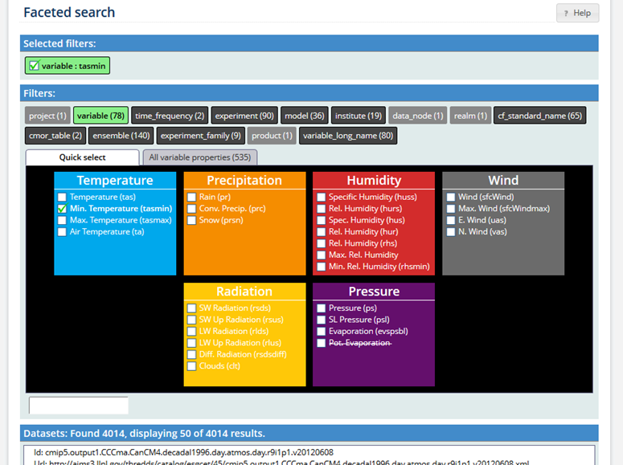
New search – Drill down search results using available filters

Slide 6
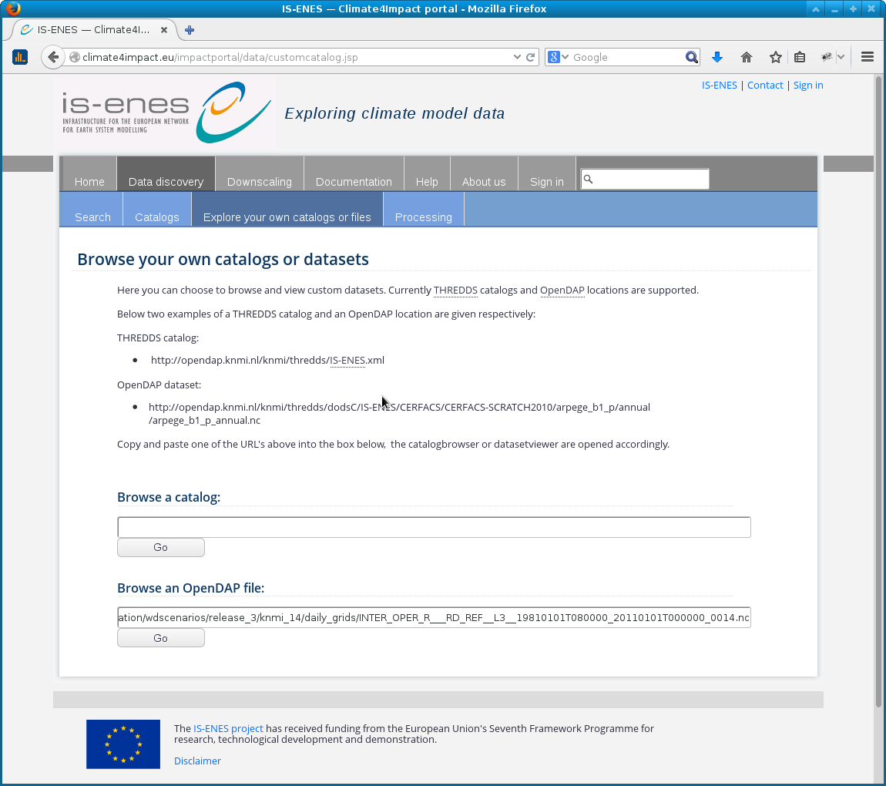
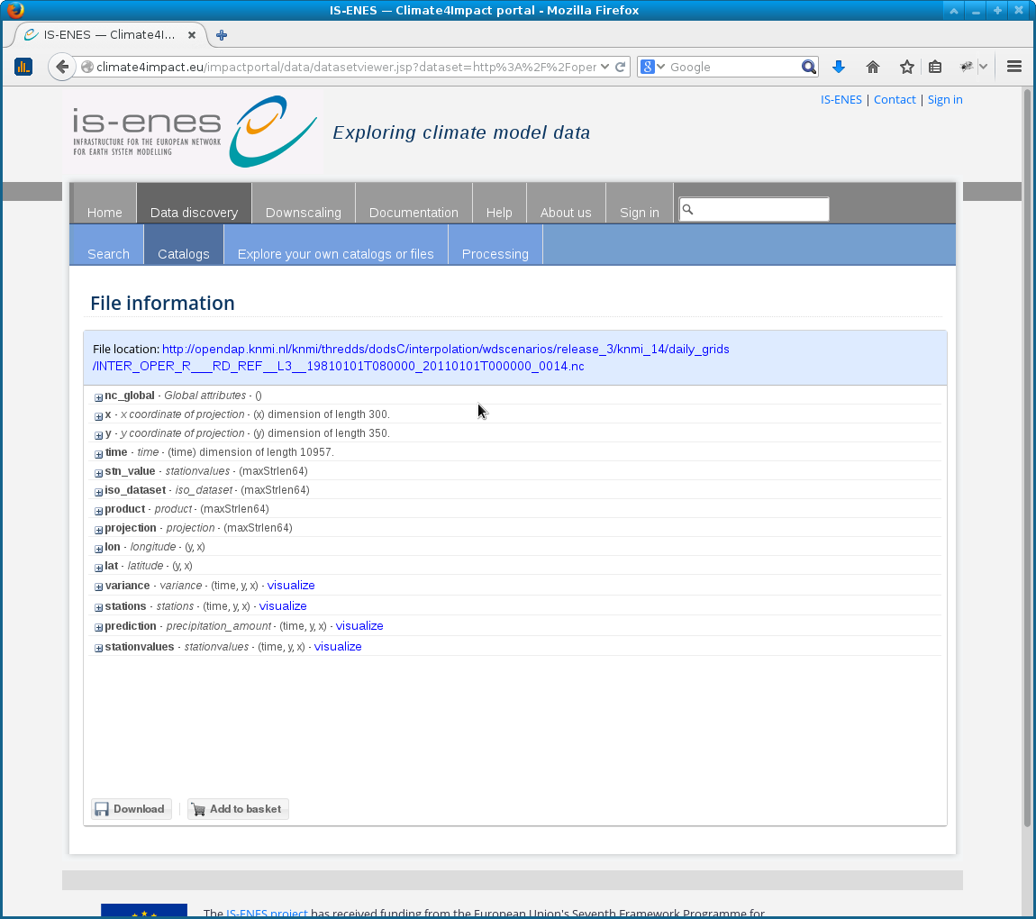
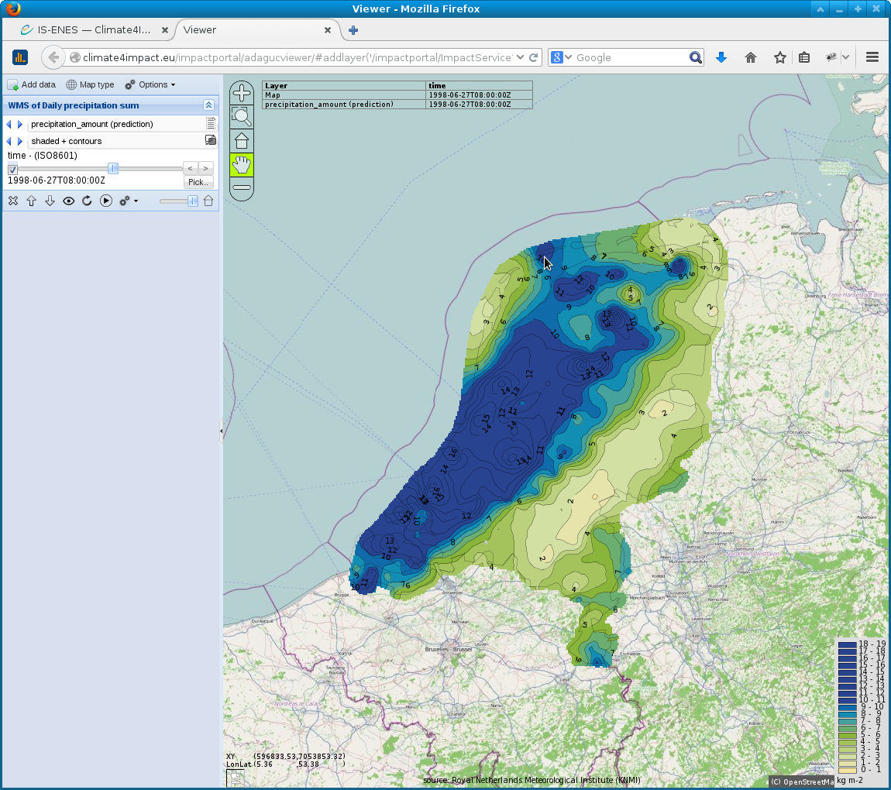
WMS / WCS on OPeNDAP
Go to “Data discovery”/
“Explore your own catalogs or files”
File Metadata
ADAGUC viewer WMS

Slide 7
Many resources served with OpenDAP can be visualized!
CMIP5 - global climate models
CORDEX - regional climate models

Slide 8
Web Processing Service for climate indices calculations
PyWPS
Backbone for WPS
ICCLIM, OCGIS, ADAGUC
Climate indices calculation
Subsetting over a large time period
Regrid and reformat, extract regions
Generic WPS UI
Based on DescribeProcess XML file.
Links to basket
Comboboxes / select from list
Strings/text elements
Wizards (in progress)
For indices calculation
Subsetting / file conversions

Slide 9
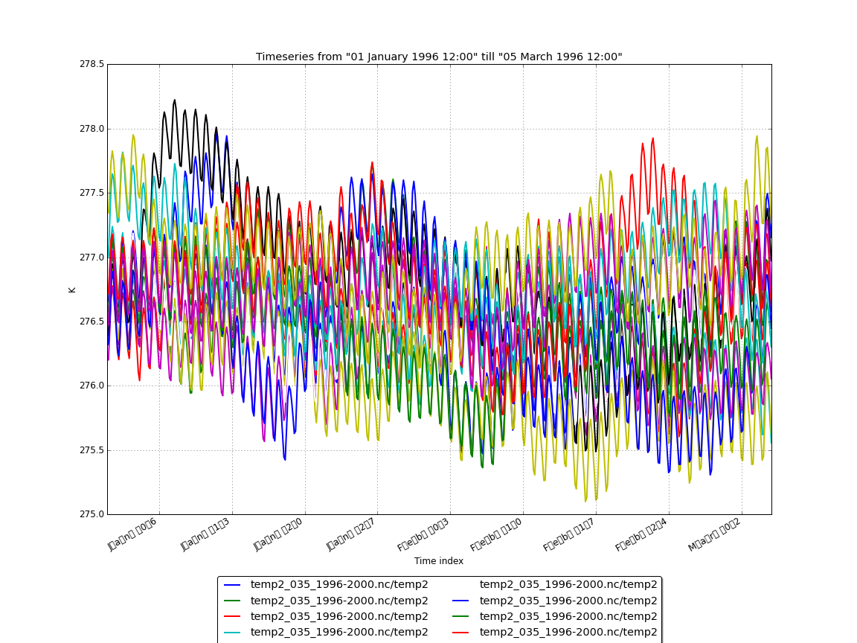
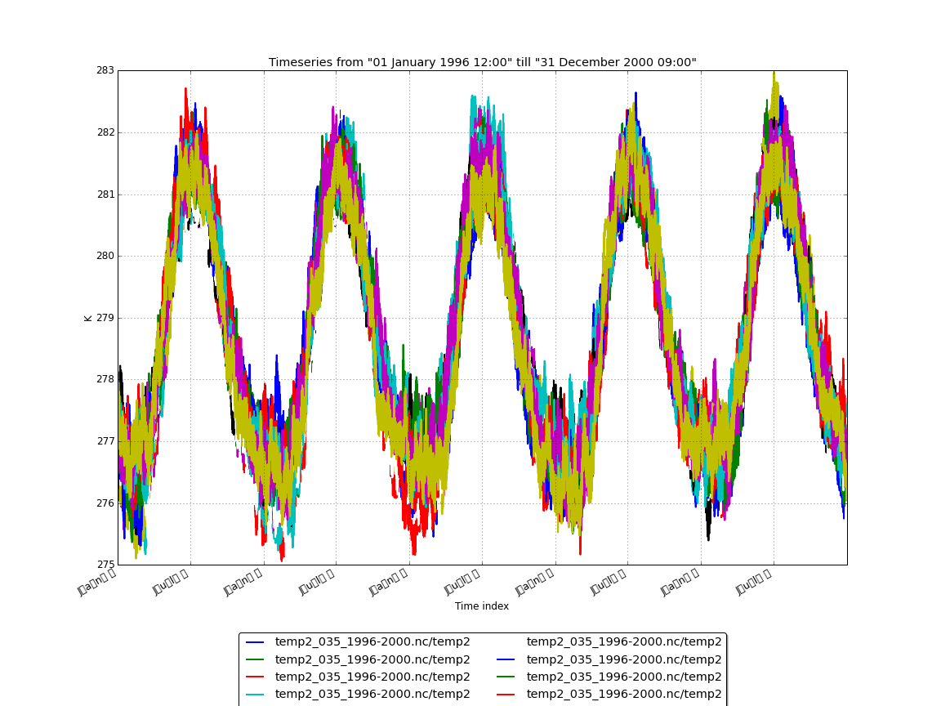
Multi member timeseries – created with WPS
3 months
5 years
Temperature for several ensembles from the ESSENCE dataset

Slide 10
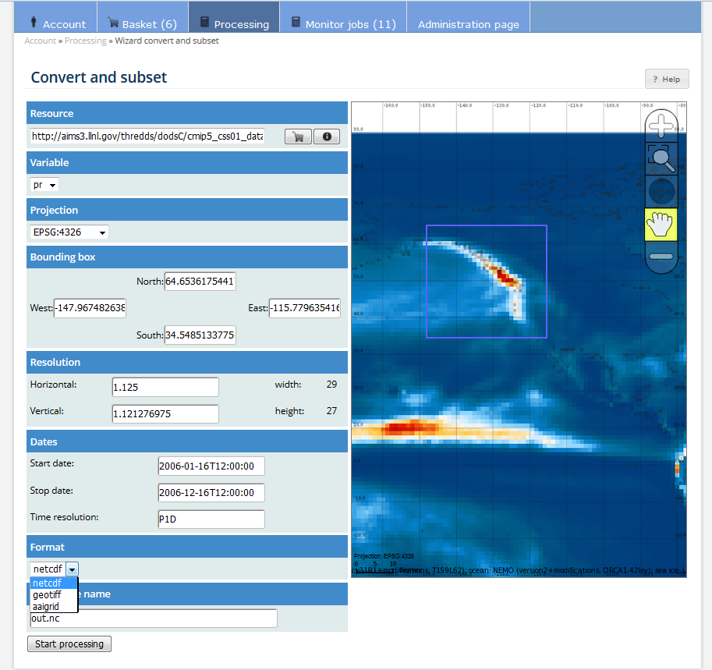
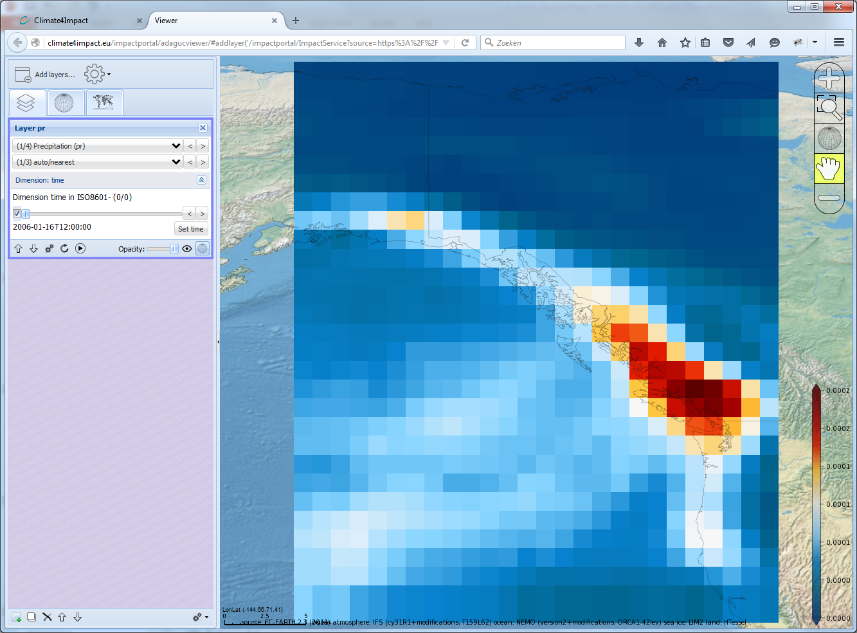
Convert and subset
Data reduction
Subsetting
GIS formats
Reprojection
WPS uses ADAGUC WCS iteratively

Slide 11
Web Processing Service – Security
PyWPS is executed from a Java servlet
Full control over environment, user sessions, etc...
Each process is executed with per user environment settings
Credentials (x509 certs, .dodsrc, .dodscookies)
Access to climate4impact personal basket
WPS / WMS / WCS can be accessed externally via:
Browsers:
OpenID
OAuth2 (See Phil’s presentation)
Command line:
x509 myproxy certificates (SLC client authentication, same as ESGF)
Access tokens

Slide 12
Web Processing Service – Access tokens
Unique identifiers as access tokens, as part of URL
https://dev.climate4impact.eu/impactportal/WPS/<accesstoken>/?
Limited lifespan, can be created and revoked by user in website
Easy commandline access to WPS (Python, R, Matlab, Bash)
Climate4impact is implementing a prototype in Java
Being used by the Copernicus CLIPC portal
DRKZ is implementing “Twitcher” as part of their Birdhouse project
https://dev.knmi.nl/projects/impactportal/wiki/API
http://twitcher.readthedocs.org/

Slide 13
WPS is used by the climate information portal - CLIPC
MyProxy
X509
PyWPS (WPS)
ICCLIM
Apache HTTPD Proxy
Impactportal
Java, Servlets, JSP
Tomcat
WMS
WCS
WPS
Storage API
Discovery
Catalogue
Drupal CMS
Openlayers3
Visualization
Access
token
Impact data node
THREDDS OpenDAP
ADAGUC
Viewer (WMS)
ADAGUC
Server (WMS)
Postgre
SQL
My
SQL
Climate4impact infrastructure
CLIPC Infrastructure

Slide 14
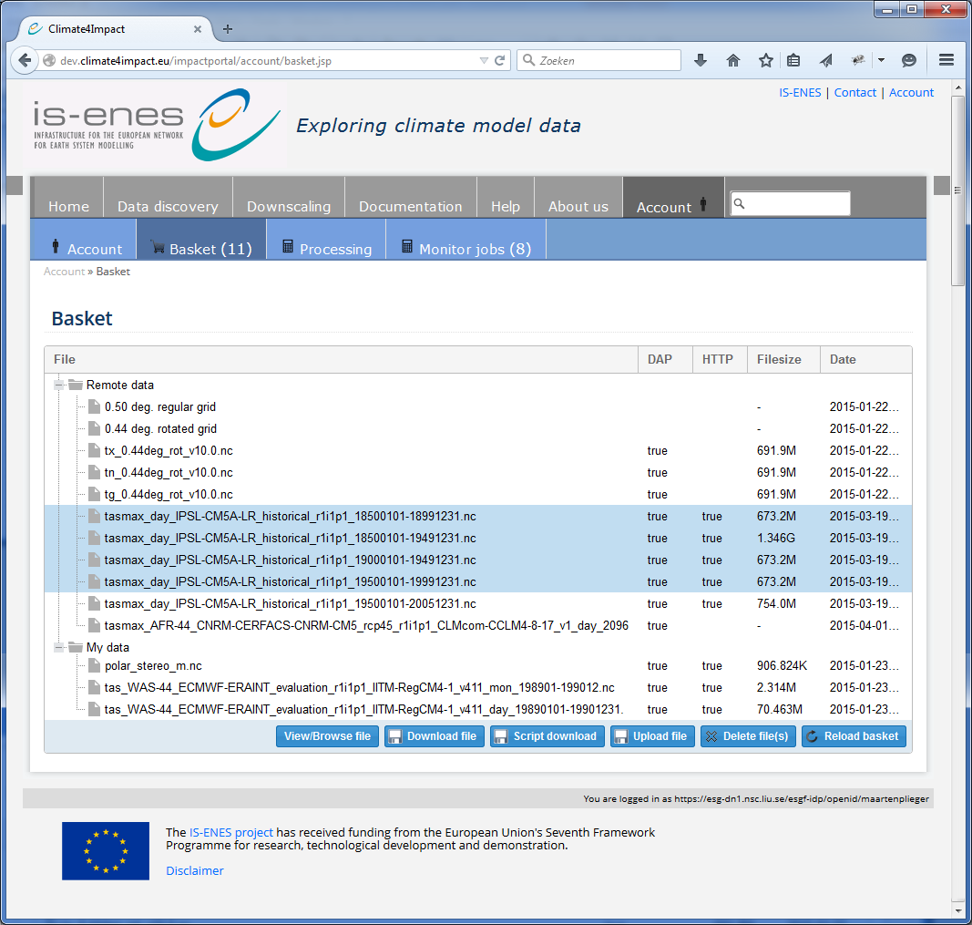
Download
By default the basket contains:
“Remote data” for links
“My data” for your own data
Script based download: select and download multiple files
The basket allows for uploading your own files
Can be used in processing or visualization

Slide 15
Conclusion and next steps
ESGF + climate4impact enables impact research
Researchers at KNMI / WUR: subsetting and regridding is useful
Requires ESGF search api, OpenDAP and Thredds catalogs
Climate4impact processing and visualization is a layer over ESGF
Climate4impact is flexible due to applied technologies and standards
PyWPS with ICCLIM as generic processing framework for climate indices
ADAGUC WMS can be used to visualize local and remote files
OPeNDAP can be used to access small bits of large files over the internet
Next steps:
Implement use cases from climate impact researchers
Finalize the connection to the University of Cantabria downscaling portal
Climate indices calculation wizard

Slide 16
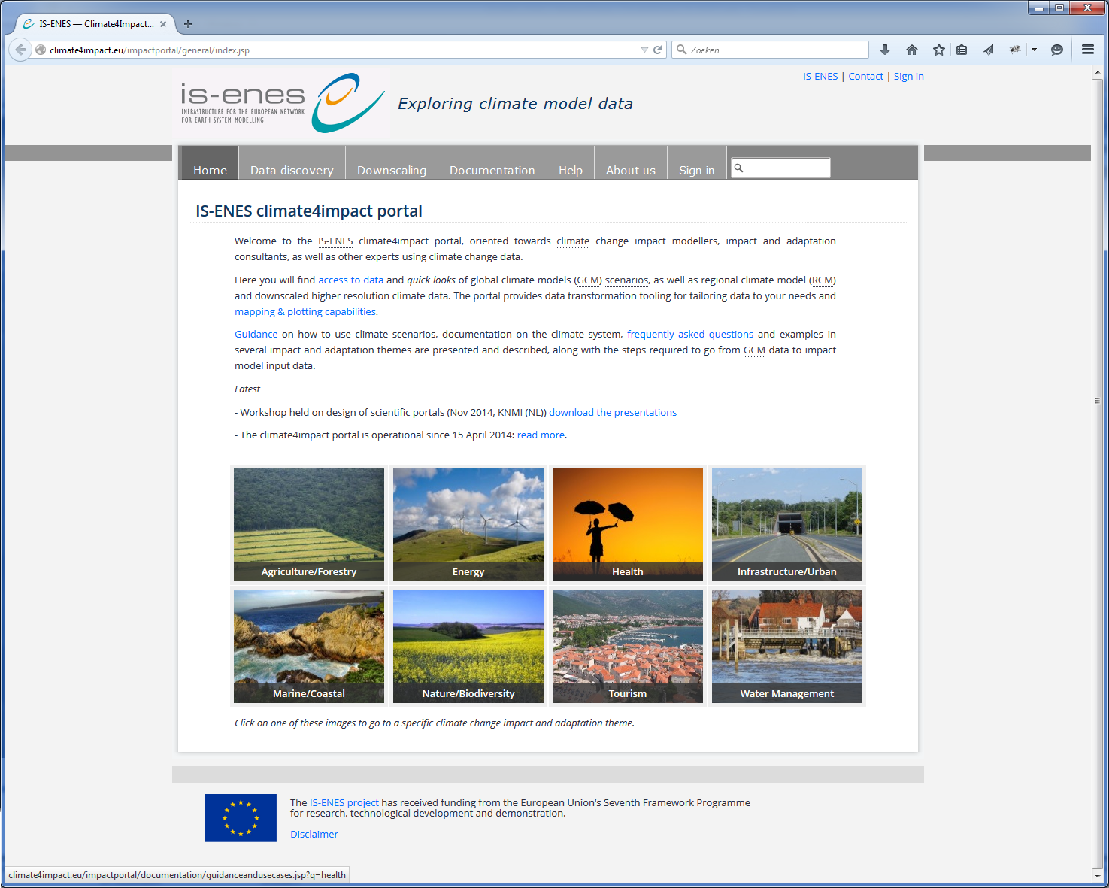
Thanks!
The next slides are for details

Slide 17
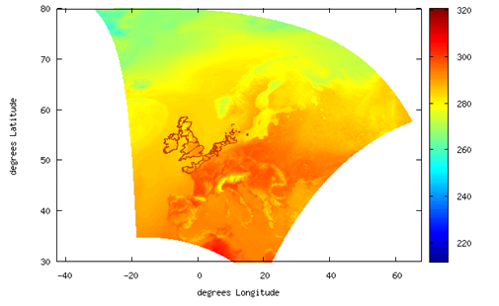
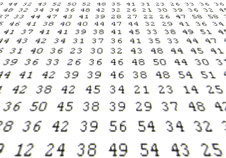
Data standards – HTTP download, OpenDAP, WCS and WMS
Work done on client
Graphics
Referenced data
WMS
Array based data
WCS
Data files
HTTP / FTP
01001010010
01010010010
10010100100
10010011000
Work done on server
(de Boer & Plieger, 2014)

Slide 18
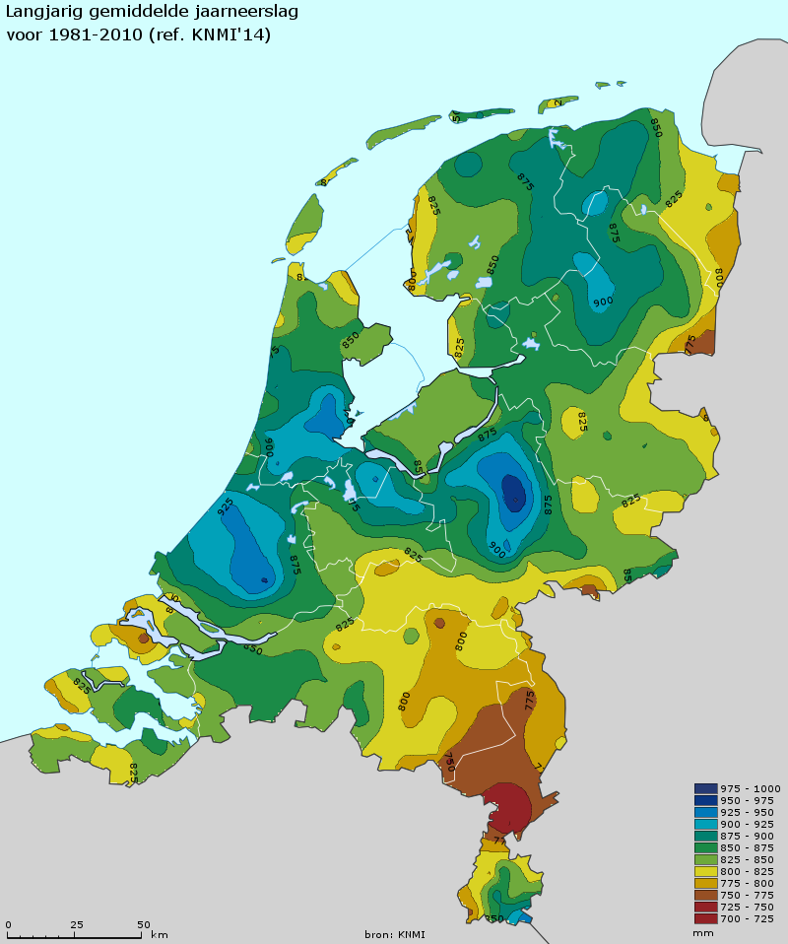
Web Map Service – for visualizations
Generates visualizations of geospatial data in the form of 2D images, suitable for transfer over the internet (JPG/PNG/GIF)
REST based:
Compose an URL with key value pairs,
and you will get an image!
Standard is developed and maintained by the Open Geospatial Consortium
Generated images are geo-referenced
Images from several sources can be easily combined
Images have dimensions
Time, elevation, member
WMS services can be viewed in many web based clients
OpenLayers, Leaflet, GoogleMaps, ADAGUC viewer, …

Slide 19
OPeNDAP – for data access and subsetting
OPeNDAP is the name of the organization and the name of the protocol
Open-source Project for a Network Data Access Protocol
Data is stored at remote server
Data model is similar to NetCDF’s data model (with differences)
N-dimensional array container, with variables, dimensions and attributes
Only requested pieces of data are sent
Accessing small pieces of large files on a remote server can still be quick
Data is requested based on sub-setting along dimensions
OPeNDAP resources can be opened locally on your computer as if it were local files using the NetCDF library
Local files versus remote files is transparent
The concept of a file is gone, an OPeNDAP endpoint can represent thousands of files aggregated along a dimension
E.g. Usually concatenate a large time series observation to one endpoint using the time dimension
OPeNDAP within ESGF is served using the THREDDS data server

Slide 20
Indices calculation using ICCLIM – developed in IS-ENES
Temperature indices
ECA&D indices
Humidity indices
Heat indices
Compound indices
Cold indices
Rain indices
Drought indices
Snow indices
Intra-period extreme temperature range [°C] - ETR
Warm days (days with mean temperature > 90th percentile of daily mean temperature) - TG90p
Summer days (days with max temperature > 25 °C) - SU
Python code developed at CERFACS, started in September 2013
Generic and modular approach, can be reused in other environments
C functions called for optimization
I/O interface is structured for optimal performance, with wrapper functions
Some percentile-based indices (TG10p, TX10p, TN90p, etc): OpenClimateGIS
ICCLIM source code and documentation is available via https://github.com/cerfacs-globc/icclim

Slide 21
How components fit together
ES-DOC
MyProxy
X509
PyWPS (WPS)
ICCLIM
Apache HTTPD Proxy
ESGF-Search API
Impactportal
Java, Servlets, JSP
Tomcat
OpenID, SSO
Drupal CMS
ESGF Data nodes
(OpenDAP)
Impact data node
THREDDS OpenDAP
ADAGUC
Viewer (WMS)
ADAGUC
Server (WMS)
Postgre
SQL
My
SQL
EUPORIAS
Google doc
External Infrastructure
Climate4impact infrastructure

Slide 22
MyProxy
X509
PyWPS (WPS)
ICCLIM
Apache HTTPD Proxy
Impactportal
Java, Servlets, JSP
Tomcat
WMS
WCS
WPS
Storage API
Discovery
Catalogue
Drupal CMS
Openlayers3
Visualization
Secured by
JWT Bearer
(OpenID-Connect)
Impact data node
THREDDS OpenDAP
ADAGUC
Viewer (WMS)
MyCLIPC
Wizard
ADAGUC
Server (WMS)
Postgre
SQL
My
SQL
Climate4impact infrastructure
CLIPC Infrastructure

Slide 23
Web Processing Service
Job progress can be viewed from anywhere

