Slide 1
Compute Working Team Update
Charles Doutriaux, ESGF CWT Team
State of the Project
December 4th, 2018

Slide 2

Outline
Quick Individual Highlights per Institutions
Certification
Take Home
Resources

Slide 3

Institution Highlights
LLNL (Jason Boutte): Compute Node ready for stack. Python API
NASA (Thomas Maxwell): Switch to EDASK
CMCC (Alessandro D’Anca): Ophidia ready for HPC, optimized operators
University of Utah (Steve Petruzza): XIDX, containers for VISUS, pip
CERFACS (Christian Page): Seamless Delegation of Calculations to the CWT
CRIM (Tom Landry): Advancement of ESGF-CWT API interoperability
OURANOS (David Huard): xclim, a climate indices library based on xarray + dask + WPS
CEDA, IPSL, DKRZ (Stephan Kindermann): Establish components supporting future OGC WPS deployments at ENES sites

Slide 4

Certification

Slide 5
Preserving ESGF Brand
Needed to protect ESGF reputation: worked with XC committee to solve this issue: Certification
Operator Certification
  Ensure service/operator is sound, reviewed, tested and documented
Server Certification
  Ensure user experience will be reasonable
  Compatible with other servers (can talk to each other)
  Core set of functionalities
Hybrid systems:
  Non-certified server can still host certified operators but ESGF cannot be blamed for glitches
  Certified Server can host non-certified operators, but ESGF cannot be blamed for results from these services
Notes:
Done by group in concertation with XC
Approved and posted
Implementation left to do.

Slide 6
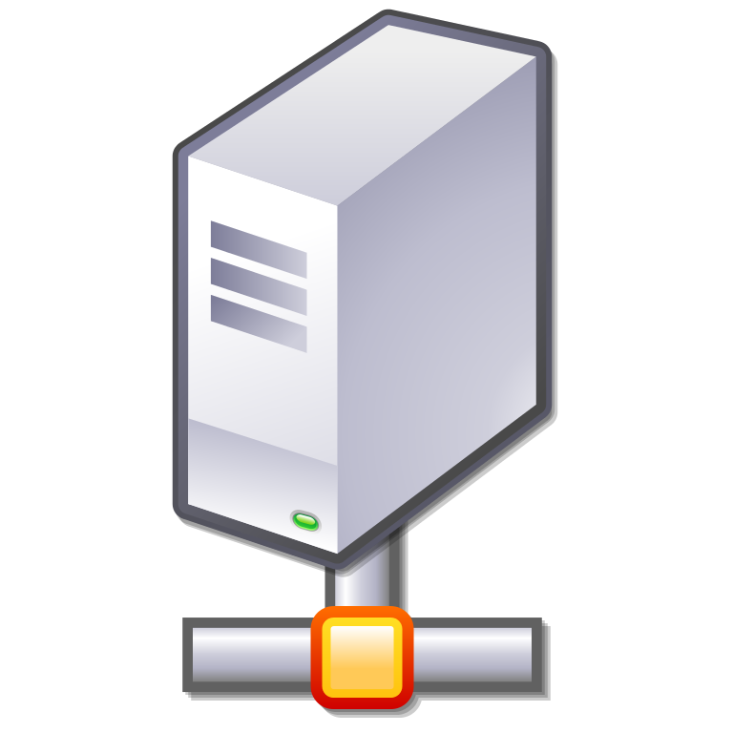
Server Certification
Official ESGF Operators
  Aggregate, subset, regrid, min, max, average over dim
Official Dataset
  So far CMIP5, but will update to CMIP6 soon
Security
  Scan, user credentials, etc…
Metrics
  Health Metrics (# of jobs running, queues, active users, users in queue, nodes and CPU load)
  Usage Metrics (Files accessed, services used, requests timings, data volume, etc.)
Stress
  Queue system

Slide 7

Operator Certification
Scientifically Sound
API compliant
  Update to latest version when out
  Respect naming convention
Performance
  Must be within range of other service producing same or similar results, large discrepancies should be understood and explained
Stress test
  High number of datasets
  High volume of data
Public test results
Provenance (TBD)

Slide 8

Actual Implementation
LLNL is developing first cut of certification script
CWT will review request and recommend favorable candidates to ESGF XC at F2F. Fast track possible on case-by-case basis
ESGF main website will list every official server and operators

Slide 9

Compute Challenge
There’s a need to assure community and developers that CWT is up to the task -> Compute Challenge
Use this F2F to devise a comprehensive set of rules for a “Compute Challenge” that will test our work

Slide 10

Things to Come
Compute Challenge
Trying to get every server to be API compatible
Dynamic Federated Workflows
Integrated into install stack?
VCDAT 2.0

Slide 11

Take Home
Rich Ecosystem; Many Backends
New Technologies Incorporated
Certification Process
Compute Challenge?

Slide 12

Resources
Email: esgf-cwt@llnl.gov
Webex:
  First Monday of the month: General Meeting
Documentation
  Certification: https://esgf.llnl.gov/esgf-media/pdf/ESGF-Compute-Certification.pdf
  Web: https://acme-climate.atlassian.net/wiki/spaces/ESGF/pages/3997828/Compute+Working+Team+esgf-cwt
  API: https://esgf-compute-api.readthedocs.io/en/latest/
Code (GitHub)
  Server: https://github.com/ESGF/esgf-compute-wps
  End-user: https://github.com/ESGF/esgf-compute-api
  Certification: https://github.com/ESGF/esgf-compute-cert

Slide 13
Thank You.

Slide 14
Additional Slides

Slide 15
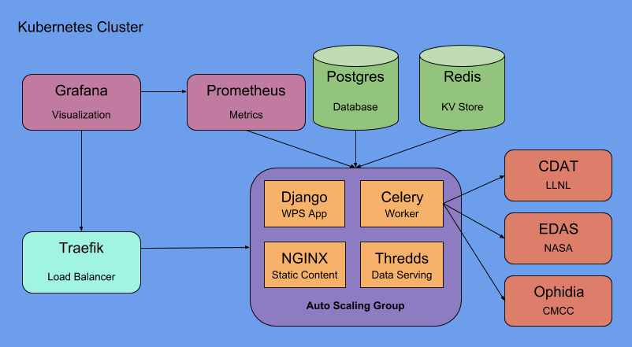
LLNL (Jason Boutte)
Develop and maintain container-based “compute-node”, ready to be used as ”standard” ESGF compute node deployment
Develop and maintain Python-based compute API as well as API standards themselves (in conjunction with rest of CWT of course)
New UI for workflows
Certification CLI
New Server for production

Slide 16

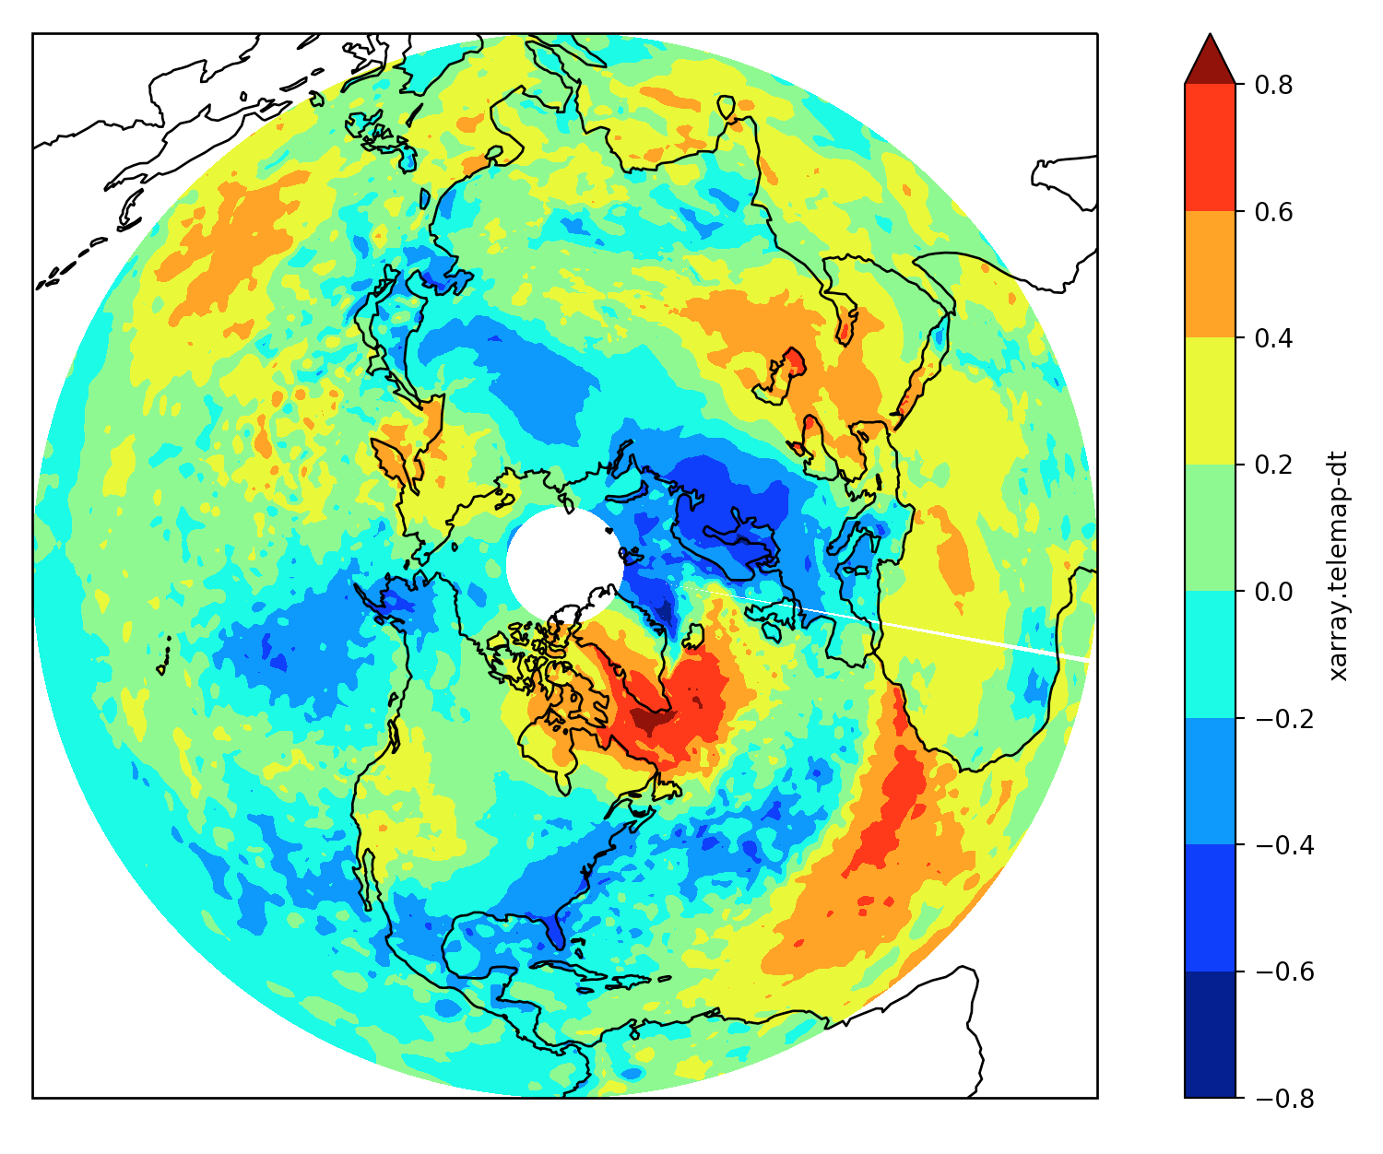
NASA (Tom Maxwell)
EDASK Analytic Services Framework
  Implemented in 100% Python
  Built on Dask/Xarray
  Restful WPS interface
  Parallel data access
  Workflow framework
Canonical Operation Options
  Domain: subset to region
  Axes: reduce over axes
    X, Y, Z, T, E (ensemble)
  Groupby: split-apply-combine
    Custom or existing Axis
    Pandas groups
  Resample: upsampling and downsampling
    Pandas resample API
Taught at AMS
Computes a map of covariances between a chosen point and all other points in the ROI.
Domain
Lat: { 0, 80 }
Time: { 1980, 2010 }
Collection: CFSR
Variables: tas
Input
Input
Collection: 20CR
Variables: tas
Collection: ECMWF
Variables: tas
Input
telemap
Axis: t
Selection: djf
detrend
Lat: 60
Lon: 310
filter
Wsize: 15
Input
Collection: MERRA2
Variables: tas

Slide 17

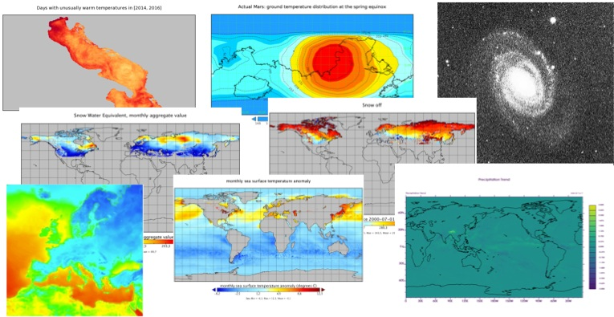


CMCC (Alessandro D’Anca)
Ophidia provides support for declarative, parallel,
server-side data analysis as well as large-scale
analytics workflows.
Highlights 2018:
User management, accounting and monitoring
Improvement of data operators (e.g. parallel I/O aspects)
HPC deployment (e.g. Athena) and preliminary benchmark
Contribution to BigData2018
Register at: https://ophidialab.cmcc.it/web/registration.php

Slide 18

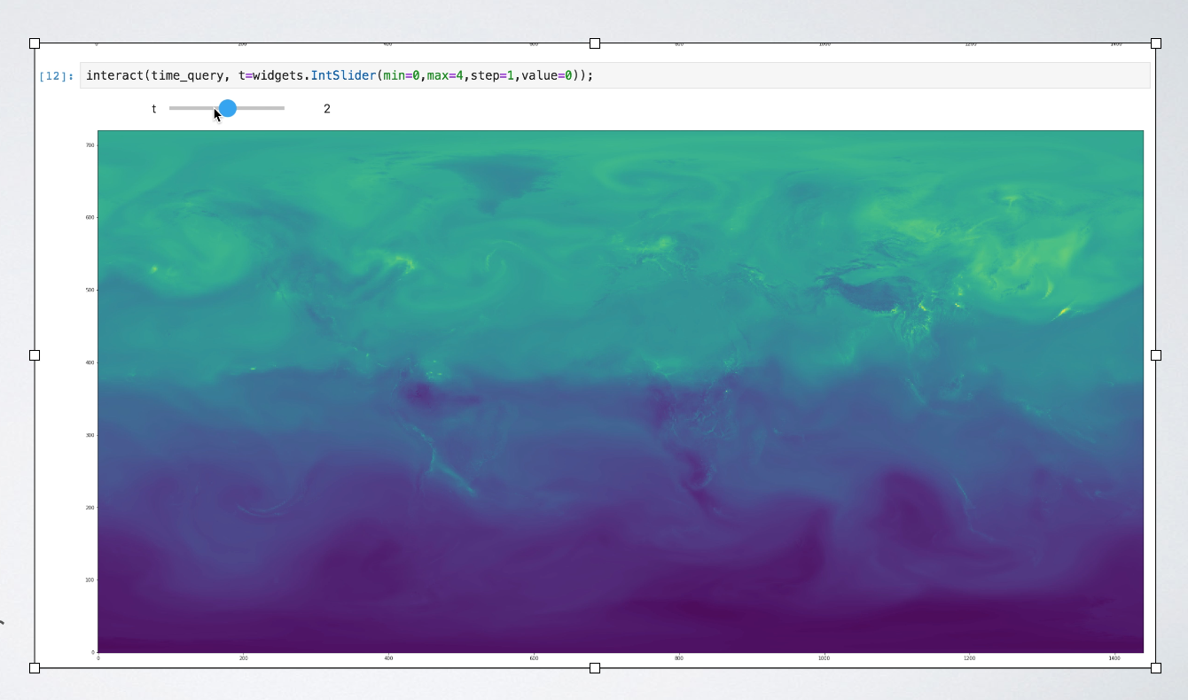
Visus (Steve Petruzza)
New metadata format (XIDX) to support all useful NetCDF metadata into the multiresolution (IDX) format
  Portable C++ implementation with Python wrapper for integration in existing Python applications
  Automatic importer adds NetCDF metadata to existing and new IDX volumes
Containerized Docker deployment of:
  Manual conversion tools
  On-demand conversion service
  Data streaming server
  Web viewer for interactive data visualization in the browser
Easy Python installation via “pip” of both data I/O library
and converter
Multi-platform, self-embedded deployment
of converter and desktop viewer executables
Jupyter notebook examples of interactive streaming analysis of large-scale datasets over different spatial resolutions using ViSUS Python libraries

Slide 19

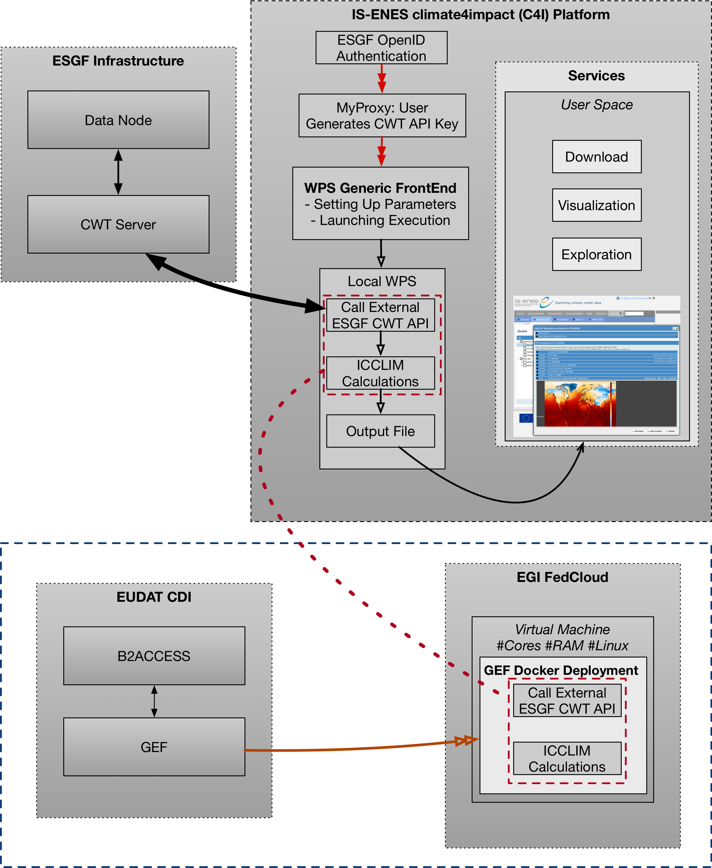
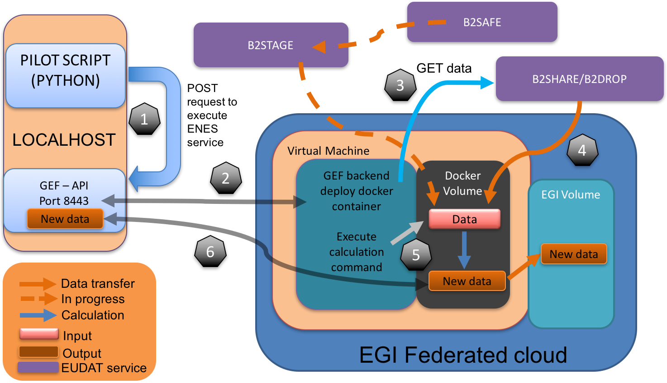
CERFACS (Christian Pagé)
Seamless Delegation of Calculations to the CWT
C4I WPS deploys EUDAT GEF backend into EGI FedCloud
  Authentications:
    ESGF OpenID (C4I)
    CWT API Key
    B2ACCESS
    EGI FedCloud X.509

Slide 20
CRIM (Tom Landry)
Implementation of a WPS-T 2.0 REST JSON server
Creation of a new AuthZ/AuthN module in Birdhouse (Magpie)
Experimentations with Application Packages in secured workflows
  Docker Image + Common Workflow Language (CWL) + OAuth2 from WSO2 endpoint
Advancement of ESGF-CWT API interoperability concept
  Potential use of both client and server components of API on PAVICS and Birdhouse
Exploration of various Machine Learning use cases and systems

Slide 21





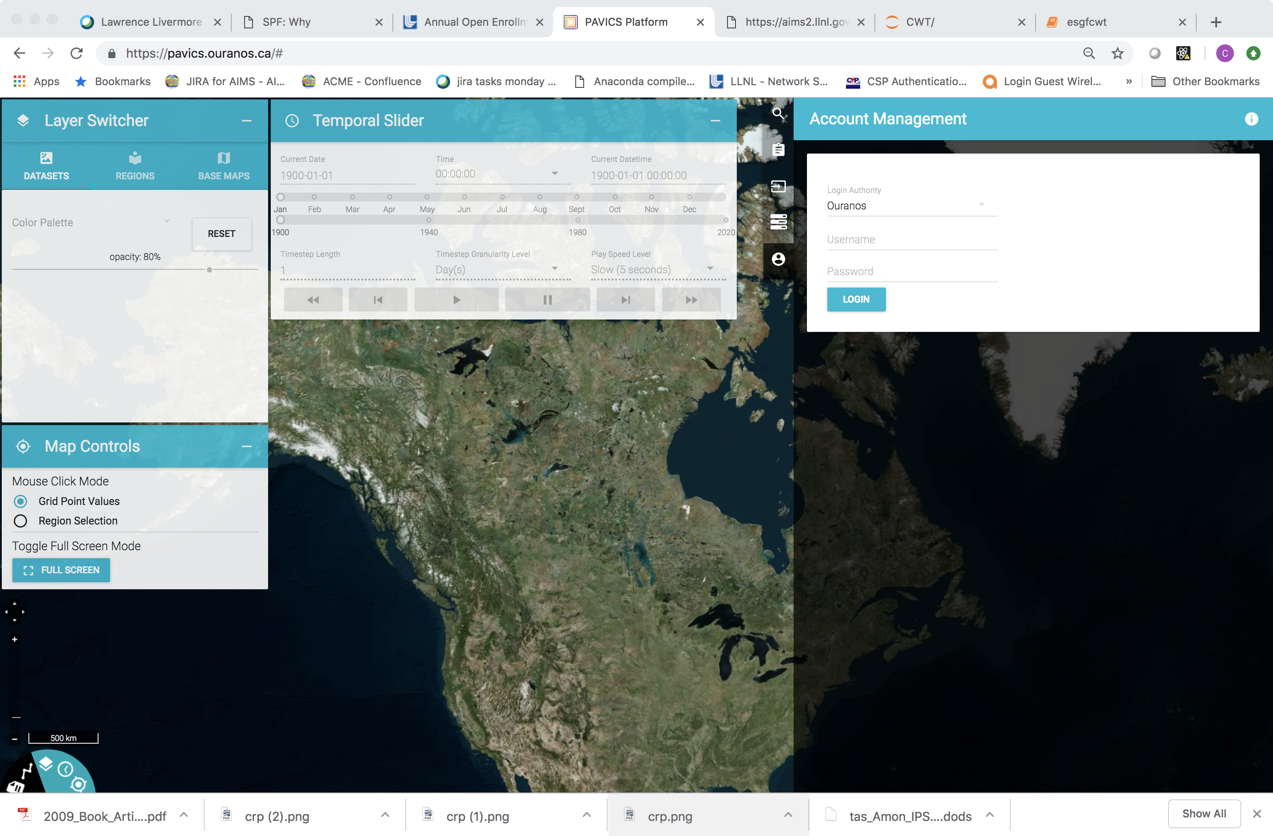
Ouranos (David Huard)
Launched operational WPS server for climate analysis (https://pavics.ouranos.ca)
Started project to embed hydrological models and related analytics as WPS
Developed xclim, a climate indices library based on xarray+dask+WPS
Provided tech support to the new Canadian Center for Climate Services
Added native support for OPeNDAP to PyWPS (still in master)
Wrote Python interface to WPS processes based on OWSLib (birdhouse/birdy)

Slide 22





CEDA, IPSL and DKRZ Contributions (Stephan Kindermann)
During 2018 work continued to establish components supporting future OGC WPS deployments at ENES sites:
  Driving EU project in 2018: Copernicus - Compute node for the Climate Data Store (CMIP5, CORDEX)
  Components are part of Birdhouse framework effort
Software Components:
  Cookiecutter template for a customized PyWPS service.
  Ansible script to deploy PyWPS services
  Birdy “native” client for WPS service usage within Jupyter Notebooks.
  Twitcher security proxy with x509 certificate support
  OpenDAP support in PyWPS
Further Work:
  WPS deployment in container infrastructure (Kubernetes)
  Load-balanced solution for a WPS compute service
  WPS plugin for GeoHealthCheck
https://cp4cds.github.io/

