Slide 1
Deep-Hurricane-Tracker: Tracking and Predicting Extreme Climate Events using ConvLSTM
Sookyung Kim
Post-doc
12/4, 2019
LLNL-PRES-812582
This work was performed under the auspices of the U.S. Department of Energy by Lawrence Livermore National Laboratory under contract DE-AC52-07NA27344. Lawrence Livermore National Security, LLC

Slide 2
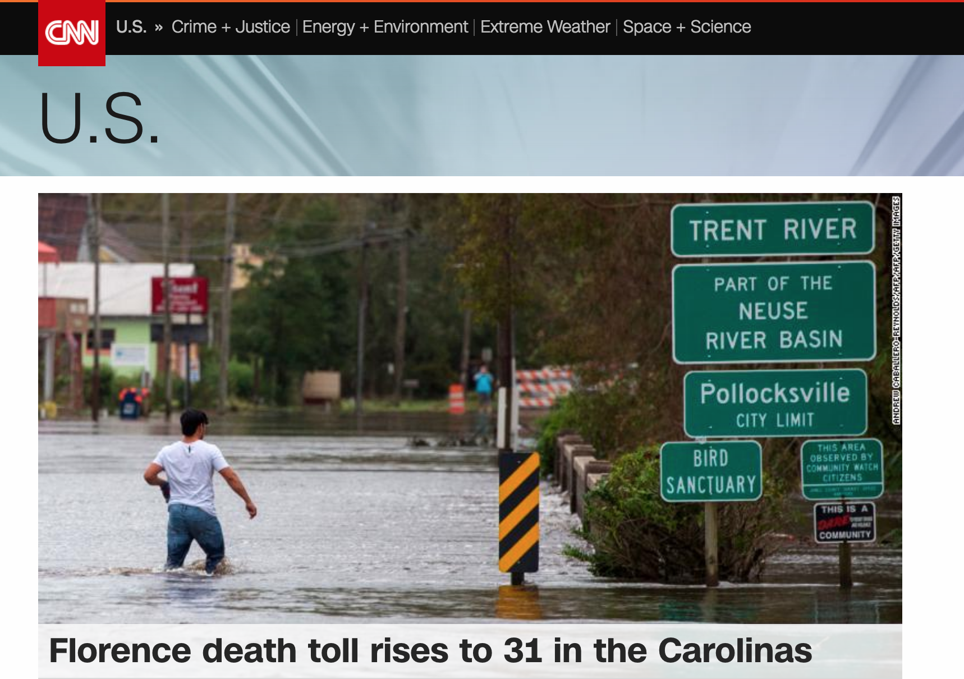
Notes:
This is the screenshot that I captured recently from CNN breaking news.
The hurricane Florence death toll rises to 31 in the Carolinas.
Its devastating.
=============================================================
Global warming and tropical cyclone
https://www.skepticalscience.com/hurricanes-global-warming.htm

Slide 3
http://extremeweather.co/
Notes:
Other than hurricane Florence, for past several years, we watched breaking news regarding hurricane literally every day.
This year, we had the unusual season that the multiple storms are rising at different locations and crossing the globe.
It is Incredible!
=============================================================
Global warming and tropical cyclone
https://www.skepticalscience.com/hurricanes-global-warming.htm

Slide 4
Pew Centre, “Globally, there is an average of about 90 tropical storms a year”. The IPCC AR4 report (2007)
Notes:
The average damage of such big hurricanes exceed "several hundred billion" dollars and made "several hundred" fatalities.
The more depressing news is this.
According to the IPCC report, the annual frequency of north Atlantic tropical storms is keep increasing, and size of storm is also increasing.
It is obvious that fast and accurate hurricane detection and localization is the top priority to us.

Slide 5
Conventional Methods for tracking extreme climate events
A. Labor intensive
B. Expert-based (subjective)
Data-Driven method?
Notes:
Then, let’s see how did we detect and track hurricane so far.
In conventional method to detect extreme climate, human expert actually detected hurricane one by one based on hand-picked thresholds from large simulation data.
And the threshold to define extreme events mostly are defined by intuition of human expert.
So, we can see that the conventional methods is “A. labor intensive” and “B. Expert-based” which means subjective.
To save human effort for the conventional method
and decide standard decision rule to define the events,
Here we propose the neural net based model to detect and track hurricane
which is based on data, not based on human expert.

Slide 6
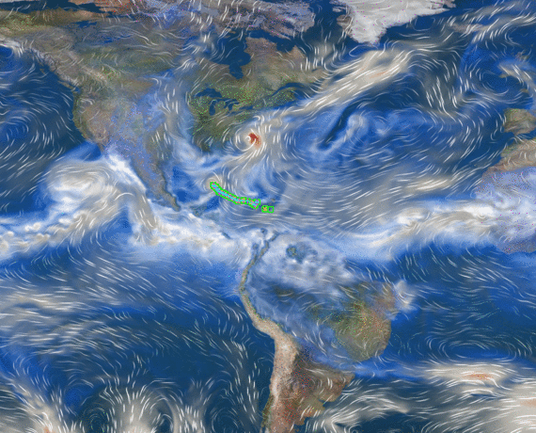
Challenges of extreme climate event detection and tracking problem
The number of objects is not known previously.
Target object is defined by spatio-temporal dynamics and correlation of multiple climate variables
Copyright of figure: https://github.com/LBL-EESA/TECA
Notes:
To do this, we should understand unique challenges for extreme climate event detection problem.
There are two main challenges of extreme climate event detection problem.
Firstly, like multi-object tracking problem, the number of objects is not known previously, so it cannot be parameterized.

Slide 7
Problem 1. How to deal with unknown number of objects? : Density map
Design output Y_{i} as density-map with same size of input X_{i}
$X_{i}$ $∈R^{mxnxc}$
$$Y_{i}∈R^{mxn}$$
$$y_{i}^{1}$$
$$Y_{i}=\left\{y_{i}^{0}\right\} \\ =\{\left(a_{i}^{0},b_{i}^{0}\right),\left(a_{i}^{1},b_{i}^{1}\right)\}$$
$$y_{i}^{0}$$
$$y_{i}^{1}$$
$$y_{i}^{0}$$
$$y_{i}^{0}$$
$$y_{i}^{0}$$
$$y_{i}^{1}$$
$$y_{i}^{1}$$
$$Y_{i}=\left\{y_{i}^{0},y_{i}^{1},y_{i}^{2}\right\}=\{\left(a_{i}^{0},b_{i}^{0}\right),\left(a_{i}^{1},b_{i}^{1}\right),(a_{i}^{2},b_{i}^{2})\}$$
$$y_{i}^{2}$$
$$y_{i}^{2}$$
Design problem as pixel-wise regression problem from climate image to density-map of events
Notes:
Let’s discuss the first problem.
That means, if there are k-hurricanes in one climate images, the number k is not known previously.
So, number of hurricane can be three or four or zero.
So, when we try to learn location coordinate value from one image by regression, we don’t know how many coordinates to be sampled from.
Because, k, the number of object is not pre-defined.
Therefore, it is hard to design model to learn arbitrary numbers of coordinates.
Then, how can we deal with unknown number of objects?
To resolve this issue, here, we formulated the problem as density-map prediction problem using ConvLSTM.
Basically, input (X_i) is climate image with multiple channels of climate variable at timestep i
,and output is hurricane heat map with same size of input image.
In this way, we designed the multi object tracking problem as pixel-wise regression problem from input of climates image to output of density map of extreme events.
In this way, model can estimate location density of k-hurricane even if we do not know what k is.
Here, because hurricane has circular shape, the gaussian distribution has been used to generate density map labels.

Slide 8
Challenges of extreme climate event detection and tracking problem
The number of objects is not known previously.
Target object is defined by spatio-temporal dynamics and correlation of multiple climate variables
Copyright of figure: https://github.com/LBL-EESA/TECA
Notes:
Okay. Now, let’s consider second challenge of extreme climate event detection.
Second challenge is, the target objects are defined by spatio-temporal dynamics and correlation of multiple climate variables.
If extreme events are just visual objects, like cat or dog, we can apply general representation learning techniques at stilled image, and connect them by so-called “tracking-by-detection” techniques.
However, extreme event is dynamic movement rather than stilled visual object.
Therefore, we should consider not only spatial but also temporal dynamics between multiple climate variables to define events.
For example, hurricane looks spiral wind pattern at first glance, but there are specific temporal pattern for different climate variable.
Wind is slowly rising at starting of event and dropping at the end of event.
Pressure is keep dropping around hurricane center and rising again at the end of hurricane and so on.
So, it is difficult to define hurricane just from one shot, but should be defined by looking for the long time sequences.

Slide 9
How can we deal with spatiotemporal data? : LSTM vs ConvLSTM
FC-LSTM
Convolutional LSTM
Hidden state at a timestep is 1-d tensors.
Dot-product for input-to-state and state-to-state transition.
Inputs and states at a timestep are 2-d tensors.
Convolution for input-to-state and state-to-state transition.
Notes:
Then, how can we deal with spatiotemporal data?
The most popular method to deal with temporal data set using neural net is lstm, which is so called long short term memory.
Primitive fully connected LSTM is good to represent simple time series data, such as natural language or value typed data.
But it is considered not enough to contain spatial correlation information.
This is because FC-LSTM compress image feature as 1-D vector to save it as small hidden representation.
So, abundant spatial information is lost in a process to change image to hidden state vector.
Therefore, lstm is working well to deal with temporal correlation, but not enough to deal with spatial correlation.
Then, how can we deal with spatiotemporal data and capture spatio-temporal dynamics in defining event?
Here, we propose to use convLSTM.
Briefly speaking, convLSTM is variant of fully connected LSTM which change dot product in LSTM operation as convolution operation.
In ConvLSTM, the input and state at each time steps are 2-d spatial tensors, and it use convolution operation for input-to-state and state-to-state connection.
So, hidden state is generated and transferred to another time-sequence by considering spatial correlation.
We can think ConvLSTM as LSTM containing CNN inside. So, Conv part will deal with spatial dynamics and LSTM will capture temporal information.

Slide 10
Proposed Tracking Model using Conv-LSTM
f: Multi-layered Conv-LSTM
3-layered and 4-layered
Input-to-state, state-to-state kernel: 5x5
Loss: pixel-wise MSE btw output and GT
${\tilde{Y}}_{0},…,{\tilde{Y}}_{T−1}$ = $f(X;θ)$ = $\underset{Y_{0}…Y_{T−1}}{argmax}{p\left(Y_{0},…,Y_{T−1}\right|X_{0},…,X_{T−1}\text{)}}$
Notes:
This is our proposed ConvLSTM tracking model
. At each time-step, multi-layered convLSTM generated density map of hurricane at corresponding time, based on “input” and “historical spatio-temporal information” from hidden state taken from previous time-step.
In this way, we learn the model f to optimize sub-parameter “theta” to generate corresponding density map of hurricanes, given time sequenced climate images.
For our model, we tried 3-layered and 4-layered vanilla ConvLSTM and we designed kernel size as 5x5 considering size of hurricane.
And, we used pixel wise mean squared error loss between ground truth density map and output from our model.

Slide 11
Baseline Tracking Model 1 : Extreme weather detection using CNN
Is it hurricane? (Binary Classification)
Labeled 2-d patches (Reanalysis and Simulation)
Yes
…
No
Liu, Yunjie, et al. "Application of deep convolutional neural networks for detecting extreme weather in climate datasets." arXiv preprint arXiv:1605.01156 (2016).
Notes:
As a base-line, we compared the result of our convLSTM based model with regional CNN based tracking model.
There is previous work to detect hurricane with CNN based binary classified. And, the detection accuracy is almost 100%.

Slide 12
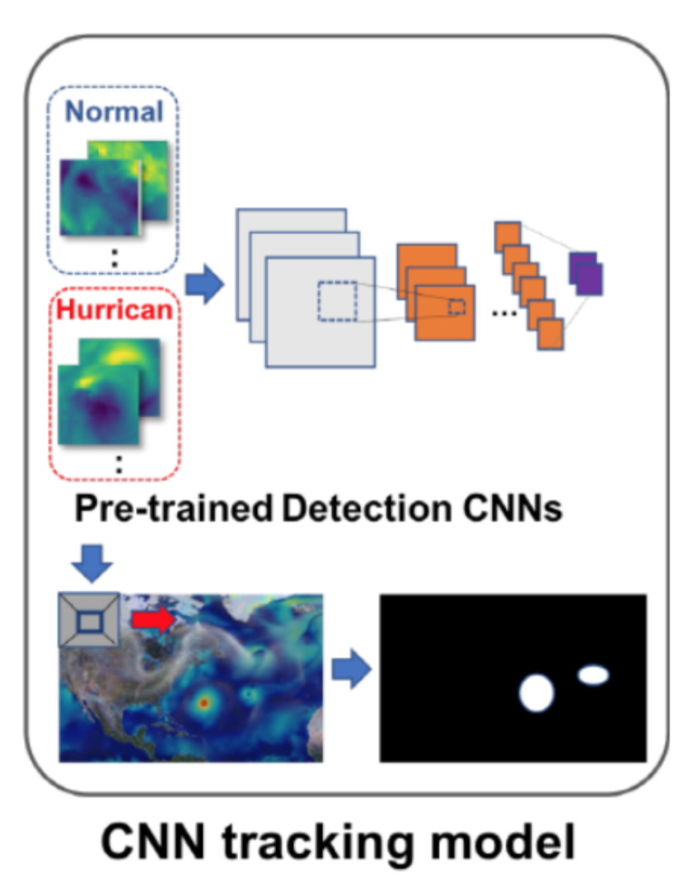
Baseline Tracking Model 1 : Tracking-by-detection using CNN
Previous works:
Detection of hurricane with 2-layered CNN ~ 100%
Pre-train detection CNN for binary classification of hurricane
Overlapping image patches to pretrained detection CNN (Scan through image)
Generate density-map by integrating outputs
Notes:
Inspired by previous work, we designed CNN based model to predict density map given climate image input.
Firstly, we pre-trained hurricane detection CNN with cropped input image patches with same method as baseline,
and then scan this detection-CNN through global scaled climate data.
Then, the model can generate hurricane density map by integrating outputs from detection CNN.
In this CNN based tracking process, temporal dynamic is not considered.

Slide 13
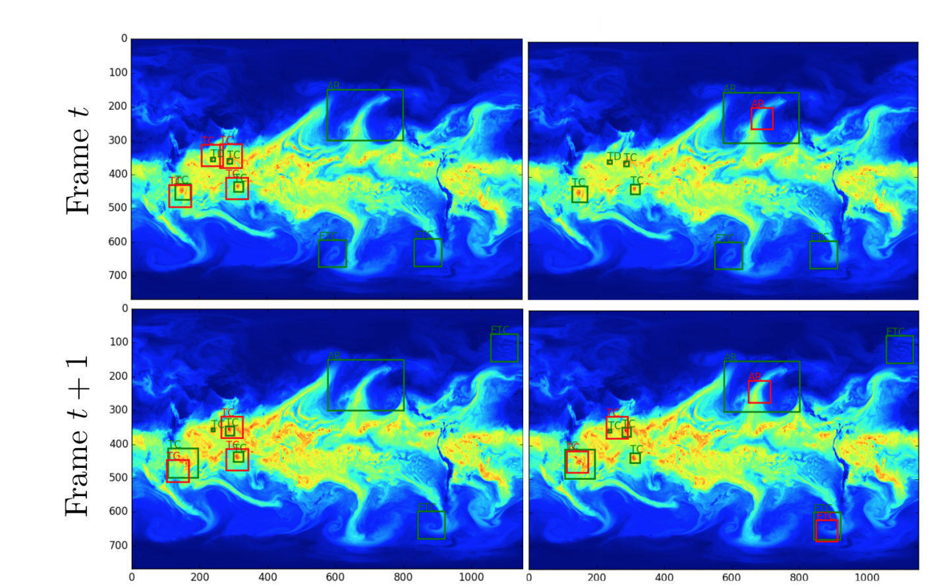
Baseline Tracking Model 2: Semi-supervised detection, localization of extreme weather events
Racah, Evan, et al. "ExtremeWeather: A large-scale climate dataset for semi-supervised detection, localization, and understanding of extreme weather events." Advances in Neural Information Processing Systems. 2017.
Notes:
We also compared out model with another baseline to detect hurricane using neural nets.
This paper is published by LBL,by prabhat, one of my collaborator.
In this paper, they used auto encoder architecture to compress spatio temporal climate data first, and then detect hurricane in the embedding that autoencoder compressed based on spatio-temporal data. And, they reported average precision of spatio-temporal detection accuracy from this model.

Slide 14
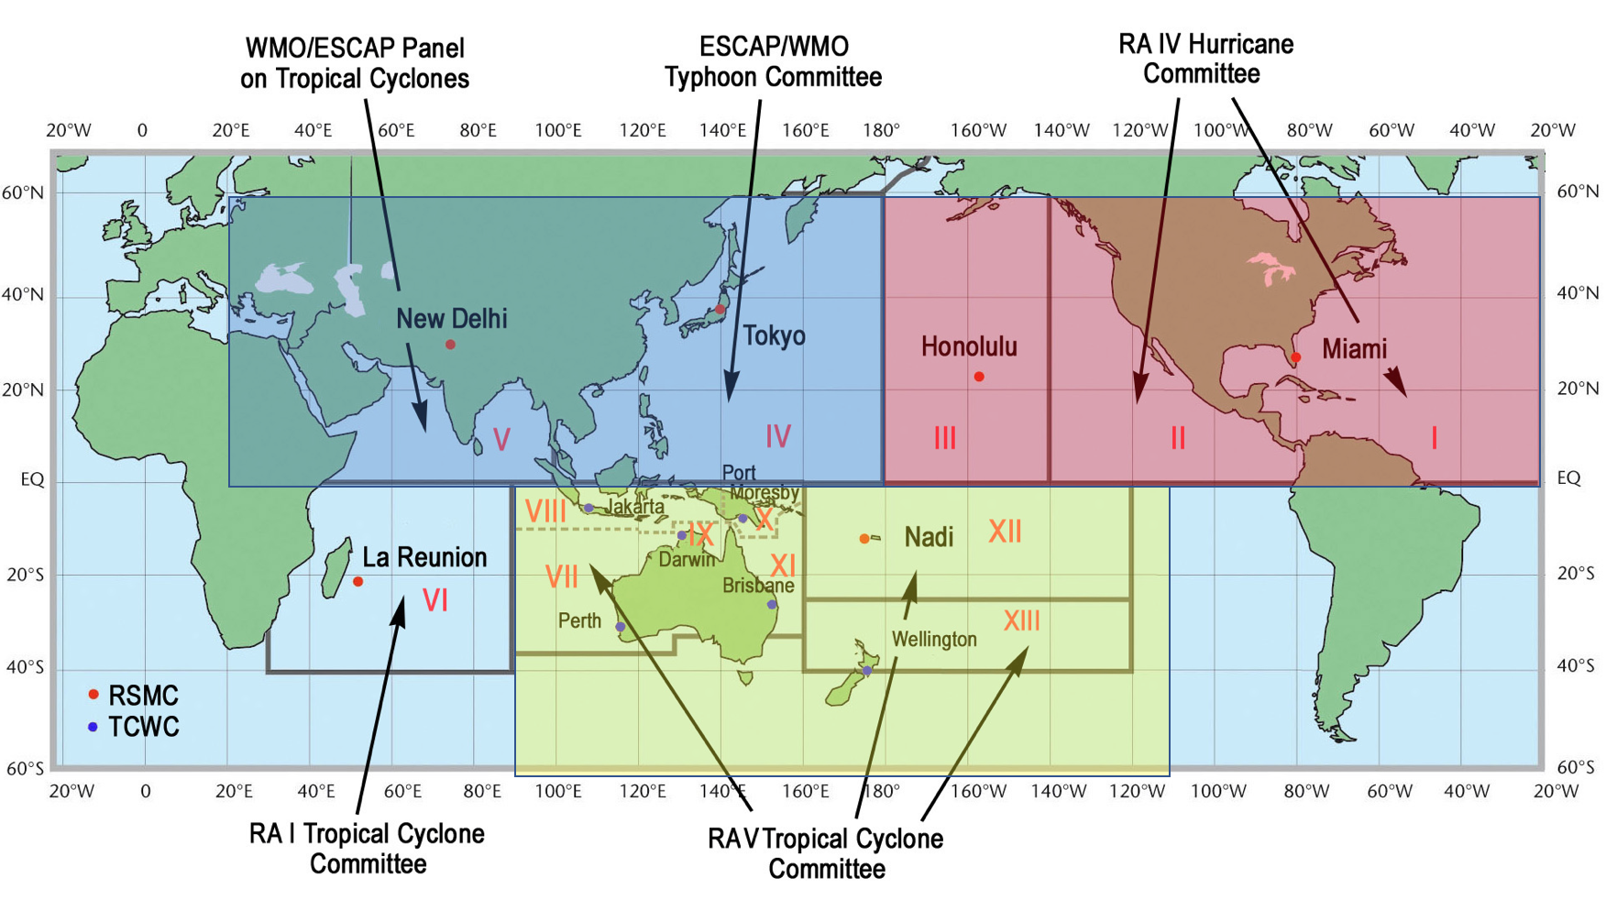
Experimental Settings
Dataset
Input: 20-year run (1996 to 2015) 3 hourly climate simulation data : CAM5 (Community atmospheric model v5)
Climate variables: zonal wind (U850), Meridional wind (V850), Precipitation (PRECT)
Output label: Ground-truth trajectories obtained from TECA (Toolkit got Extreme Climate Analysis)
Time-steps: 10 (30 hours)
Notes:
Here are the short description of our experimental setting.
For our input data, we have used CAM5 climate simulation data, and used 3 channels of variables including zonal wind, meridional wind and precipitation.
For output density-map, we used hurricane trajectories from TECA software, and synthesized ground truth label using gaussian mixture.
In our experiment, we fixed time steps as 10 which corresponds to 30 hours.

Slide 15
Results
conv-LSTM based tracking model
Detection CNN:
Ground Truth
Output
Notes:
This is the result of convLSTM tracking model. These top three rows represented inputs of our model for different climate variables And those two rows are time-seriesed ground truth and output of the model.
And this is the reconstructed trajectory from ground truth and output heat map.
we can see that our model give us trajectory with strong agreement with ground truth.
And, this is the heatmap at timestep 1 using baseline-CNN model, we can see that there are many false positives due to the lack of temporal information in detecting trajectory.

Slide 16
Results – Average Precision
Notes:
Our quantitative analysis of output also showed that ConvLSTM based model outperform our two baseline, CNN based model and 3d conv encoder decoder structure, in its Precision and F1-score.
This is due to the many false positive instances from CNN model.

Slide 17
Take-home message
Proposed ConvLSTM tracking model
Enable to capture pixel-level spatio-temporal pattern of hurricane
Succeed for heat-map prediction and forecasting
Learn dynamical correlation between multiple climate variables.
Proposed ConvLSTM based hurricane tracking method outperforms baseline tracking-by-detection method
Proposed ConvLSTM based hurricane tracking method can be implemented and integrated with ESGF framework
Notes:
To sum up,
we proposed convLSTM hurricane tracking model which can able to capture pixel-level spatio-temporal pattern of hurricane.
Also, our model could learn dynamical correlation between multiple climate variables.
To verify the performance of our model, we compare our model with CNN-based tracking by detection method.
The results from proposed ConvLSTM model showed that it outperform baseline tracking method using CNN.

