Slide 1


input4MIPs: ESGF experiences from a 2-year old project
Paul J. Durack, Karl E. Taylor, Sasha K. Ames, Jiwoo Lee, Charles Doutriaux,
Denis Nadeau, Chris Mauzey and Tony Hoang
Lawrence Livermore National Laboratory
5th December, 2018
LLNL-PRES-953604
This work was performed under the auspices of the U.S. Department of Energy by Lawrence Livermore National Laboratory under contract DE-AC52-07NA27344. Lawrence Livermore National Security, LLC

Slide 2


Project support
All LLNL contributions are supported by the DOE Office of Science
  PCMDI
  ESGF
DKRZ provides citation service
18 contributing institutions and their associated funding agencies
10 contributing countries
Supporting CMIP6
  44 contributing institutions
  101 contributing models (Sebastien, plus 1!)

Slide 3
input4MIPs: motivation
After CMIP5 simulations became available issues were found with the forcing datasets used
Numerous assessments noted discrepancies e.g. with the volcanic forcing data used with a number of forcing-relevant volcanoes omitted from the post-2000 time history (e.g Santer et al., 2014 NATGeo; Schmidt et al., 2014 NATGeo)
input4MIPs improves this situation for CMIP6 – better describing, documenting and collating the datasets used for simulations, in particular the historical simulations

Slide 4

input4MIPs: brief history (part 1)
Project initiated to better curate forcing datasets used in CMIP6
Project began in April 2016
By December 2016 the first release v6.0.0 of the CMIP6 forcing dataset collection was in place
2 more CMIP panel endorsed releases have been announced subsequently (Primarily CMIP/DECK updates)
  6.1.1 22nd May 2017
  6.2.1 6th October 2017
All datasets and data history is described in http://goo.gl/r8up31

Slide 5
input4MIPs: brief history (part 2)
Project is a rolling evolution
  Very tight timelines – modeling groups needed datasets to start simulations – project needed to deal with provided data with an inability to request data/format corrections
  Datasets were collected and initially were rewritten to ensure project metadata and versioning was enforced
  “Dual versioning” having a dataset version i.e. v1.1.4 in addition to an ESGF version i.e. v20180427 necessary as some datasets exist outside of ESGF (data provider distributed datasets outside of ESGF project)
Complete project republication 22nd Jan 2018 to cleanup evolving metadata, add tracking_id and metadata inconsistencies (enabling Synda project replication)

Slide 6

input4MIPs: current status
Current dataset collection ver 6.2.18 (30th Nov 2018)
  7304 netcdf files
  1.5Tb total storage footprint
  13 MIPs served
Datasets being updated/added
  6.2.19 (~December 2018) – ScenarioMIP – Future Land Use v2.1f – added_tree_cover
  6.2.20 (~December 2018) – CMIP – AMIP Boundary forcing v1.1.5
  6.2.21 (~January 2019) – CMIP – Stratospheric aerosol v4.0.0
  6.2.22 (~March 2019) – ScenarioMIP – ozone (additional exps)
  PMIP – Jean-Yves?

Slide 9
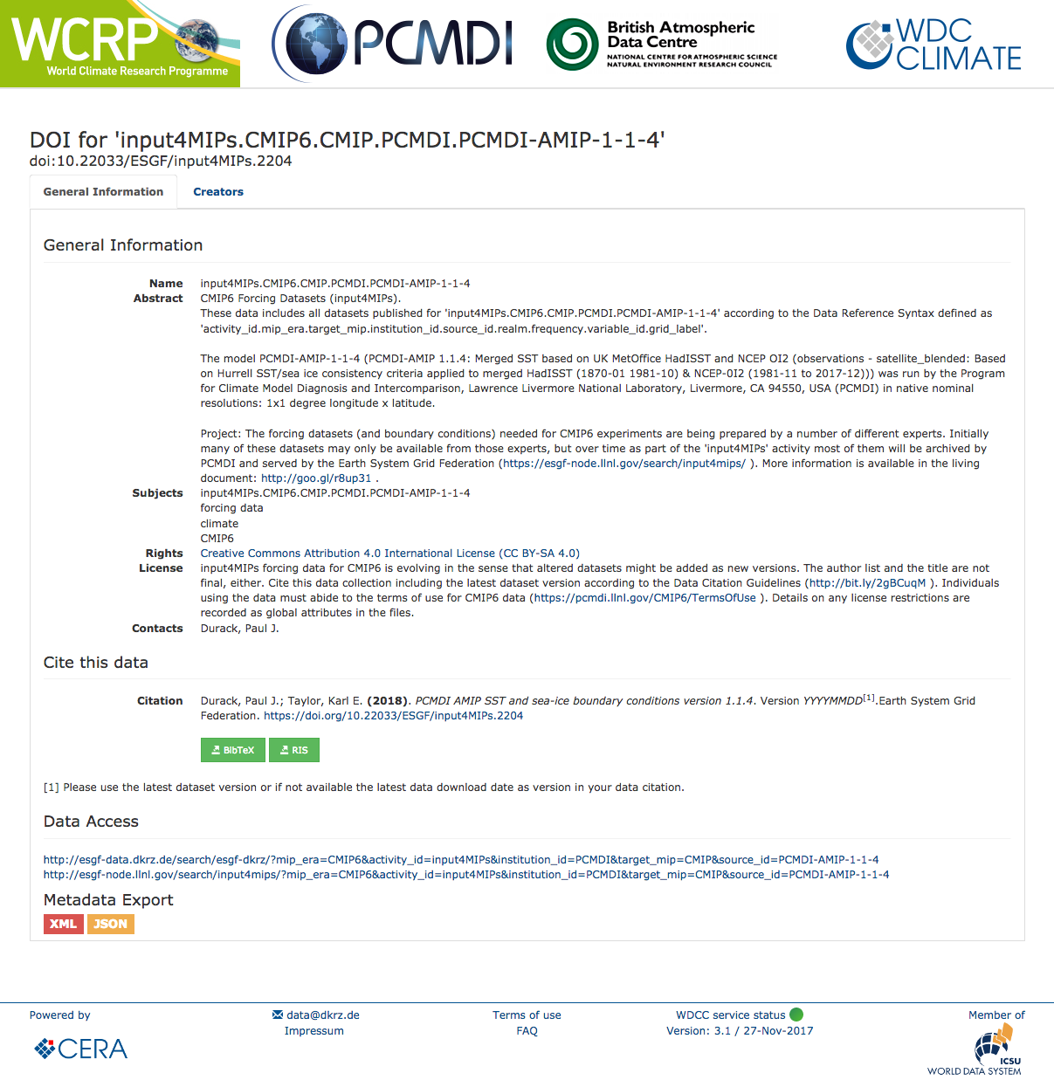
input4MIPs: current status
Project is replicated by DKRZ and IPSL (partial)
DKRZ data citation service/DOIs are now active
  Republication on 20th January 2018 improved this
Discussions underway to provide dataset collection version documentation to ES-DOCs to facilitate CMIP6 contributing modeling groups to correctly document the versions of datasets used (using input4MIPs data DOIs to accurately identify data/versions used)
input4MIPs planning meeting happening Sunday 9th December 2018 to start discussions of how to better organize and leverage infrastructure to improve data quality and flow

Slide 10
input4MIPs: Future plans
As CMIP moves towards the DECK “continuous release” paradigm updated forcing datasets are required
This will be challenging for current infrastructure configured for discrete mip_era entries (e.g. CMIP5, CMIP6, ..)
Require data contributors to align with CF standard names/variables (facilitating data evaluation)
New input4MIPs post-CMIP6 datasets are beginning to land
  Increment mip_era CMIP6 -> CMIP6-plus to allow identification of ”non-endorsed” datasets (SAOD/Volcano v4.0 dataset)
  Use input4MIPs as a “clearing house” to provide beta forcing dataset releases for use by modeling groups creating a feedback loop (CMIP6+ “continuous” DECK simulations)
  Provide quicker feedback on datasets so that when next mip_era/CMIP7 lands many of the issues encountered in CMIP6 don’t recur

Slide 11
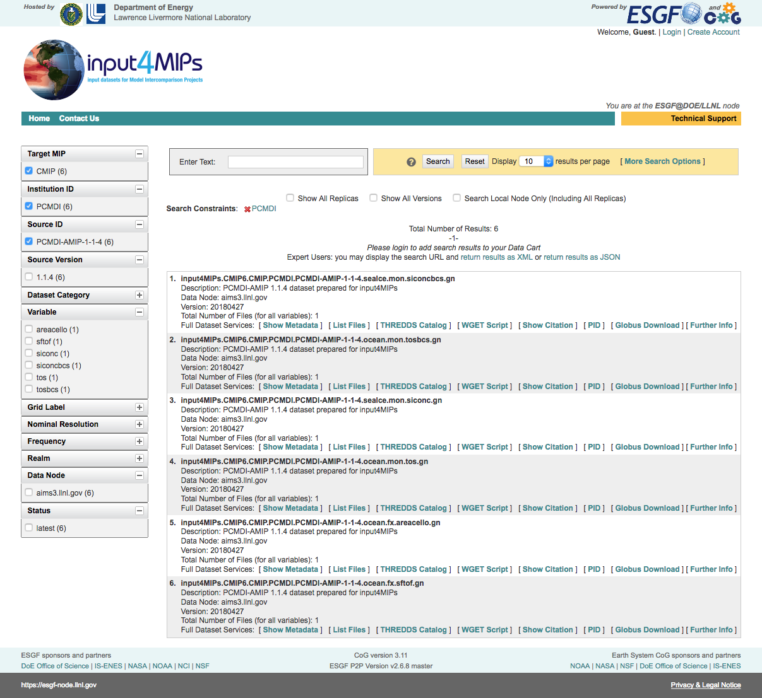
input4MIPs: ESGF wish list
Project communication is a key required improvement
User notification of new/updated/retracted datasets
Documentation of input4MIPs data issues
Descriptive documentation of data issues in deprecated earlier data (preservation of past data information)
Ability to monitor/report dataset downloads
Targeted communication of data errors to users who have downloaded specific dataset versions

Slide 13
Brief history
History/backstory
  20th Dec 2016
Dealing with what we got
Issues (republication)
  Complete republication of the input4MIPs archive to cleanup evolving metadata standards (22nd Jan 2018)
Engagement with citation and ES-DOCs services
Future plans
  Continuous release (how to keep this consistent with CMIPx?)
Wishlist
  Notification
  Communication of data issues

