Slide 1



ESGF Dashboard: data usage statistics on the Earth System Grid Federation
Alessandra Nuzzo
Maria Mirto
Paola Nassisi
Sandro Fiore
CMCC Advanced Scientific Computing Division
Giovanni Aloisio
Director of CMCC Supercomputing Center
December 5, 2018

Slide 2

Outline
The ESGF Dashboard context
The ESGF Dashboard in a nutshell
Architecture of the ESGF Dashboard
Progress Report 2018
CDNOT activities during 2018
Roadmap 2019
ESGF Dashboard User Interface: some pictures

Slide 3



The ESGF Dashboard context
Decentralized database
Tens of federated sites
More than 6 Petabytes
More than 100 projects
Over 900,000 datasets
How to get statistics from the sites?

Slide 4
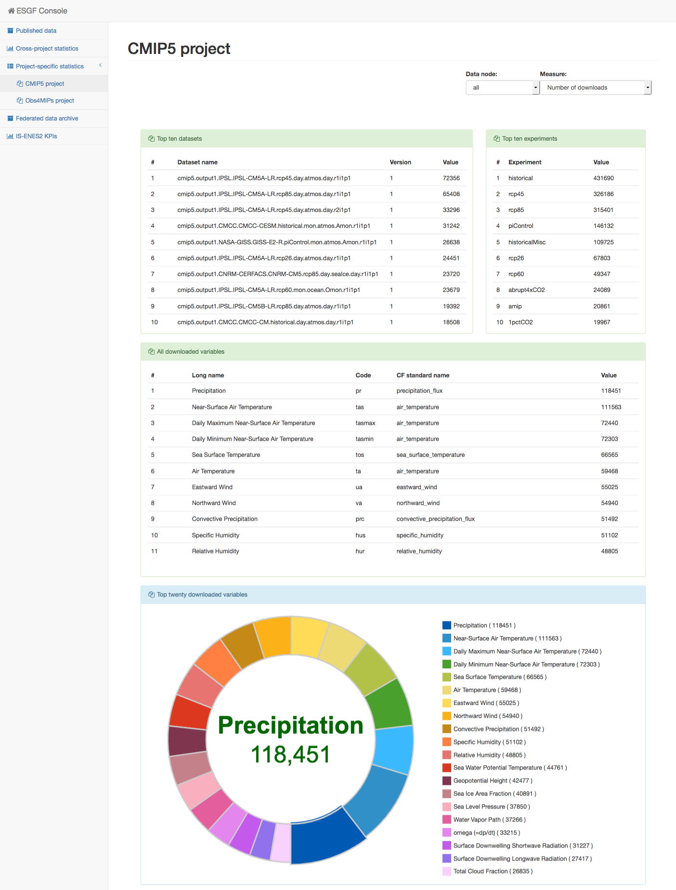
The ESGF Dashboard in a nutshell
esgf-dashboard
esgf-dashboard
On each node, the Dashboard collects and stores a high volume of heterogeneous metrics, covering aggregated cross-project and project-specific download statistics as well as the status of the federated archive in terms of published datasets, models and institutes involved.
esgf-stats-api
esgf-stats-api
Data node 1
Data node n
…
esgf-dashboard
esgf-dashboard
esgf-stats-api
esgf-stats-api
Data node 2
Data node 3
Dashboard UI
esgf-dashboard
esgf-stats-api
Collector node

Slide 5
Architecture of the ESGF Dashboard
The Dashboard engine, included into the ESGF software stack, can be configured to collect information at single site level or to gather statistics from other nodes.
The data nodes will be distributed in a hierarchical structure, some data nodes will act as leaf node and others will act as collector nodes.

Slide 6

Progress report 2018
Support for CMIP6 project statistics collection (more details in the next slide)
REST API service on CMCC collector node to provide federated statistics
Graphical restyling and new views/metrics for the dashboard user interface
Export CSV file from charts and tables
Documentation and configuration info for the ESGF Dashboard
Fixed installation on CentOS7

Slide 7
CDNOT activities during 2018
Starting from January 2018, the Dashboard team took part in the CDNOT activities, a sequence of data challenges with the aim of verifying the operational readiness of the federation and providing clear and well-exercised instructions for CMIP6 data providers.
Two releases of the software have been issued during the period:
The first one (included into the ESGF 2.6.8b-master release) to include a black-list feature to distinguish regular from replication downloads by excluding specific users, providing thus more accurate statistics on the data usage.
the latest one, released in the ESGF 2.8 master version few days ago, with the project-specific statistics on the CMIP6 project.
At the moment, the dashboard gathers cross-project statistics for CMIP6.
As soon as the production data nodes will be updated to the latest ESGF master release (2.8), the collector node at CMCC will gather and visualize a new section for the CMIP6 project.

Slide 8

Roadmap 2019
Collection of statistics coming from other download services (wget, GridFTP, etc.)
Discussion with Compute Working Team to integrate metrics about computation
Net statistics from PerfSONAR integration
New views related to Project-specific statistics (e.g. E3SM, CMIP3 and INPUT4MIPS projects)
This activity will be supported by IS-ENES3 as part of the core data services foreseen in the project

Slide 9
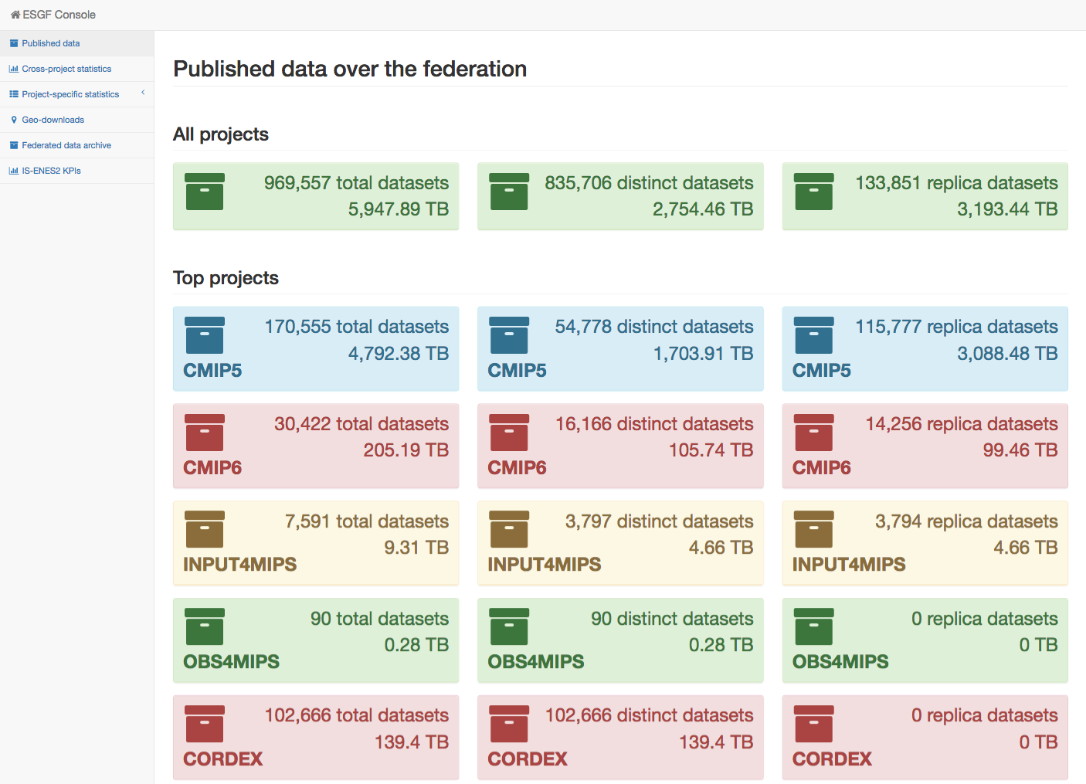
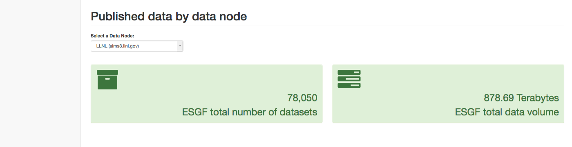
Dashboard UI
The ESGF Dashboard UI is deployed on the collector node at the CMCC Supercomputing Center and reachable at the link below.
http://esgf-ui.cmcc.it:8080/esgf-dashboard-ui/pages/index.html

Slide 10
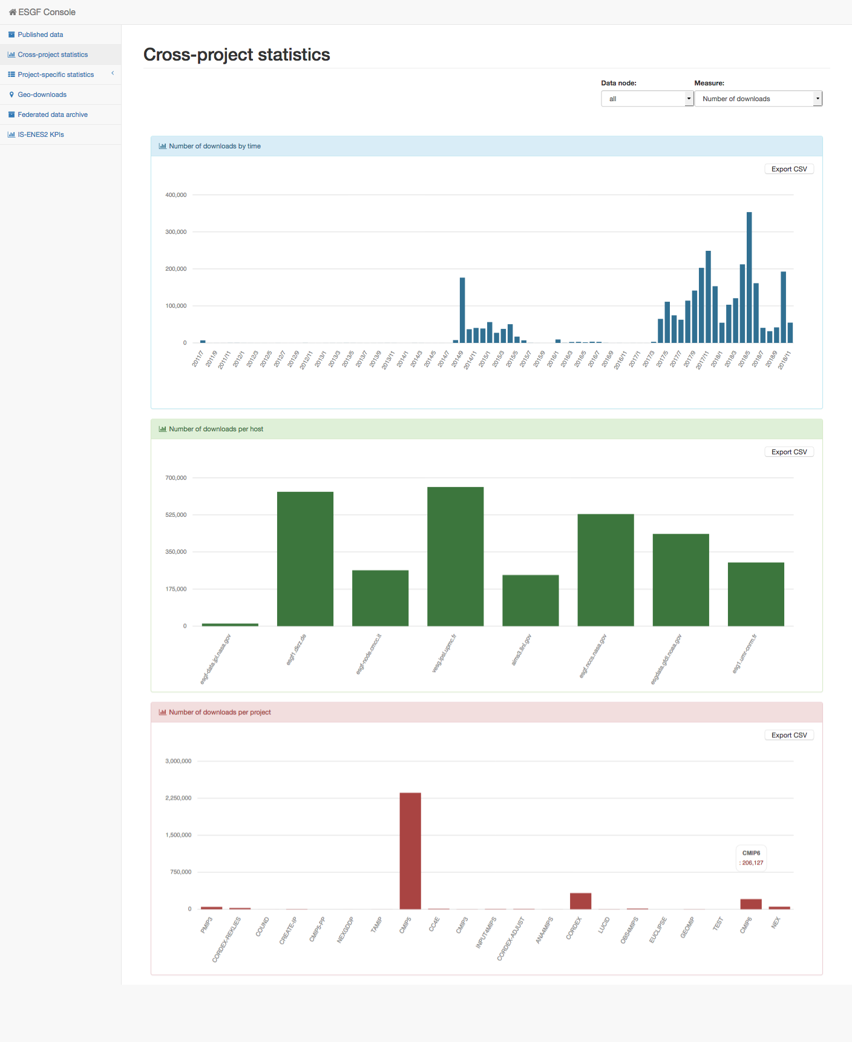
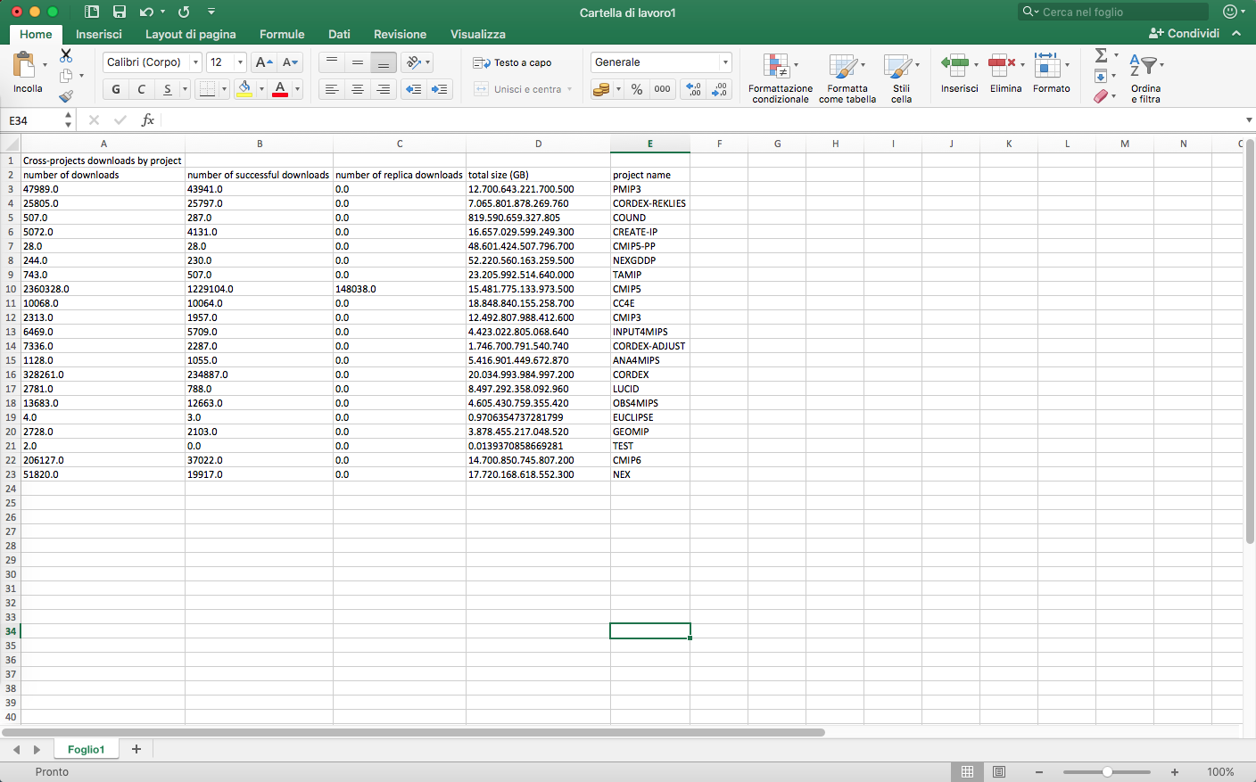
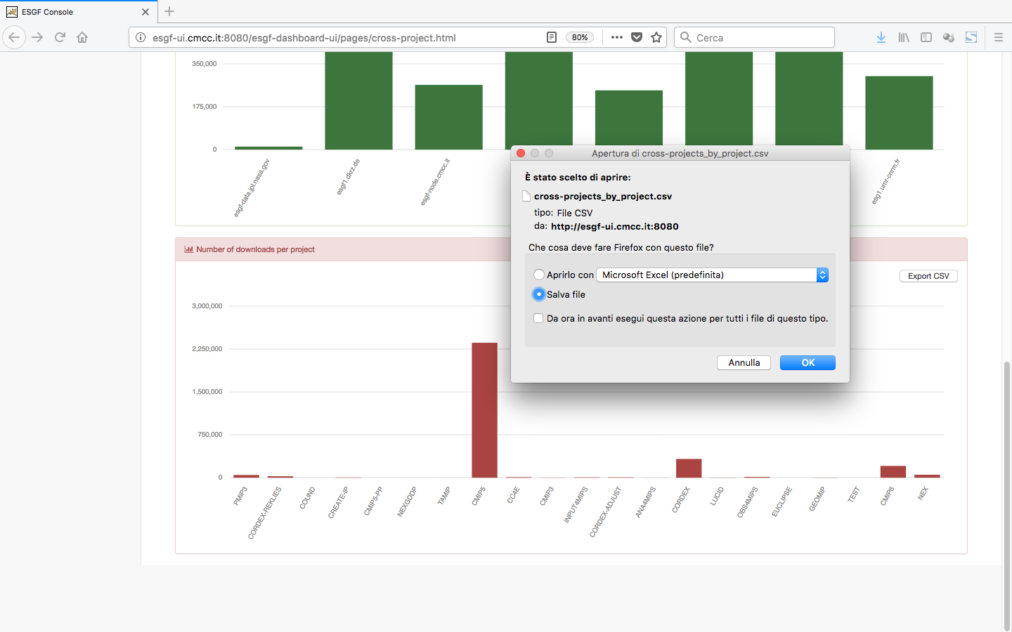
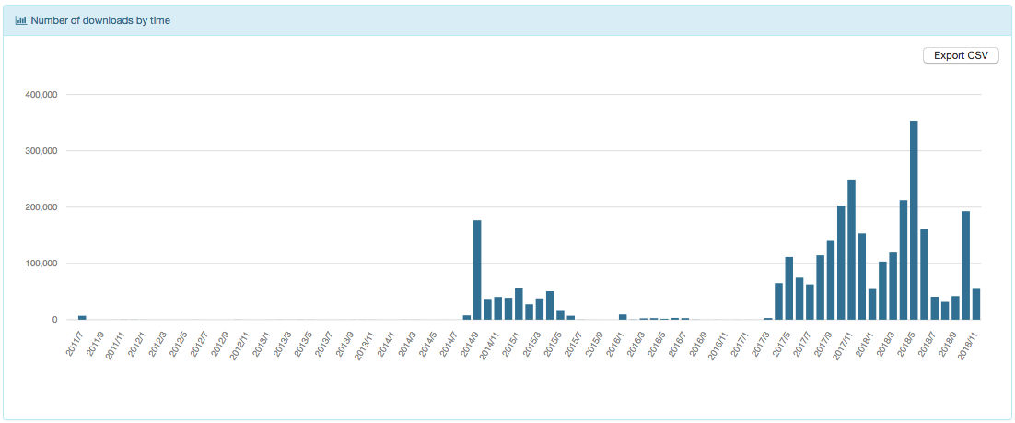
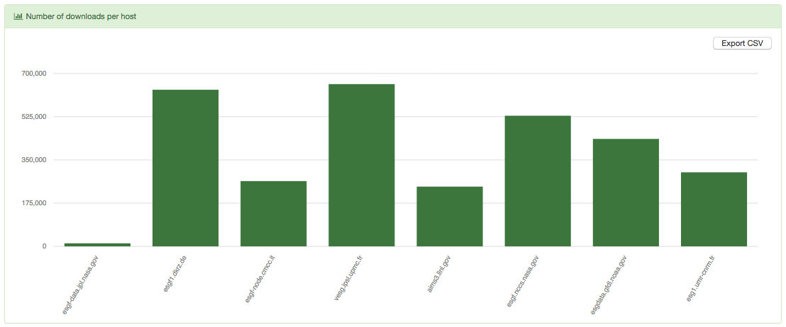
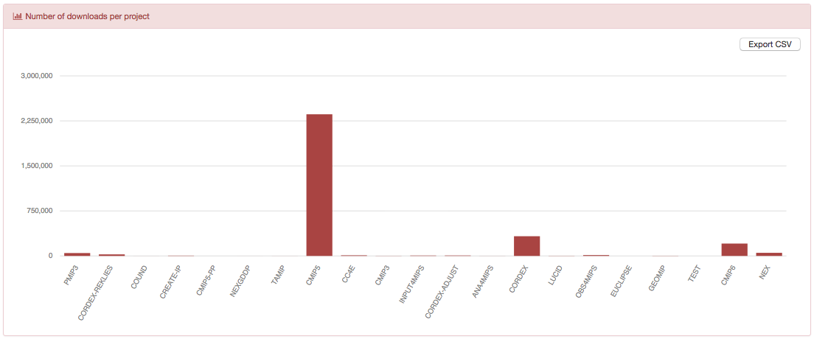
Dashboard UI –
Cross-project statistics
Data from:
CMCC
DKRZ
LLNL
CNRM
IPSL
NASA/JPL
GFDL/NOAA

Slide 11
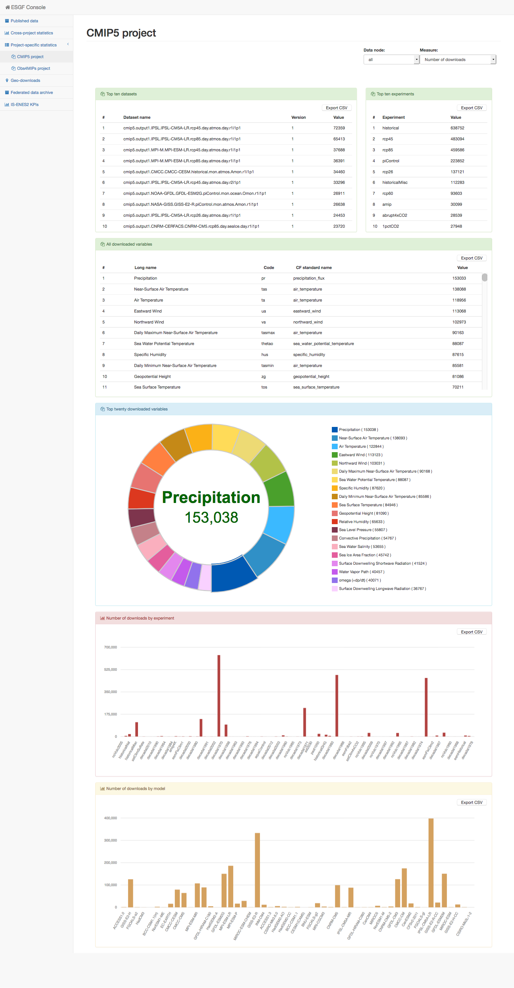
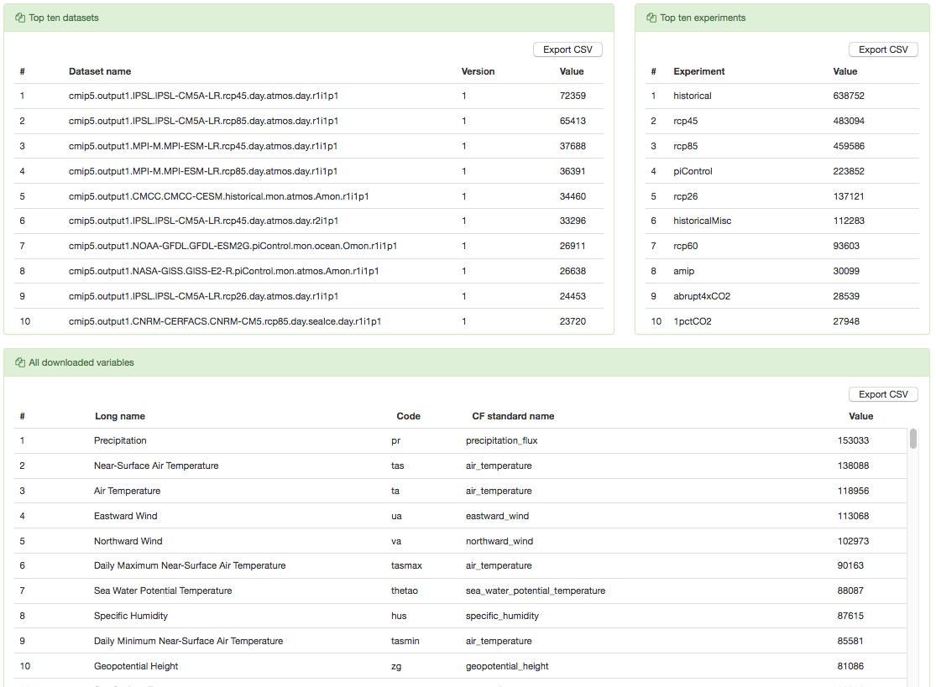
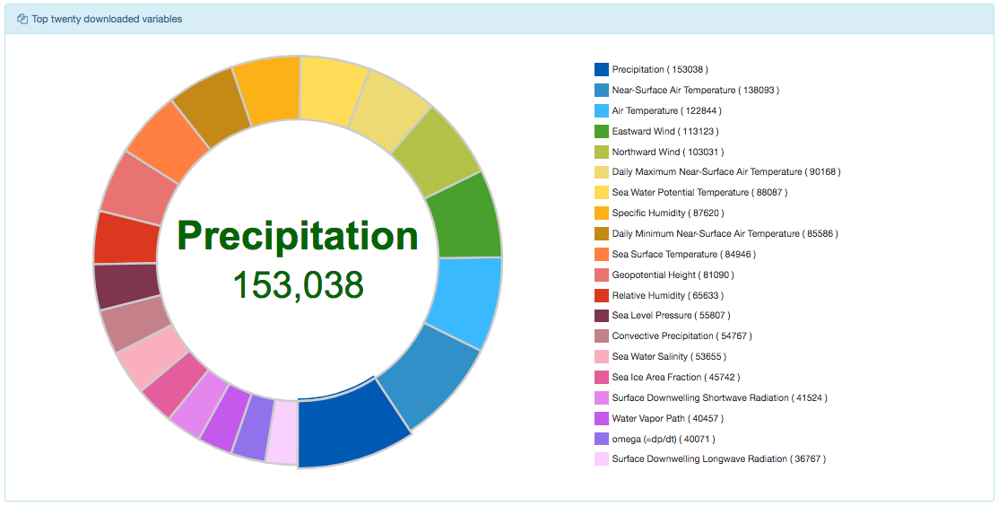
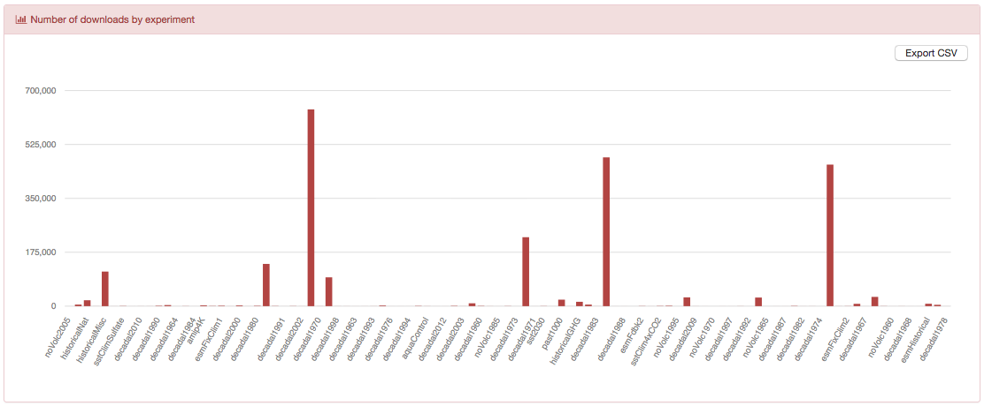
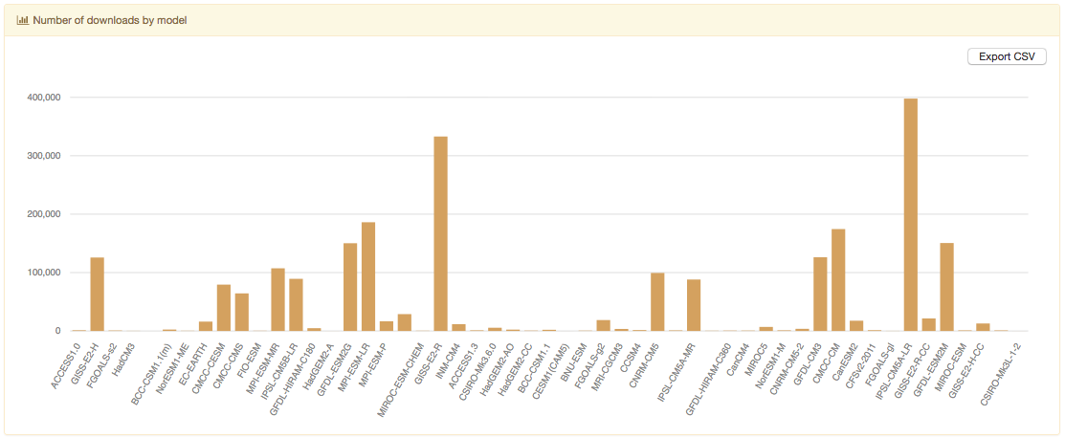
Dashboard UI – CMIP5
Project-specific statistics

Slide 12
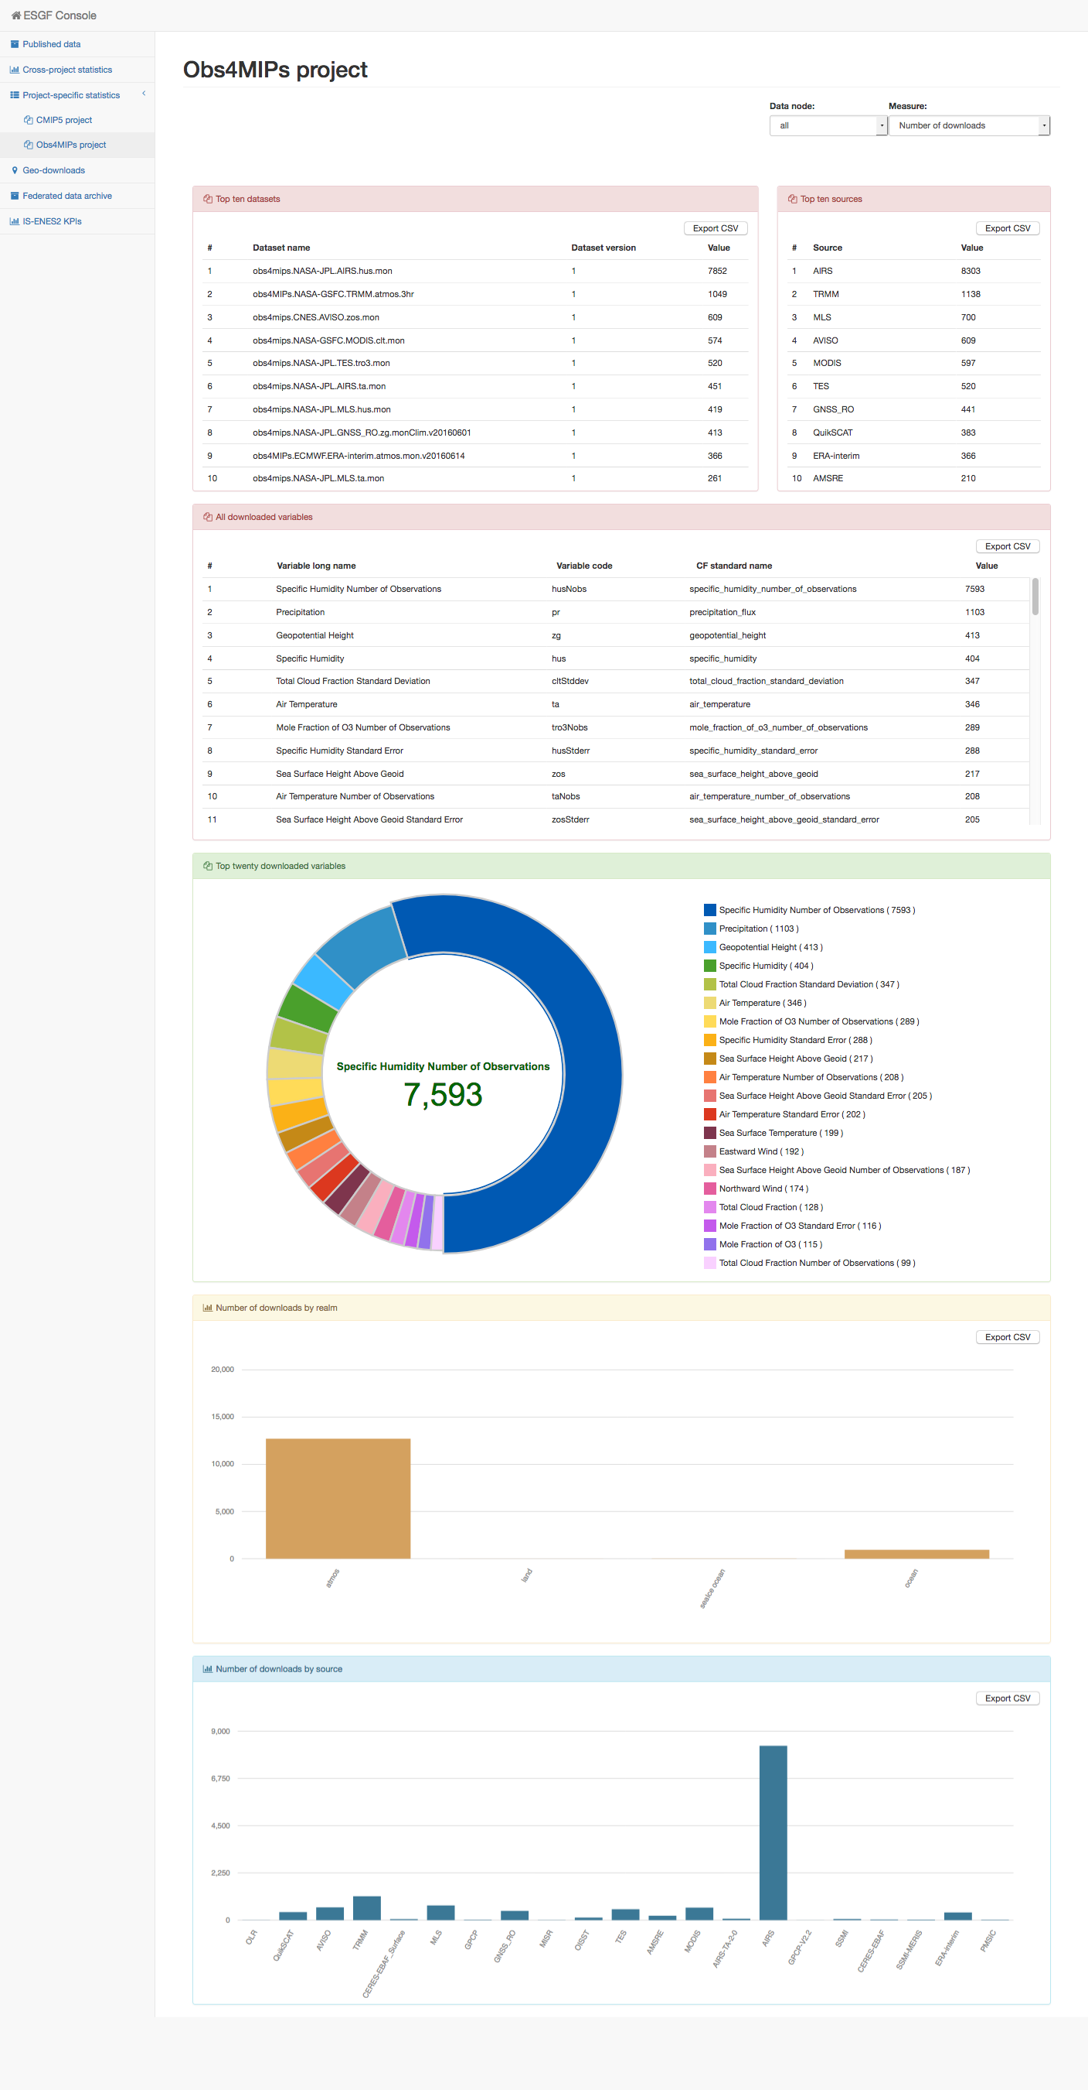
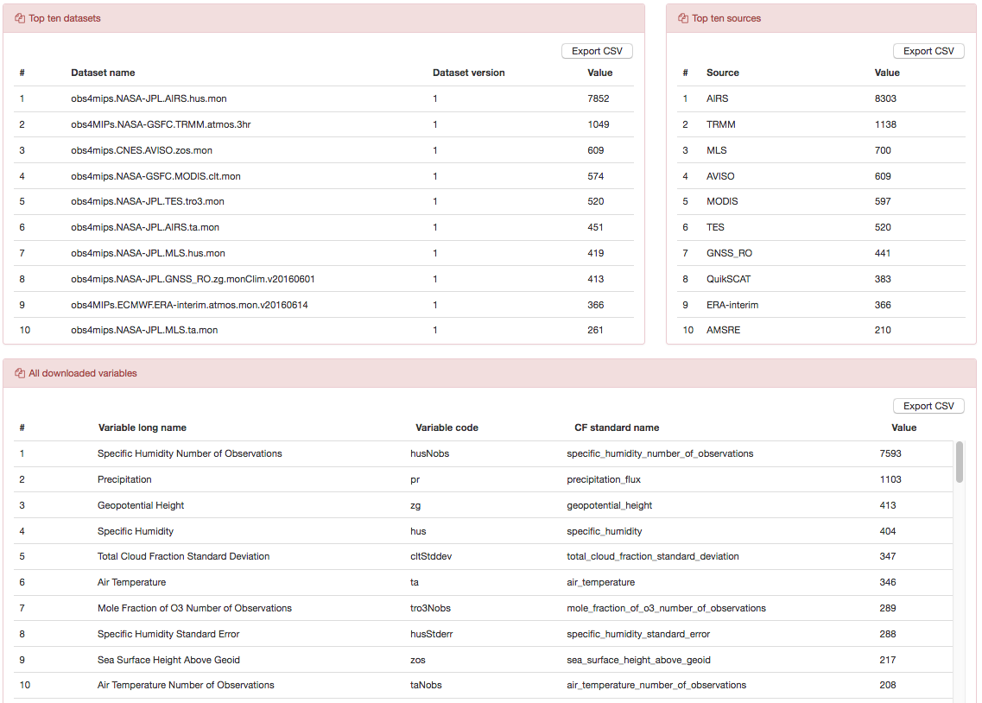
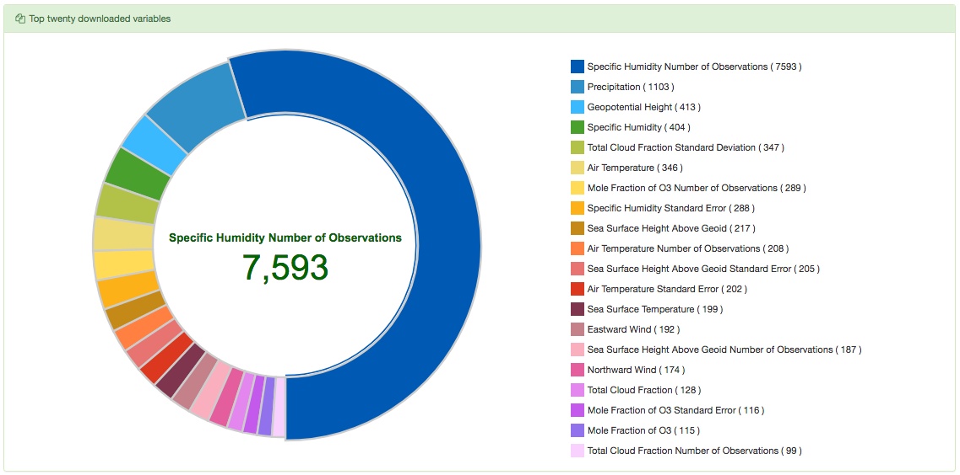
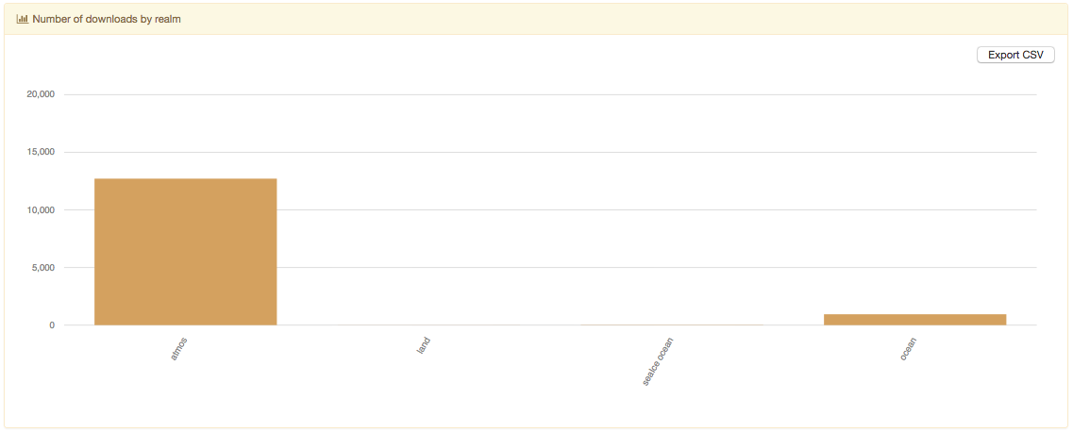
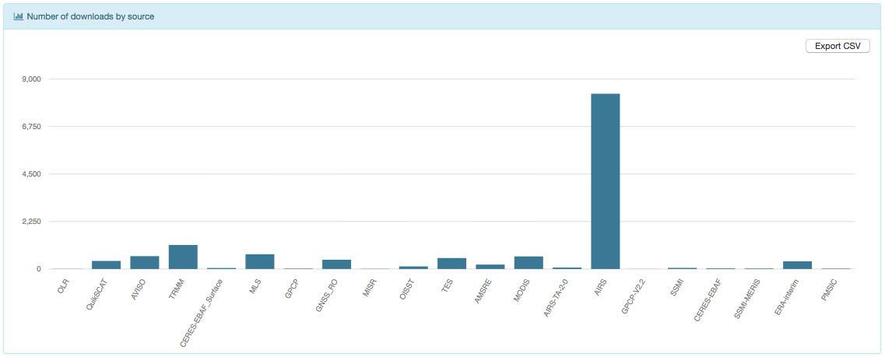
Dashboard UI –
Obs4MIPs
Project-specific statistics

Slide 13
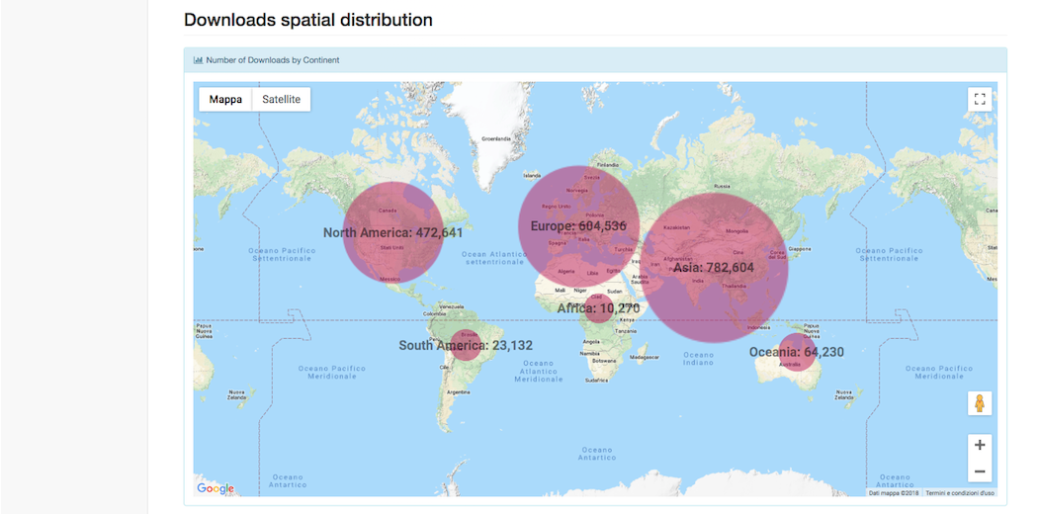
Dashboard UI – Geo-Downloads
Distribution of the downloads’ numbers per continents

Slide 14
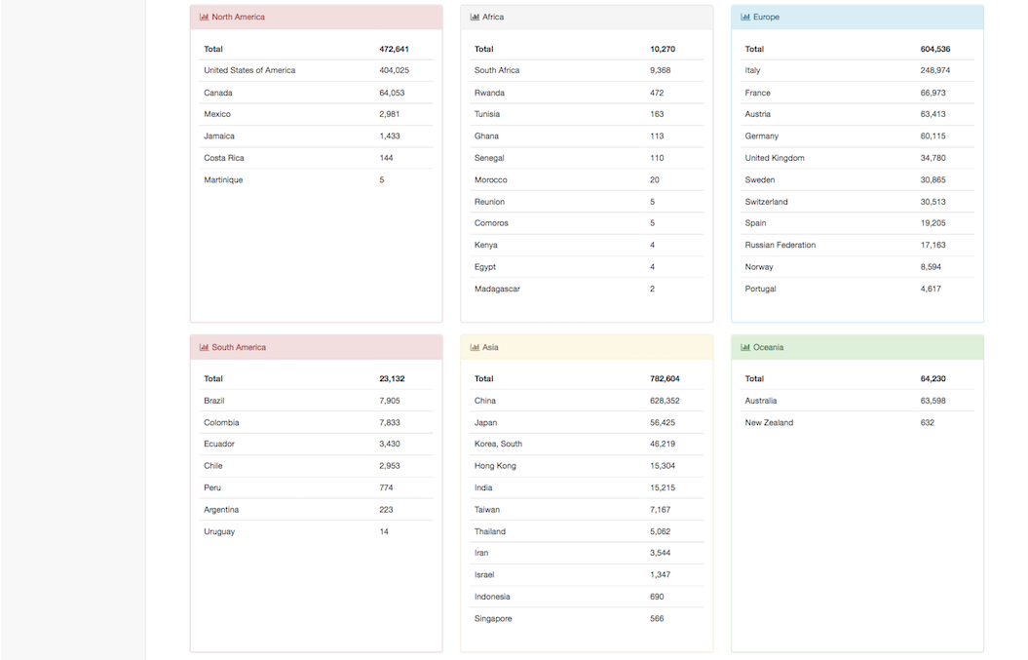
Dashboard UI – Geo-Downloads
Distribution of the downloads’ numbers per countries

Slide 15
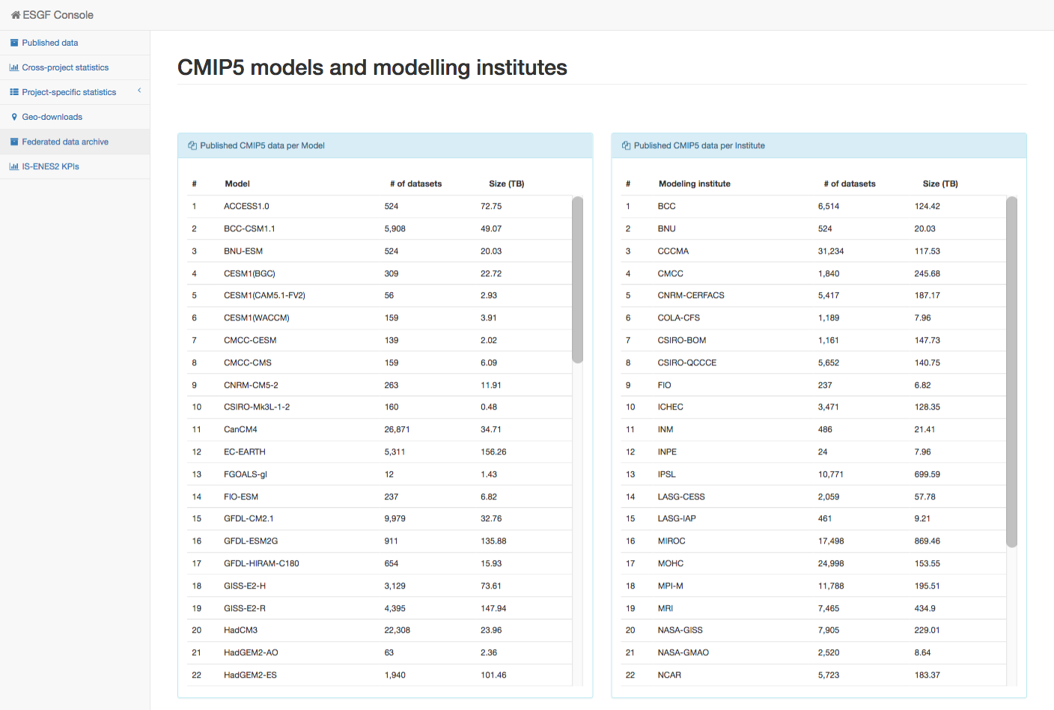
Dashboard UI – Federated data archive

Slide 16

Documentation and useful links
Node Manager documentation under review
Confluence section: https://acme-climate.atlassian.net/wiki/spaces/ESGF/pages/3998259
Validate the dashboard working: https://acme-climate.atlassian.net/wiki/spaces/ESGF/pages/898171111/ESGF+Dashboard+validation
Configure the esgf-dashboard to exclude Synda downloads: https://acme-climate.atlassian.net/wiki/spaces/ESGF/pages/109380158/Configure+the+esgf-dashboard+to+exclude+Synda+downloads
Github: https://github.com/ESGF/esgf-dashboard & https://github.com/ESGF/esgf-stats-api

Slide 17
Thanks!
http://esgf-ui.cmcc.it:8080/esgf-dashboard-ui/pages/index.html

