Slide 1
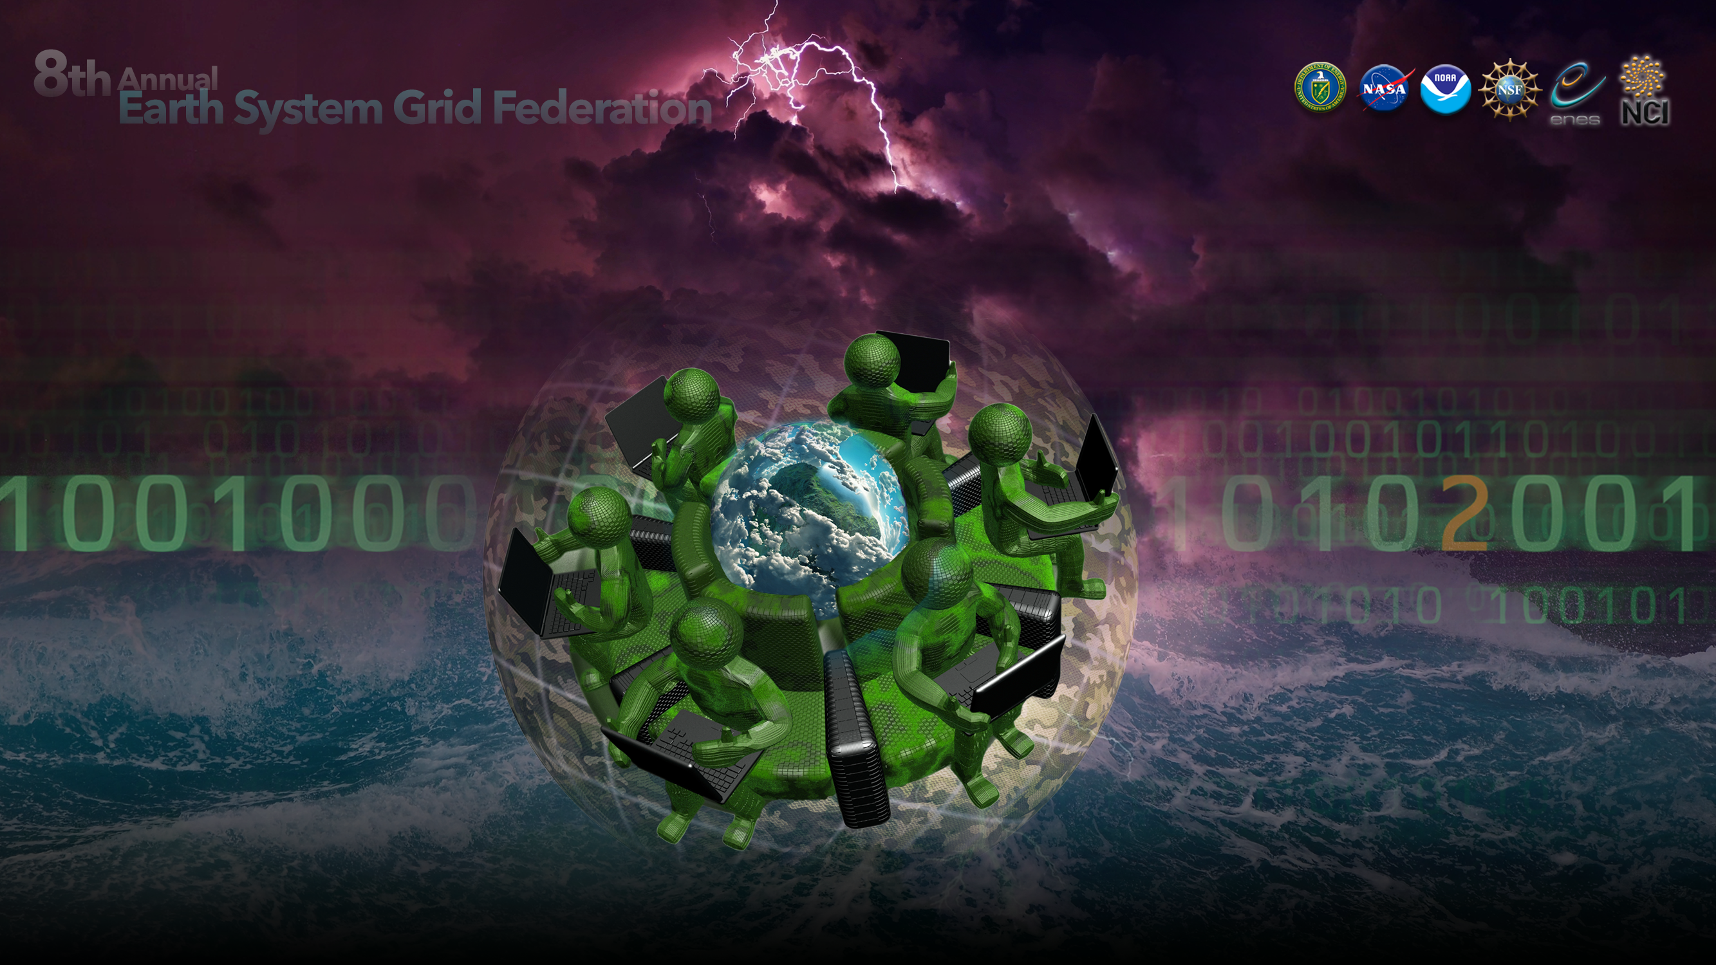
C4I: Leveraging and Easing End Users' CMIP6 Access by Interfacing Infrastructures
Christian Pagé
CERFACS, Climate Research Engineer & Project Manager
December 4-7, 2018

Slide 2
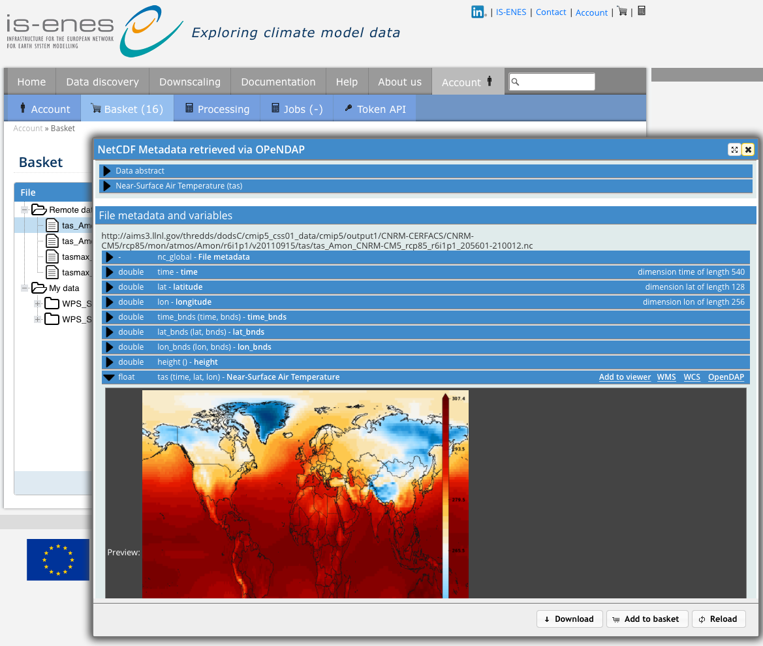
IS-ENES C4I: Easier & Tailored UI to access ESGF datasets
https://climate4impact.eu
Platform for researchers to explore climate data and perform analysis
Not only UI, but also Standard Services (WPS, WCS, ...)
Connects to ESGF web services
Tailored for end-users
Supports on-demand data processing and statistical downscaling
Now containerized version
docker & docker-compose
Compatible with CMIP6, Cordex, etc.
Much closer collaboration with birdhouse WPS framework

Slide 3
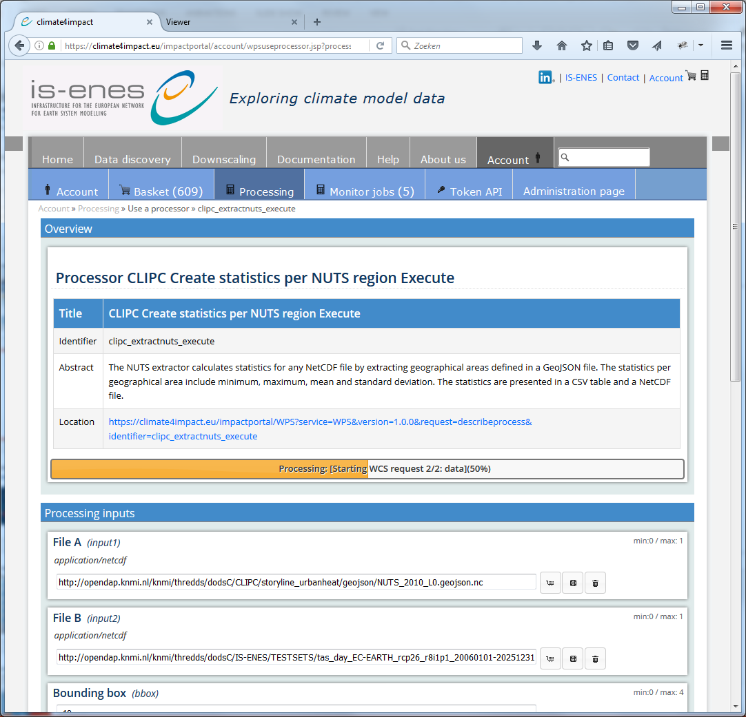
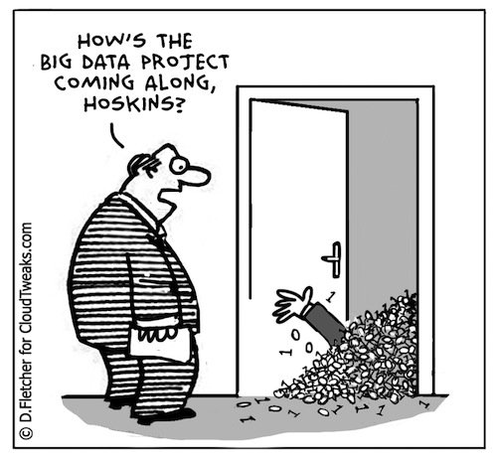
IS-ENES C4I: On-demand Data Processing
PyWPS to perform calculations / Process data
ICCLIM python climate indices calculation, data reduction
Personal store for processing outcomes
Backend for other portals (CLIPC)
But: Where should data be processed???
Currently on the C4I server itself... should be avoided
Bring computing to the data.... delegation...!
title
identifier
abstract
value
basket
preview
delete

Slide 4
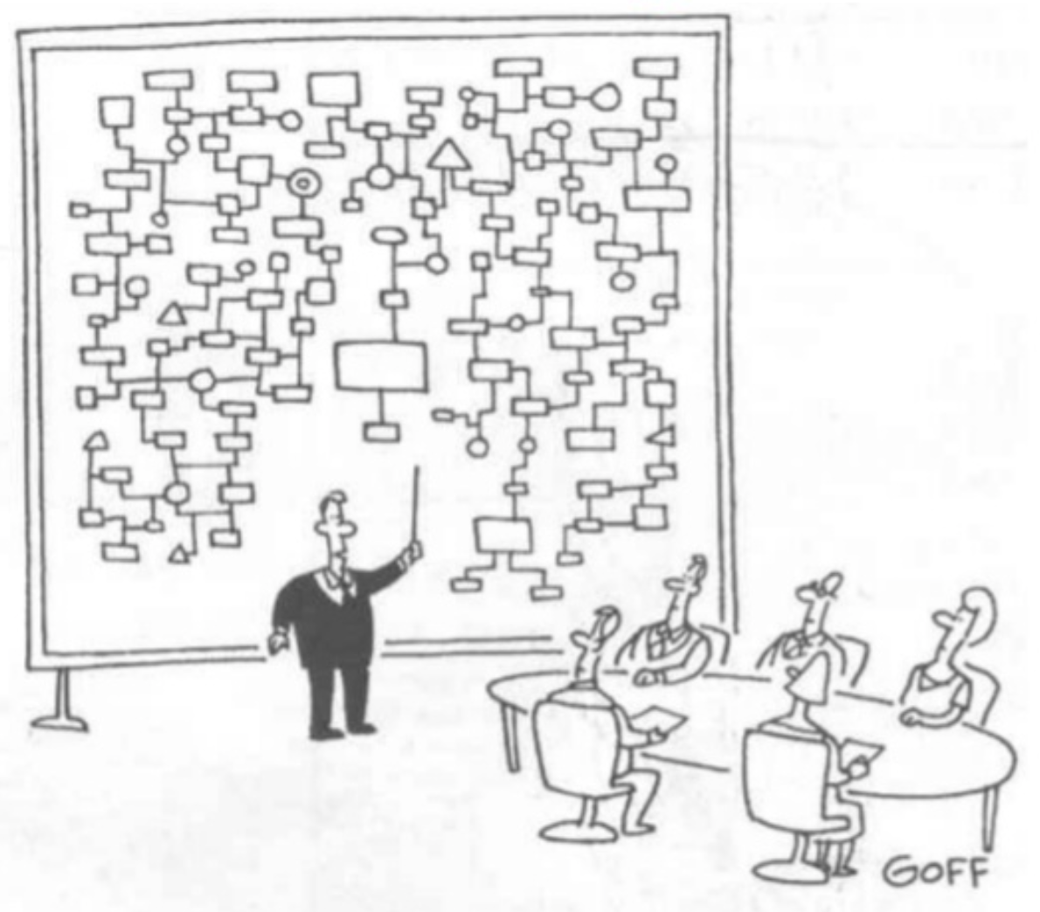
IS-ENES C4I Possible Backends...
Domain and RI specific like ESGF CWT
Most obvious choice: as close to the data as possible
Many processing backends will be available
Generic e-infrastructures providing a portfolio of Services for "any" researcher/user
EUDAT CDI: Common Data Infrastructure
DKRZ & CERFACS: Thematic Level 2
EOSC: European Open Science Cloud (EUDAT/EGI)
DARE: Delivering Agile Research Excellence on European E-Infrastructures
ALL?!

Slide 5
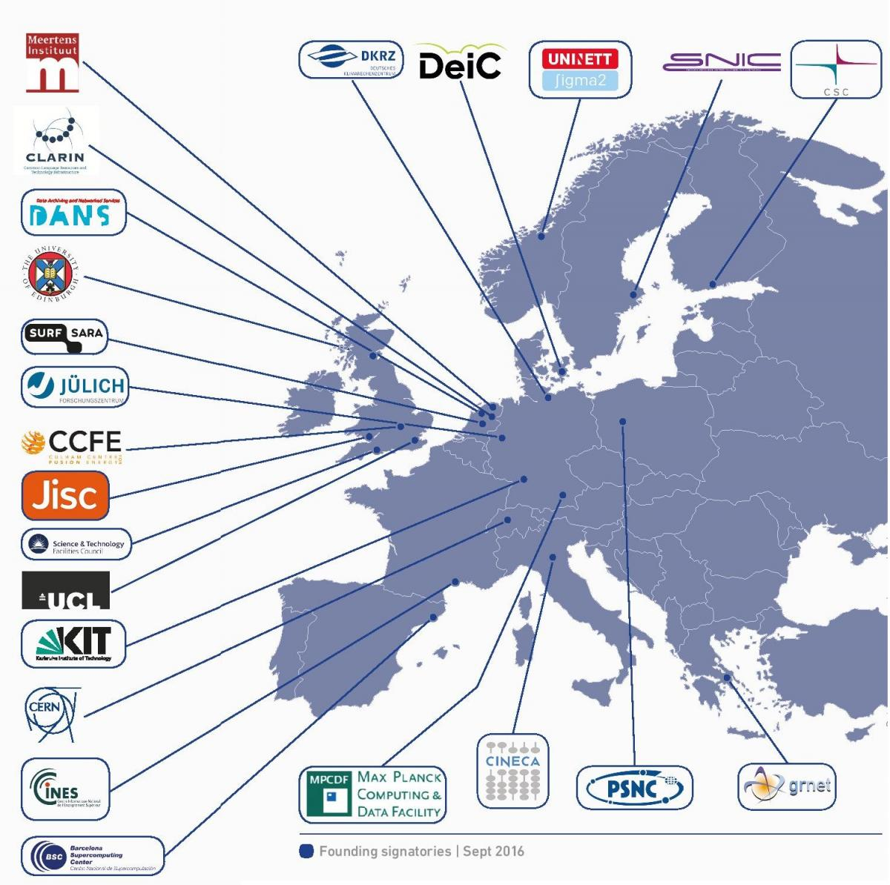
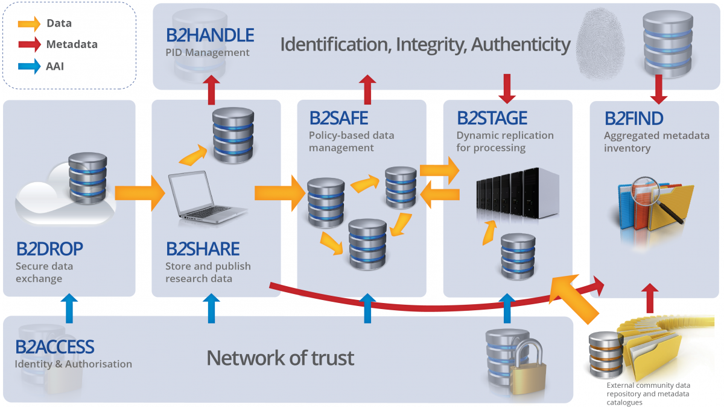
European Landscape & Components EUDAT CDI

Slide 6
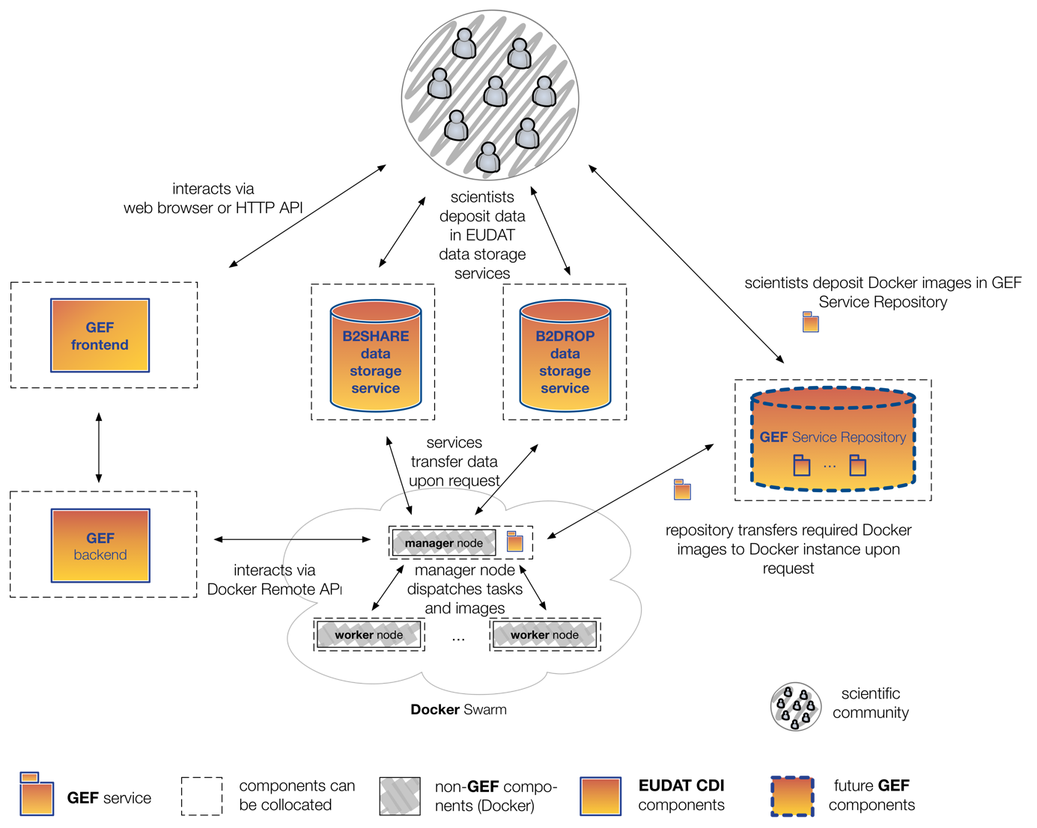
EUDAT2020 GEF
GEF in a nutshell
Written in google's go language
Container-based Solution: currently Docker
Interfaces to B2* Generic Services
Trusted and Community-validated Dockerfiles
Using Docker Swarm (considering kubernetes)
Generic API acting as an Abstracting Layer
Front-End and Back-End

Slide 7
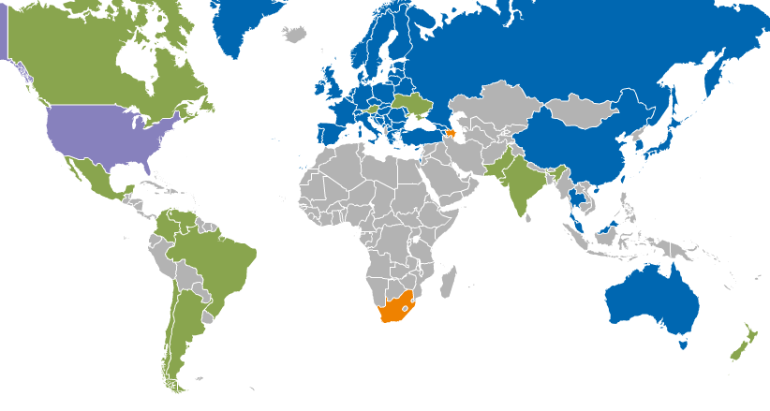
European Landscape & Components EGI
Registered Users: 21714 VOs: 233
LCPUs: 470,000 Disk: 143PB Tape: 138PB
Jobs: 1.62 million/day
Integrated EGI-InSPIRE Partners and EGI Council Members
External Resource Providers (integrated)
Internal/External Resource Providers (being integrated)
Peer Resource Providers
Computing Power (FedCloud) resources

Slide 8
More e-infrastructures: EOSC
The European Open Science Cloud (EOSC)
Virtual environment
Open and seamless services for storage, management, analysis and re-use of research data, across borders and scientific disciplines
Federating existing scientific data infrastructures
Open Data Science Environment
Federates existing scientific data infrastructures

Slide 9
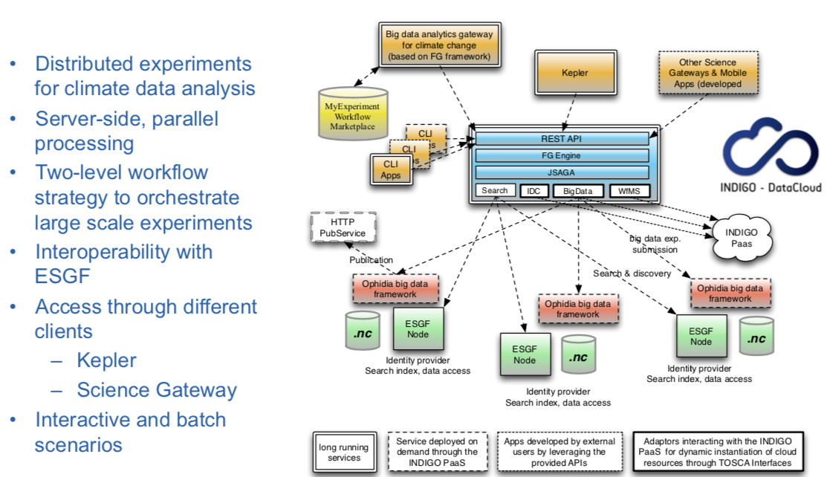
INDIGO-DataCloud Architectural Solution
Credits Sandro Fiore

Slide 10
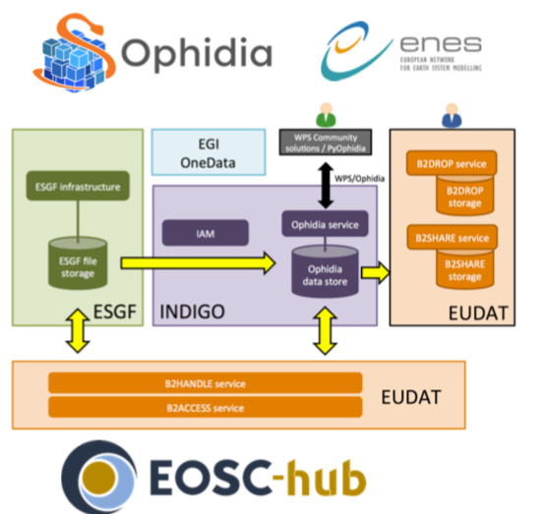
EOSC-Hub: ENES Climate Analytics Service (ECAS)
Credits Sandro Fiore
Credits Sandro Fiore

Slide 11
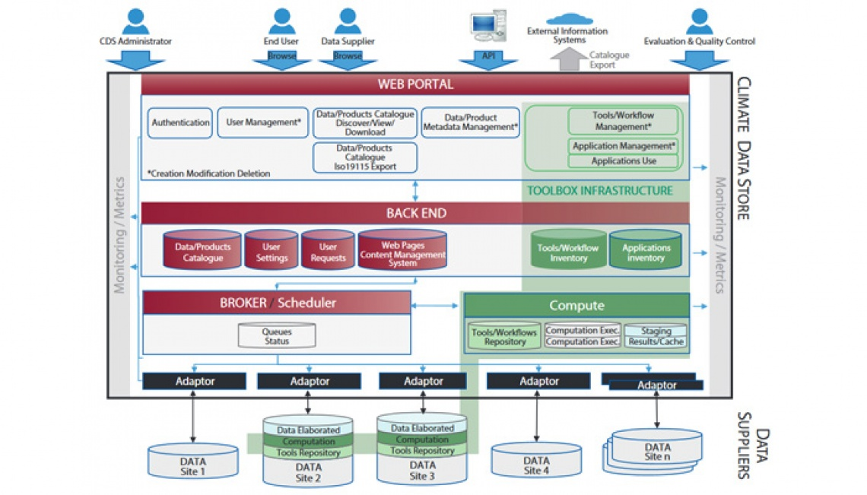
Copernicus C3S Operational Platform Architecture
Credits Sandro Fiore

Slide 12
Infrastructure Integration
Objective: C4I Delegates selected processing/storage to EUDAT B2 Services
IS-ENES (FP7+H2020)
20+ partners
EUDAT CDI
20+ partners
Infrastructure for the European Network of Earth System Modelling
Access to large climate datasets for climate impact researchers C4I
http://climate4impact.eu/
Collaborative Pan-European Data infrastructure
Developing Generic Execution Framework: Providing data processing on EGI Federated Cloud using EUDAT B2 Services
Objective: C4I Delegates selected processing to future ESGF Computing Nodes
Objective: C4I backend for on-demand calculations: icclim
DARE (H2020)
9 partners
ESGF-CWT
Compute Working Team
Delivering Agile Research Excellence
Computing Platform
Container-based with automated provenance
dispel4py workflows, Exareme high-parallel computing
Worldwide (mainly US-Europe) Collaboration on Data Processing of climate data near data storage
Design of API and Implementation of Processing Capabilities for ESGF

Slide 13
Backends' Requirements
Metadata Standards & Semantic
Provenance/Lineage
Integrated AAI (Authentication&Authorization)
Services Standardization
Dynamic Catalogs
Resource Scheduling, Orchestration, Pipelining/Streaming, Data Locality
Generic Layers APIs

Slide 14
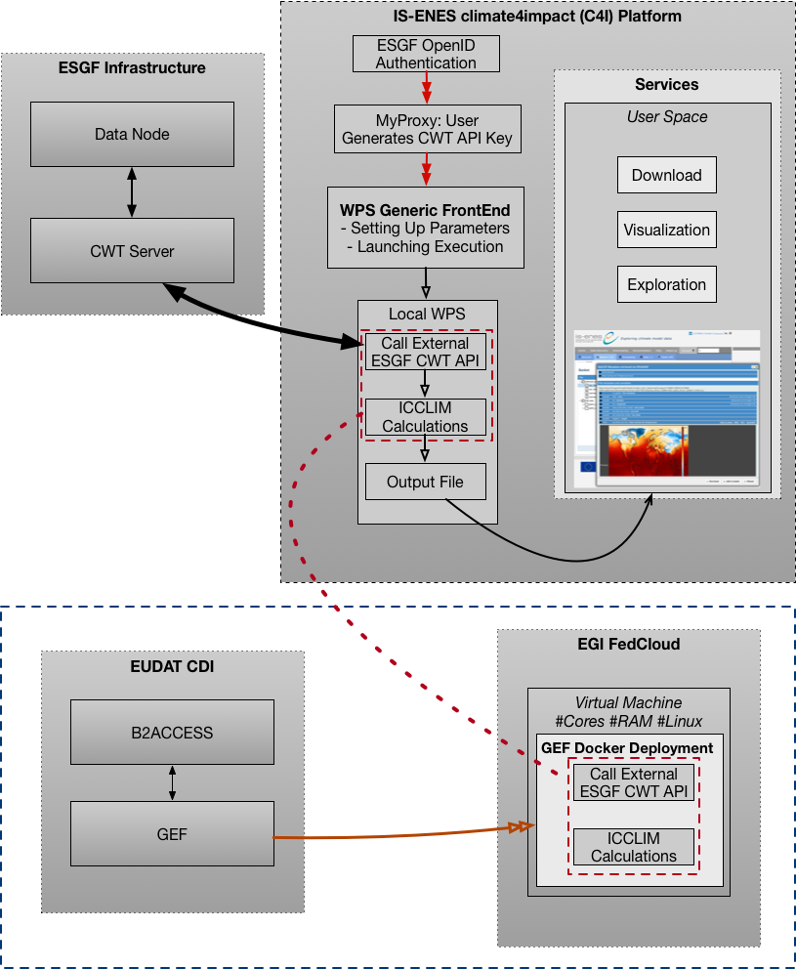
EUDAT2020 Integration Prototype
IS-ENES CDI C4I as UI
Transparent and Seamless to the User
Main authentication with ESGF OpenID-Connect (OAuth2)
GEF Deployment on EGI FedCloud Resources
Specific Dockerfile used to deploy the GEF Backend
EUDAT B2ACCESS Authentication
Hosted on an EGI VM pre-launched on a specific EndPoint with specific Linux Dist., # Cores and qt. RAM
ssh-Copying Certificates and CWT-API-Key into the Container inside the VM
Results send back to C4I using B2* storage

Slide 15
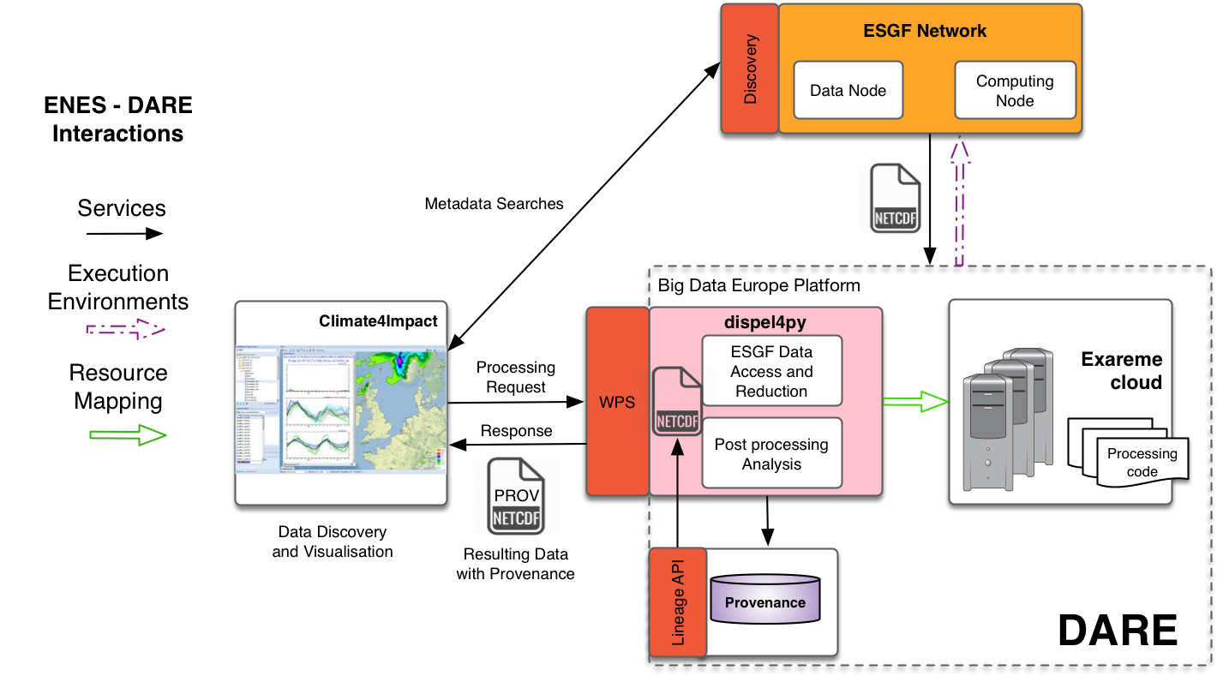
DARE Integration Prototype
IS-ENES CDI C4I as UI
DARE Platform
dispel4py (VERCE project) as workflow manager
Processing Elements (PEs): icclim backend for the climate domain Pilot
Automated Provenance Generation
Automated Parallelization with Automated Resources Discovery
Possible Exareme automated HPC distributed calculation using DataCubes
Evaluation of using GEF as an Abstracting Layer

Slide 16
Open Questions
Several European platforms will be available: C3S-DIAS, EOSC, ESGF Data/Computing Nodes, IS-ENES CDI & ECAS, EUDAT CDI, EGI, DARE, National Platforms, etc.
How do we ensure that we do not have duplicate efforts (too much)?
Which kind of users do they each address? How users will know which one to use? The ones they can access? With what kind of resources limitations?
How do we "educate" different kind of users for wide adoption and usage of those platforms?
How can they be interoperable? APIs, AAIs, ...
How to ensure that they make available promptly new datasets
Will they be scalable enough?

Slide 17
Open Questions
How do we deal with non-mature services, changing APIs?
On-demand remote data processing and data sharing is really needed
Containerized solutions: distributed processing, orchestration, AAIs...
What about Data Locality (Distributed Input Data)?
Metadata Aspects and Reproducibility for the DLC: metadata mappings, full provenance and lineage information, PIDs

Slide 18
Questions! ☺
Christian Pagé, CERFACS
christian.page@cerfacs.fr

