Slide 1
NCI Experience with ESGF for CMIP6
Kate Snow, Clare Richards, Ben Evans, Chris Allen, Matt Nethery
Dec 5th, 2018
LLNL-PRES-XXXXXX
This work was performed under the auspices of the U.S. Department of Energy by Lawrence Livermore National Laboratory under contract DE-AC52-07NA27344. Lawrence Livermore National Security, LLC

Slide 2
Current Focus
NCI’s 2018 focus has been on:
1. Re-replication of an official CMIP5 replica dataset
2. Replication of priority CMIP6 variables
3. Publication of Australian CMIP5 data to the new NCI ESGF node
4. Re-publication of the replicated CMIP5/6 Data
Assessment of performance issues and possible improvements.
Variables are the priority Australian climate community requirements.
The new NCI ESGF node deployment incorporated a local deployment procedure to ensure resilience and ease of updates.
To be progressed in the near future.

Slide 3
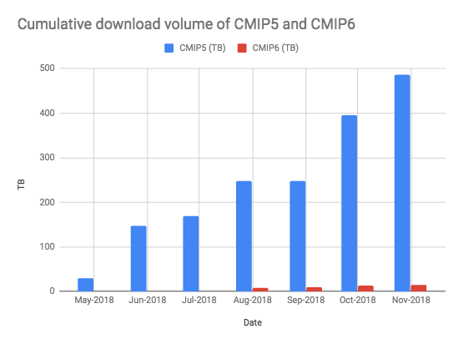
CMIP5 Replication Status
NCI has re-replicated priority variables of CMIP5 using Synda
Currently have ~500TB of CMIP5 replicas.
Operational lessons (re)learnt:
Re-published data replicas can have different versions/checksums (some no checksums).
Synda config using custom directory path not consistent with default.
Performance issues from some nodes (mostly 2nd Tier).
Some ongoing error for files downloading.
Started CMIP5 Replication May 2018
Experienced some operational issues along the way
Complete downloading 500TB at ~5TB/day
Notes:
NCI aimed to re-replicated the CMIP5 data we hosted in order to permit improved maintenance and assurance of the ‘official’ dataset
We experienced some learning curves with Synda as we went along which led to some ‘steps’ in our progress (RHS plot). Some issues we saw:
Re-published data replicas can have different versions: We are required to download originals only in most cases, can lead to slow throughput from particular nodes.
Synda config using custom directory path: there is not consistent in how the custom paths translate to the default paths (like “treevar”). If change between them need to manually update the db to account for the change (or alternatively redownload.).
Files published with the no checksum yet replication succeeds (might be good to have at least a warning message for these files?).
Performance issues with some nodes, can see that more clearly in later slides.
We now have about 500TB, 5TB/day - but rate has been highly variable.

Slide 4
CMIP5 Re-publication Status
CMIP5 publication of Australian data to the new node is underway.
Some operational issues have been identified (on slack channels).
E.g., CMIP5 publication of multiple versions of same dataset leads to issues with ESGF-THREDDS publication of the variables
Next step is to try republishing the CMIP6 replicas, and then we will return to republish the CMIP5 replicas we have just downloaded
Currently we follow a manual process for the (re)publication of datasets.
Hope to look into automating this in the future.
Notes:
Currently NCI is still undertaking the steps to publish the Australian CMIP5 data to the new node. There have been a few operational issues along the way that have caused delays. An example issue, that is already under discussion on the slack channels, is how the CMIP5 publications deal with multiple versions of the same dataset as it publishes to THREDDS. In that case the published variables is incorrect for the older versions and the only way to alleviate this was to use the not-recommended combination publication option or to publish each version one at a time. Also causes issues when new versions become available.

Slide 5
CMIP6 Replication Status
Downloading priority variables as defined by the needs of the Australian climate science community.
Currently 16TB and 909 datasets.
Priority 1 | Priority 2
Variables: 45 Monthly, 11 Daily, 1 6hr, 4 3hr, 4 fx | Variables: 32 Monthly, 5 Daily, 5 6hrly, 10 3hrly, 1 fx
Experiments: piControl, ssp585, ssp245, historical | Experiments: 1pctCO2, amip, abrupt-4xCO2, ssp126
Notes:
We began replicated CMIP6 data in August and are only downloading priority variables as defined by the user community.
The priority variables focus on the current key research areas for Australian climate scientists at the moment, such as extremes, and encompass the key DECK and ScenarioMIP experiments.

Slide 6
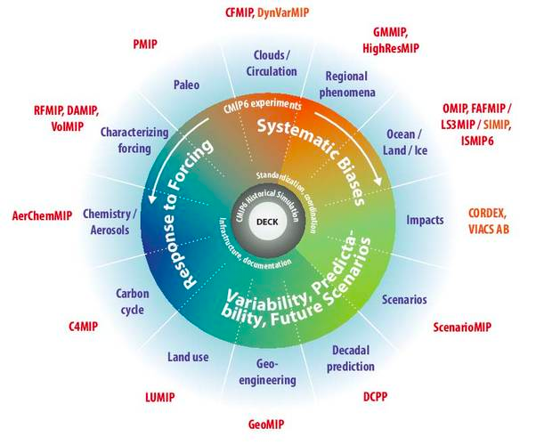
CMIP6 Publication Status
Currently have 2 Australian Models registered for CMIP6 publication
ACCESS-CM2
DECK, historical, OMIP, FAFMIP, RFMIP, ScenarioMIP
ACCESS-ESM1-5
DECK, historical, C4MIP, CDRMIP, RFMIP, ScenarioMIP
Publication timeline: Beginning Q1 2019.
Image Source: https://www.knmi.nl/kennis-en-datacentrum/project/cmip6 and adapted from Eyring et al., 2016.
Notes:
While only the two key ACCESS models are currently registered other models may be subsequently developed after these are released, as well as contributions to other MIPs, for example we have a strong CORDEX community.
We expect the publication of the first set of Australian CMIP6 data to begin in Q1 2019.

Slide 7
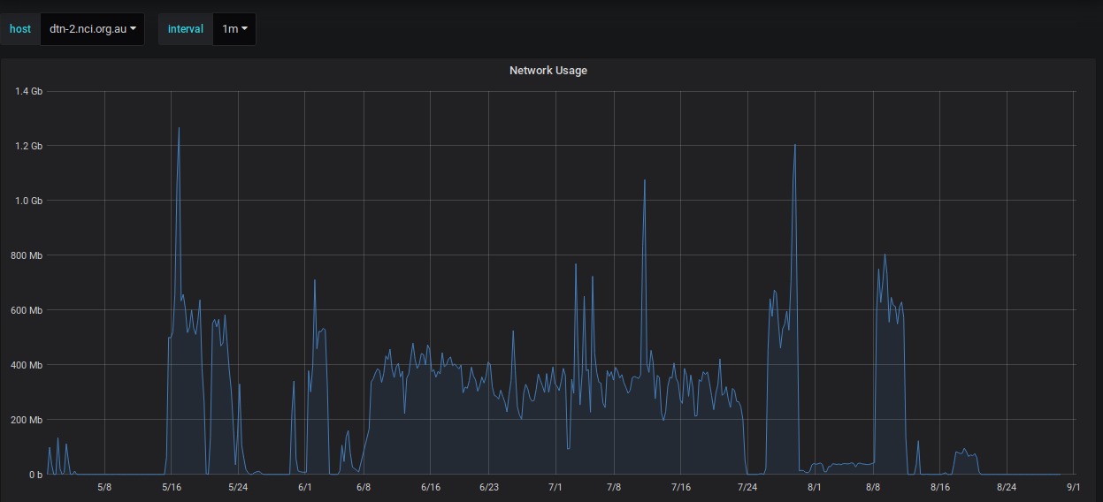
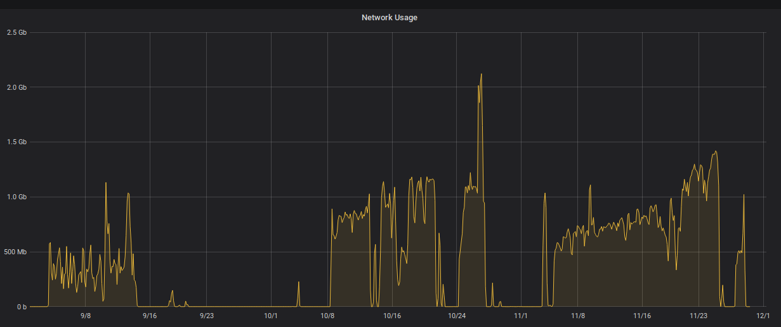
CMIP5/6 Data Transfer Speeds
The figures below are the network usage from May-Dec 2018. Note that we cannot distinguish CMIP5 from CMIP6.
Reasons for spikes and ‘flatlines’:
Unexpected issues while using Synda
Downloads stalled by slow throughput nodes
Daemon authentication timeouts
Node issues (e.g. the network and gridftp with LLNL)
Notes:
Point 1 was explained more in the CMIP5 replication ‘lessons learned’ (checksums etc, default directory path)
Point 2: A couple of the nodes (notably the ichec.ie - see next slide) showed consistently slow throughput and trying to maintain decent throughput was difficult - particularly as all slow downloads end up being the only ones left in the queue - so even with concurrent download streams the rate was still poor.
Point 3: There was a tendency for the synda daemon to periodically stop (and therefore downloads ceased) due to authentication timing out. We got around this by scheduling a check for the daemon running, and restarting if it had stopped. But it still led to some down time. This is mostly better now after Chris' rejigging of the various ESGF services.
Point 4: There were also network and gridftp related issues with LLNL (which is also our main download site - again see next slide), meaning downloading was inefficient (gridftp downloads would fail after some random period of time, then fail and attempt up to 3 retries, then failover to https). So mixed results from LLNL (although that all seems to be much improved now).

Slide 8
CMIP5/6 Data Transfer Speeds
Download rate comparison: synda metric numbers, which indicate the highest download rate for a single file from a particular node. (We typically do 16 concurrent transfers).
Data_Node Rate (MiB/s)
esgf.nccs.nasa.gov 21.6
esgdata.gfdl.noaa.gov 9.92
aims3.llnl.gov 7.92
esg1.umr-cnrm.fr 6.3
vesg.ipsl.upmc.fr 5.28
CMIP6 CMIP5
Data_Node Rate (MiB/s)
esgf-data.ucar.edu 27.03
esgf1.dkrz.de 15.67
aims3.llnl.gov 10.51
vesg.ipsl.upmc.fr 8.54
noresg.nird.sigma2.no 8.42
esgf-data1.ceda.ac.uk 8.19
esgf.nccs.nasa.gov 8.15
esg.cnrm-game-meteo.fr 7.46
dataserver.nccs.nasa.gov 6.62
esgf-data1.diasjp.net 6.53
esg1.umr-cnrm.fr 6.51
esgf2.dkrz.de 6.19
esgf-node.cmcc.it 4.02
esgdata.gfdl.noaa.gov 3.06
prodn.idris.fr 2.92
esgf.ichec.ie 0.73
Notes:
Can see now some of the problem nodes from our end (such as the ichec.ie) and also the large variation in the rates that lead to inconsistent download speeds and the many spikes we saw in the previous plots.
max rate

Slide 9
CMIP5/6 Data Transfer Speeds
A better download rate comparison is to run dedicated node-to-NCI tests. This is using globus-url-copy and synda with 16 threads. Overall see approximately 5 Tbytes/day == ~60MB/s
Download Rate Dedicated <Node>-to-NCI (MB/s)
Node | synda 16 threads | globus-url-copy
CEDA | 250 | 220
DKRZ | 96 | 320
IPSL | 50 | 29
LLNL | 110 | 92
NCI | 314 | 394
Notes:
The bottom row is a case where we downloaded data from ourselves.

Slide 10
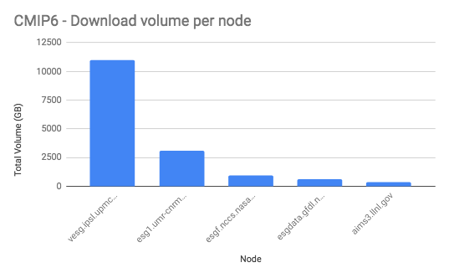
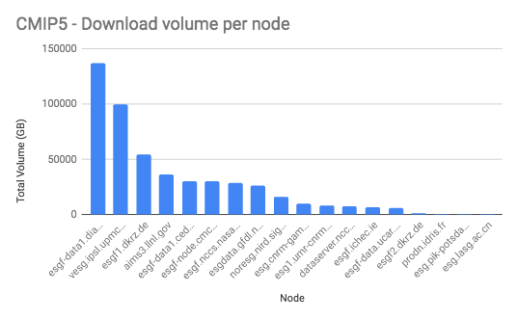
CMIP 2018 Total Downloads
Notes:
Here we can see where the majority of the data is coming from to NCI from the different international nodes.

Slide 11
NCI ESGF Production Node Deployment
The upgrade to the new NCI ESGF Node has been undertaken with a modified approach to ensure improved flexibility and management of upgrades.
GridFTP
DTN
Proxy
Publisher
TDS
Solr
CoG
IDP
File- system
Shared Storage
Notes:
Next slides are what we’ve done and will describe how this differs from a standard deployment.

Slide 12
NCI ESGF Production Node Deployment
Three components of the ESG Stack (TDS, Solr+CoG, IDP) are separate nodes at NCI
Easier to maintain and upgrade nodes separately
Each node has its own postgres database
Needed to create file exceptions in the setup to permit access between nodes
Proxy in front of each of the nodes to send requests
esgf.nci.org.au
GridFTP
DTN
Proxy
Proxy
Publisher
TDS
Solr
CoG
IDP
File- system
Shared Storage
Notes:
Notes:
The 3 components of the ESG stack are the:
IDP (this is the identity components, such as myproxy)
Solr,CoG = search index nodes
TDS = data nodes (but we’ve stopped gridftp being on that)
The key aim of having the separate nodes is to ensure everything is easier to maintain and upgrade. We can upgrade one thing at a time and not break everything! It keeps them more ‘containerised’
To allow the separation to work, each node has its own database (postgres) and NCI had to put in particular file exceptions during the installation to allow access between to databases (e.g. for the publisher to write to the TDS database, and CoG to IDP database.)
Due to the separation of the nodes, we need to have a proxy in front of the nodes to send requests and make it ‘appear’ as if it is the one node, esgf.nci.org.au. Underneath, everything gets sharded off.

Slide 13
NCI ESGF Production Node Deployment
NCI has deployed the GridFTP node outside the ESGF stack.
Has its own node.
Separate access paths
GridFTP serves out to cloud with NFS link to filesystem
DTN manages downloads with Lustre access to filesystem
GridFTP
DTN
Proxy
Publisher
TDS
GridFTP
Solr
CoG
IDP
File- system
Shared Storage
Notes:
Have taken GridFTP from the TDS node compared to the configuration of the original ESGF installer and put in in a separate node.
Separate access paths with gridftp serving out to the cloud with an NFS link to the filesystem, and a DTN for download with Lustre access to the filesystem.

Slide 14
NCI ESGF Production Node Deployment
The publisher node:
is installed in its own stand alone node
managed with anaconda
To permit node separation, publisher must write to a shared directory space.
GridFTP
DTN
Proxy
Publisher
TDS
Solr
CoG
IDP
File- system
Shared Storage
Notes:
To permit the separation of the publisher node, a shared storage/directory space needed to be created to permit the transfers between the publisher and the other nodes.

Slide 15
NCI ESGF Production Node Deployment
It’s all automated!
All the nodes are managed by puppet
Puppet invokes ESGF installer
configuration changes are completed after installer is complete
NCI does not run the installation manually
NCI has a forked version of the github esgf-installer to permit our changes
Puppet permits us to reproduce the machine if necessary
GridFTP
DTN
Proxy
Publisher
TDS
Solr
CoG
IDP
File- system
Shared Storage
Notes:
Puppet manages everything! Manages the installer and has a snapshot of what’s installed so can reproduce.

Slide 16
User Feedback for CMIP6 so far
#1 Concern of climate community: The availability, support and readiness of the tools
ESMValTool, PCMDI Metrics Package, Birdhouse
What’s the best support channel for Synda
#2 Concern: Timing of CMIP6 services
To be ready for users to interact with the CMIP6 data, the community needs time to develop tools that interact with these services (eg. ES-DOC).
In line with this, more clarity around some facets would be helpful, in particular r1i1p1fN where different groups have used different conventions.
Despite concerns the community is very positive about the vast improvements of ESGF for CMIP6 compared to CMIP5!

Slide 17
Future Focus
Publication of Australian CMIP6 Data
Automation of the re-publication procedure
ESGF Dashboard and accounting of usage stats
Providing a notification service for users when new data is available
Automation of Synda download as new data becomes available
Discussion Questions
Communication of the decision process/documentation of the ESGF software releases - what’s the best channel?
What is the plan with the proposed container release?
Plan with Globus?
There was an announcement that Globus will remove the current version of gridftp and stop myproxy and globus-url-copy, currently ESGF and Synda is reliant on these features.
What is the status/plan for Obs4MIPs, Ana4MIPs and CREATE-IP?
Notes:
Good exercise to to do the CMIP5 replication … we have learned a lot, staff are very familiar with how to manage and what to look out for with CMIP6.

