Slide 1
ESGF Installer Status Update
William Hill
ESGF IWT Team Lead
Lawrence Livermore National Laboratory
Sasha Ames, Nathan Carlson, Lina Muryanto
Lawrence Livermore National Laboratory
December 6, 2018
LLNL-PRES-XXXXXX
This work was performed under the auspices of the U.S. Department of Energy by Lawrence Livermore National Laboratory under contract DE-AC52-07NA27344. Lawrence Livermore National Security, LLC

Slide 2
Outline
Installation Working Team Accomplishments
ESGF 3.0 Development Metrics
Architecture Changes
ESGF 3.0 Distribution
Contributing Code to ESGF 3.0
Documentation
Future Work

Slide 3
2018 IWT Accomplishments
There were two minor versions of the ESGF 2.x line released this year, version 2.6 and version 2.7
Version 2.6 contained updates for CMIP6 readiness
ESGF 3.0 is a complete rewrite of the ESGF installation stack. A beta version is being released today
A continuous integration pipeline was created for integration testing in Jenkins and code linting in CircleCI

Slide 4
Major Challenges in Refactoring ESGF 2.x to 3.0
Poor code architecture
Fragmented codebase
“Clever” code
Very little error handling
No linting or automated testing
Lack of documentation
“If you are writing a script that is more than 100 lines long, you should probably be writing it in Python instead. Bear in mind that scripts grow. Rewrite your script in another language early to avoid a time-consuming rewrite at a later date.” – Google Shell Style Guide
Notes:
Examples:
Monolithic code structure; Code has inconsistent formatting; Liberal use of global variables; Really large functions
Some scripts in repo, some scripts on mirror; no namespacing when a script is sourced
Some hard to read code
Errors in Bash could fail silently if not explicitly handled. “set –e” not activated
No linting led to inconsistent code style;

Slide 5
ESGF 3.0 Current Status
The installer is currently in beta (tagged as v3.0b1)
Fresh installations of ESGF 3.0 are operational
The beta release includes a 2.x -> 3.0 migration script to upgrade an existing node

Slide 6
Metrics for ESGF 3.0 Development
ESGF Installer GitHub repo
3305 commits
224 closed issues
123 merged pull requests
Notes:
3.0 addresses several long standing problems such as a lack of error handling, lack of extensibility, and a complicated installation process

Slide 7
Architecture Changes
ESGF 3.0 has moved away from hosting installation scripts on distribution mirrors
All scripts for 3.0 are kept in the GitHub repository
Only larger files such as compiled jar files and truststore files are being fetched from the distribution mirrors
The large, monolithic structure of the 2.x installer was broken up into a modular structure

Slide 8
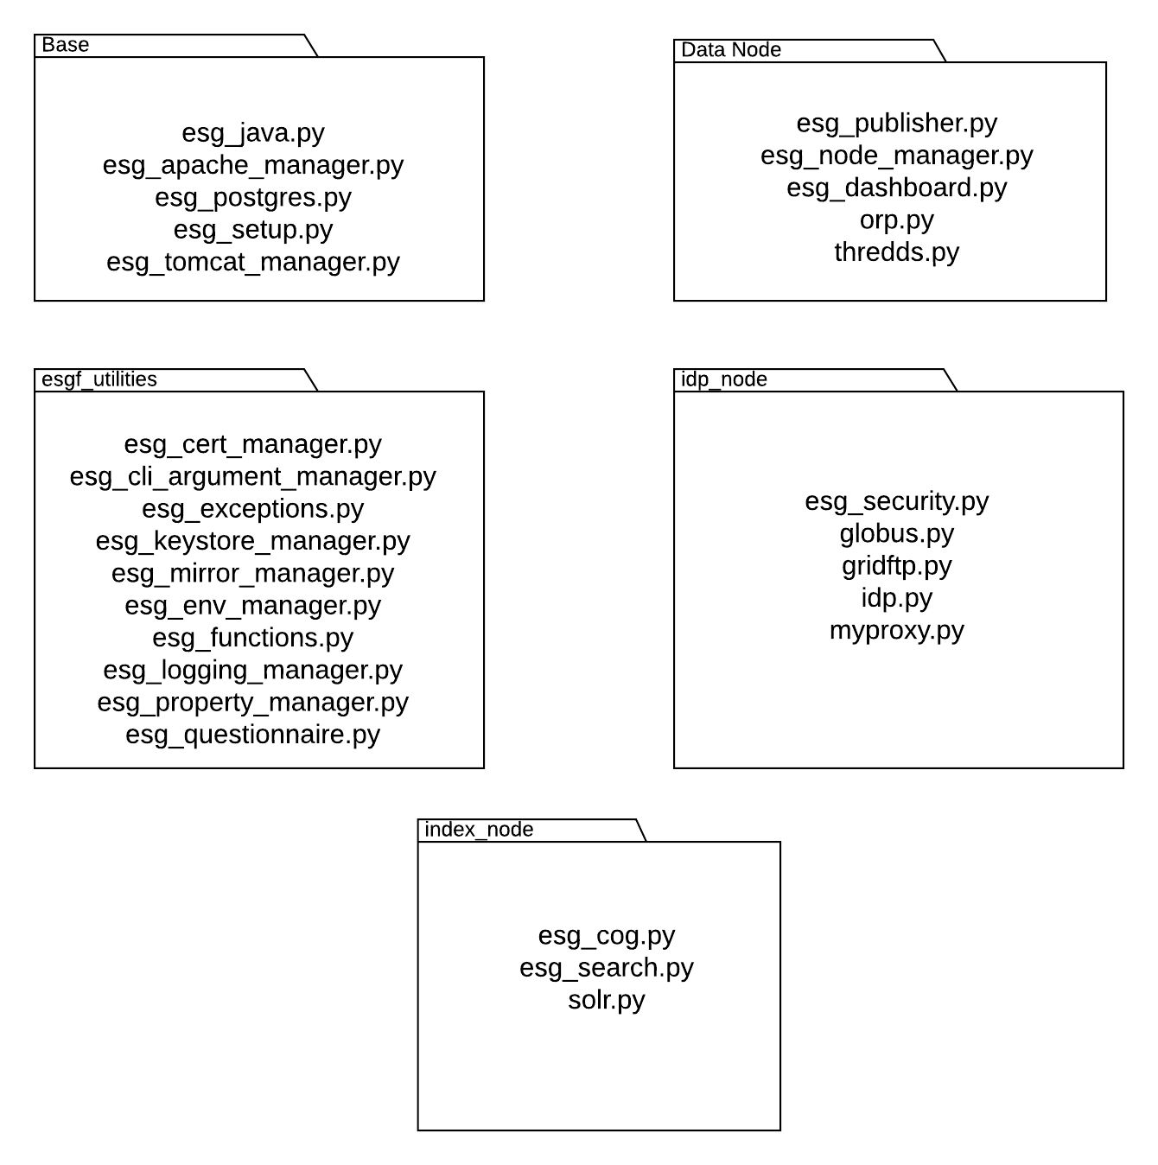
Architecture Changes

Slide 9
Architecture Changes
3.0 installations are installed in a Conda virtual environment
The Conda environment and all dependencies get installed during the bootstrap phase
The Conda environment must be activated to run the installer

Slide 10
Distribution
Users will now go to GitHub to obtain the ESGF Installer
This helps with version consistency and reduces the overhead of keeping mirrors in sync
Users can either clone the repository using Git or download the zip file from the ESGF-Installer repo
Other methods of distribution are part of future work

Slide 11
Contributing Code
We have adopted a more formal code review process for contributing to ESGF 3.0
No code should be pushed to the master branch directly
Instead, a pull request (and associated GitHub Issue) should be made that will ideally be reviewed and approved by two peers
Any time a new pull request is merged into the devel branch, a new tag will be cut
The bump in the tag will be determined according to the Semantic Versioning methodology
Notes:
Semantic Versioning link: https://semver.org/

Slide 12
Contributing Code
Notes:
Mention Lina’s poster

Slide 13
Documentation
Documentation with installation instructions, contribution guidelines, and API documentation is being hosted on GitHub Pages
http://esgf.github.io/esgf-installer/

Slide 14
Future Work
CentOS/Redhat 7 Compatibility
Moving to Python 3
Make ESGF installation package for pip and conda
Object oriented refactor
Concurrency for increased speed
Notes:
Point to Nathan’s poster

